Slide 1
Climate Sensitive Individual Tree Growth Models for the Sierra Nevada Ecoregion: FVS-WESSIN
Tim Robards
University of California, Berkeley
Cal. Dept. of forestry & fire protection,
Fire & resources assessment program

Slide 2
Collaborators
Prof. Greg Biging, UC Berkeley
Prof. John Battles, UC Berkeley
Prof. Kevin O’Hara, UC Berkeley
Dr. Martin Ritchie, USDA Forest Service, PSW
Mr. Guido Franco, Cal. Energy Commission
Dr. Adrian Das, USGS
Dr. William Stewart, UC Berkeley Extension

Slide 3
Presentation Outline
Objectives
Model Structure
Data
Modeling
Results
Implementation in FVS
Evaluation
Projections

Slide 4
Objectives
Climate-sensitive forest growth simulator
  Accurate projections for adaptation and mitigation research
  Use best available data
  Six species: PP, SP, IC, DF, WF, RF
Component of bi-annual climate change report
  Evaluate climate change impacts to forest productivity
  Mortality
FVS modified variant
  Use available add-ons (FFE, pests)
  Take advantage of work already done (volume, imputation)
  Work with LMS or FVS carbon add-on for carbon projects

Slide 5
General Model Structure

Slide 6
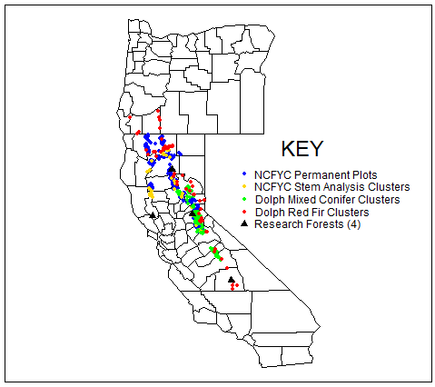
Data
Fit data
Climate data
  PRISM
  Monthly
  4x4 km grid
Evaluation data

Slide 7
Modeling
Linear mixed effects model
  Random: temporal, spatial
  Fixed: everything else
R statistical software
  LME4 library (Bates 2007)
  GRID Graphics
  Equivalence library (Robinson 2007)
  Bakuzis matrix library (modified from Johnson (2007))
Criteria
  AIC
  Parameter significance (topography exception)
  Residuals

Slide 8
Results: Common Variables
DBH
THT
CR
PBAL Index
Latitude

Slide 9
Results: Climate & Topography
Climate
Topography
Winter Precip (10/12)
Winter Temp (10/12)
Full specification (11/12)
WF height (ELEV)
Many seasonal variables

Slide 10
Climate Variables
Only red fir growth entirely negative to temperature increases
More precipitation => more growth
Degree-day variables generally better than straight temperature
Height Growth

Slide 11
Topography
PP Ht
growth
Stage and Salas (2007) formulation highly adaptable
Requires wide range of data
Requires high tolerance for insignificant parameter estimates
DF Diam.
growth

Slide 12
Implementation in FVS
Source Code from USDA Forest Service, Forest Management Service Center, Ft Collins, CO
Lahey-Fujitsu Express ver. 7.1 Fortran Compiler
Additional input file for climate data
Annual time steps, maximum of 80
Height and diameter growth models for 6 species
No changes to outputs
YEAR PRE_W PRE_P PRE_S PRE_WP PRE_PS MAXT5D MAXT5D_W MAXT5D_P MAXT5D_S MINT5D_W
1 10600 5739 7640 16339 6503 365 151 92 122 31
2 12189 2801 11030 14990 3904 365 151 92 122
3 12138 1363 4730 13500 1835 365 151 92 122
4 8022 3801 0470 11823 3848 365 151 92 122 31
5 13785 2507 9070 16291 3413 365 151 92 122 31
6 8199 5864 2960 14063 6160 365 151 92 122 31
7 10522 3045 2710 13567 3316 365 151 92 122 31
8 4300 2692 2140 6992 2906 365 151 92 122
9 11346 4333 8900 15679 5223 365 151 92 122 31

Slide 13
Evaluation
Model behavior evaluated using modified and reduced Bakuzis Matrix
  Forest Types: PP, MC, DF, WF, RF
  10 x 10 spacing to 20 years in Conifers (Ritchie 2008)
  PCT and no PCT
  Flat ground, NE and SW aspects (30% slope)
Equivalence test using regression method
(Robinson 2007)
  559 diameter, 167 height measurements
  ± 25%
  Reject null hypothesis that model and data different

Slide 14
Douglas-fir, Flat Ground, No PCT

Slide 15
Douglas-fir, SW Aspect, No PCT

Slide 16
Projections
100-year projections
  Downscaled climate (Scripps Institute, UCSD)
    A2: CO2 850ppm max; self-reliance; population increases
    B1: CO2 550 ppm max; global solutions; population plateaus
    4 GCMs
  Elevation transect (Tahoe National Forest)
  Other models in common area (Shasta County)
Climate sequestration project
  LaTour State Forest (Southern Cascades) Westcarb Project
Statewide Assessment?

Slide 17
Douglas-fir Stand, TNF, A2

Slide 18
Douglas-fir Stand, TNF, B1

Slide 19
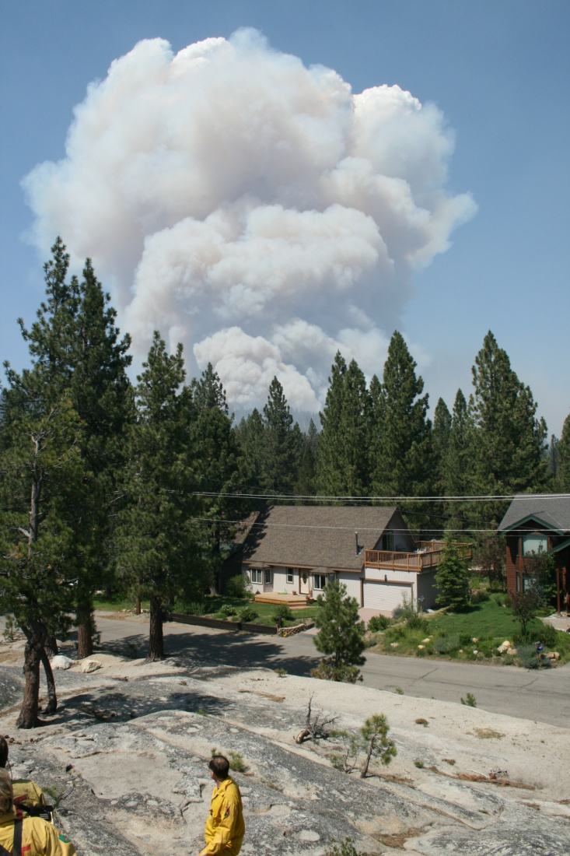
Questions/Comments
Tim Robards
tim.robards@fire.ca.gov
916.445.5342

