Slide 1

Climate-FVS
Version 0.1
USING the forest vegetation simulator to model stand dynamics under the assumption of changing climate
Developed by :
Nicholas L. Crookston, USDA-FS, RMRS, Moscow, ID
Gary E. Dixon, (Retired) USDA-FS, FMSC, Fort Collins, CO
Gerald E. Rehfeldt, (Retired) USDA-FS, RMRS, Moscow, ID
Notes:
The Forest Vegetation Simulator (Crookston and Dixon 2005, Dixon 2009) is designed to simulate stand dynamics for a few centuries. Like most models of its class, the model assumes that climate does not change, notably by assuming that site quality is constant over time. Undisputedly, this assumption is not tenable in a changing climate.
Climate-FVS, Version 0.1, is the first release of a new extension to FVS that relaxes this long-standing assumption. Ideas for the development of this system have been presented in previous symposiums (Crookston et al. 2007; Crookston et al. 2008), considered in two workshops (ESSA Technologies Ltd. 2007, 2008). Climate-FVS is an extension to the base FVS model that adjusts model performance based on input of climatic variables and species climate profiles.
Note that Climate-FVS version 0.1 is available for all FVS variants in the western United States (excluding Alaska).

Slide 2
Presentation Road Map
Background on Base FVS
Background on Climate Models
Climate-FVS Architecture
Climate-FVS “How to”

Slide 3
Description of FVS
FVS is a distance-independent, individual-tree forest growth model widely used in the United States to support forest management decision-making
Individual stands are the basic projection unit and projections are dependent on interactions among trees within stands, as well as site and stand conditions.
FVS allows users to compare management scenarios, to meet landowner objectives.
Extensions to FVS model the impact of disturbance-causing agents (fire, insects, and disease)

Slide 4
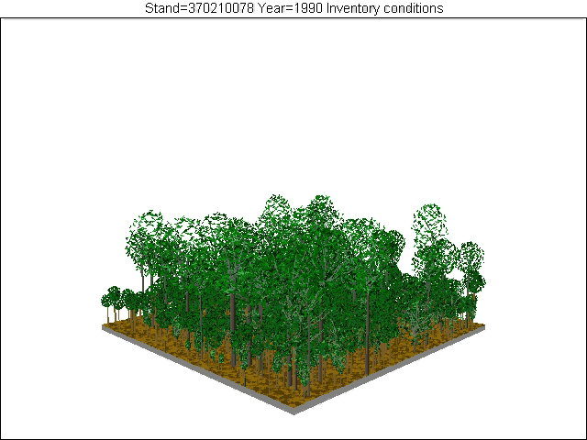
Applications example of FVS
Applications range from development of silvicultural prescription for single stands to landscape and large regional assessments
No Action Shelterwood
Notes:
Since the birth of Prognosis the precursor to FVS, its purpose was to create a tool for forest manager to compare management alternatives. One of my favorite quotes is
“All models are wrong, but some are useful” by a well known statistician and modeler Prof. George E.P. Box. I think it highlights what we strive for in a model, one that is useful---or informs the user--- and a model that minimizes as much as possible the error associated with the answer.

Slide 5
Variants of FVS
The component models differ depending on the geographic region represented by regionally specific model variants
Coefficients are estimated using available data from the variant’s geographic region
Each variant is a self-contained program executable written in FORTRAN (FORmula TRANslation)
Under development

Slide 6
FVS Basic Operation
FVS needs a keyword file to run
Keywords are mnemonic words with associated data that provide information to FVS
Keywords are used to
  enter stand and tree information
  describe management treatments
  control the printing of output
  adjust model estimates
Suppose prepares the keyword file for you and executes the FVS variant of choice

Slide 7
Processing Sequence
Initialize
Stand
Simulation
Prior to Projection
Performs
Cutting Activities
Individual Tree
Growth
(DBH & HT)
Mortality
Insect and Pathogen
Adjustments
Fire and Fuels
Adjustments
Growth Cycle
Report Projected
Conditions
Crown Change
Regeneration
3
2
1
End Stand
Simulation

Slide 8
General Circulation Models
Canadian Center of Climate Modeling and Analysis
    CGCM3-A2
    CGCM3-B1
    CGCM3-A1B
Met Office Hadley Centre –UK (HADMC3)
    HADMC3-A2
    HADMC3-B2
Geophysical Fluid Dynamics Laboratory -Princeton University, NOAA Research (GFDLCM21)
    GFDLCM21-A2
    GFDLCM21-B1
Notes:
Now that you have a brief background on FVS, I’m going to give you some basic background on Climate Models or
General Circulation models, which are just numerical models (General Circulation Models or GCMs), representing physical processes in the atmosphere, ocean, cryosphere for simulating the response of the global climate system to increasing greenhouse gas concentrations .
There are a number of GCM models available, FVS has included a total of 3 circulation models, using 2 to 3 emissions scenarios for each GCM. In the next slide I’ll explain what the emissions scenarios mean.
Cryosphere Definitions: describes the portions of the Earth’s surface where water is in solid form, including sea ice, lake ice, river ice, snow cover, glaciers, ice caps and ice sheets, and frozen ground.

Slide 9
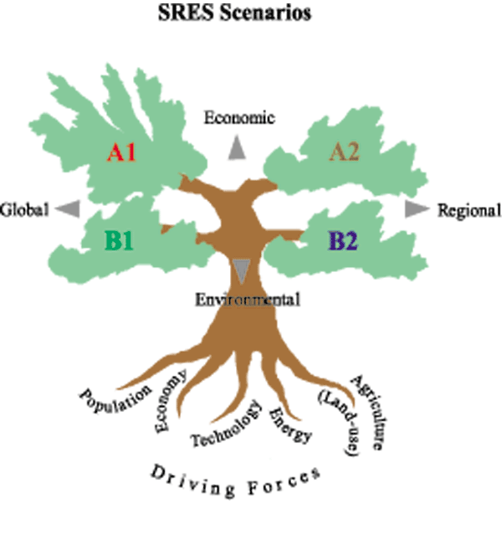
Emission Scenarios
Notes:
There are 4 main Emissions scenarios which describe developments in many different social, economic, technological, environmental and policy dimensions. The titles of the storylines have been kept simple: A1, A2, B1 and B2.
A’s Driven by Economic processes
B’s Driven by Environmental (sustainability)
1’s global growth- globalization
2’s regional growth- preservation of local identities/cultural
More Detailed Description:
The A1 storyline and scenario family describes a future world of very rapid economic growth, low population growth, and the rapid introduction of new and more efficient technologies.
The A2 storyline and scenario family describes a very heterogeneous world. The underlying theme is self-reliance and preservation of local identities. Fertility patterns across regions converge very slowly, which results in high population growth. Economic development is primarily regionally oriented and per capita economic growth and technological change are more fragmented and slower than in other storylines.
The B1 storyline and scenario family describes a convergent world with the same low population growth as in the A1 storyline, but with rapid changes in economic structures toward a service and information economy, with reductions in material intensity, and the introduction of clean and resource-efficient technologies. The emphasis is on global solutions to economic, social, and environmental sustainability, including improved equity, but without additional climate initiatives.
The B2 storyline and scenario family describes a world in which the emphasis is on local solutions to economic, social, and environmental sustainability. It is a world with moderate population growth, intermediate levels of economic development, and less rapid and more diverse technological change than in the B1 and A1 storylines. While the scenario is also oriented toward environmental protection and social equity, it focuses on local and regional levels.

Slide 10
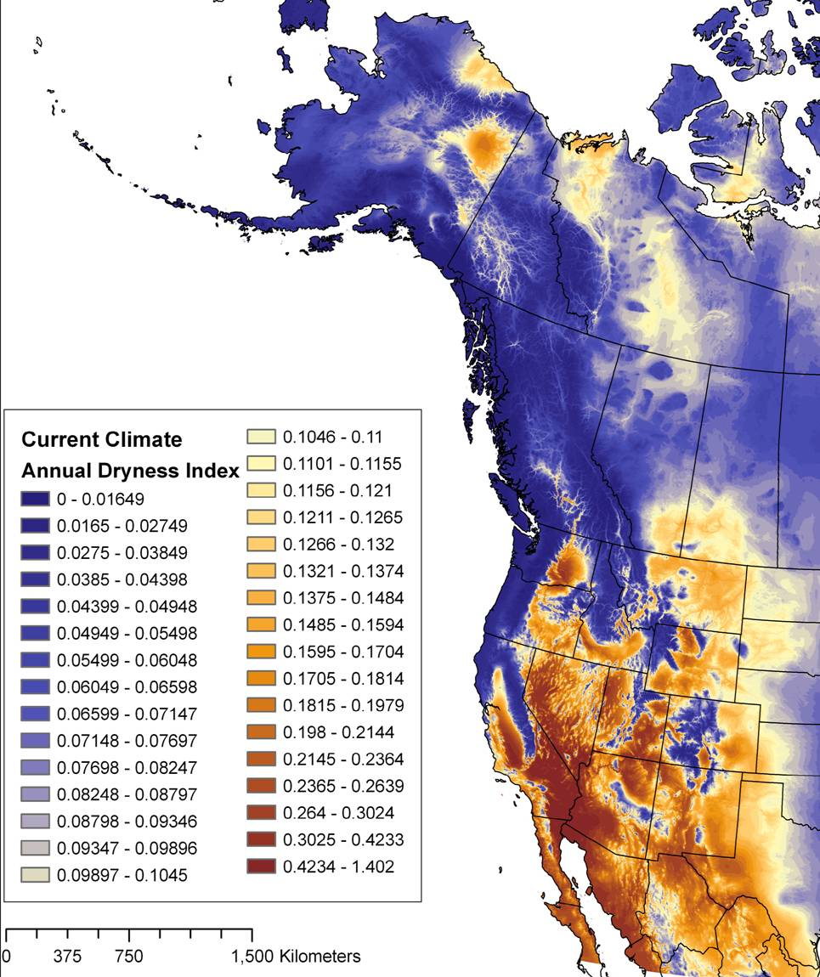
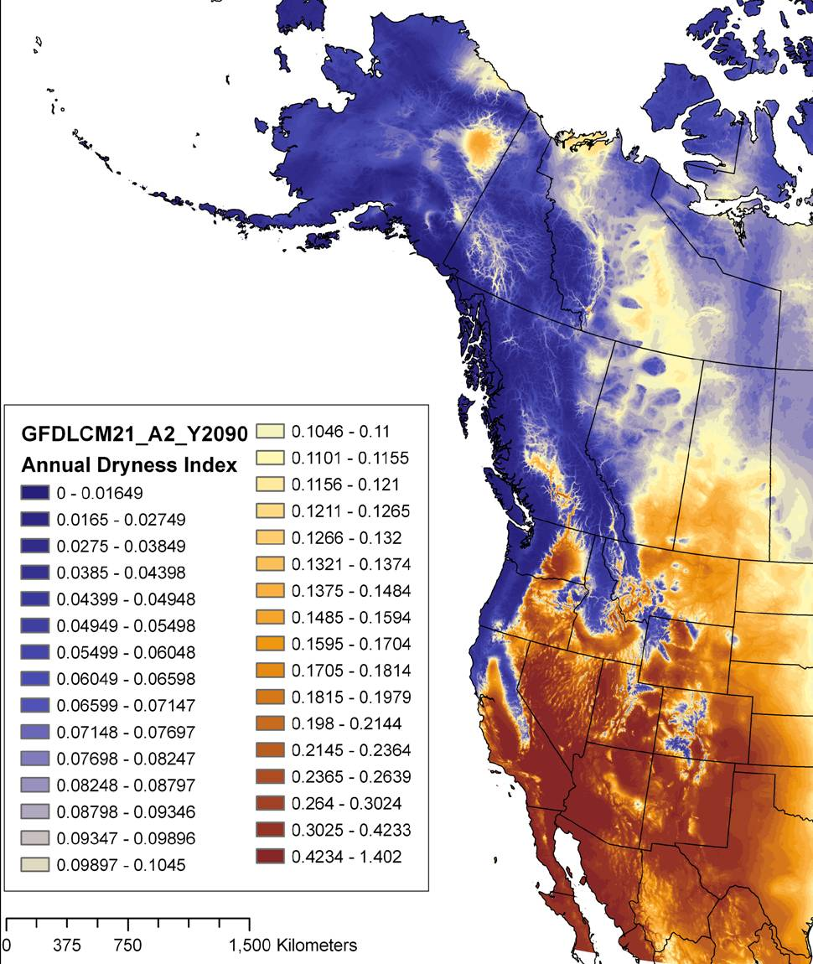
Example of predicted changes in climate
Notes:
This is an example Based on the Geophysical Fluid Dynamics Laboratory –A2 Model (GFDLCM21), prediction of the Annual Dryness Index change in 90 years.

Slide 11
Example of Viability Scores
Viability Scores* Location on Gifford Pinchot NF
CODES: | PSME | TSHE | PIPO
1990 | 0.973 | 0.96 | 0.376
2030 | 0.96 | 0.656 | 0.29
2060 | 0.857 | 0.236 | 0.546
2090 | 0.877 | 0.131 | 0.596
* Lat: 46.67, Long: 121.54, Elev: 2583, based on Hadley A2 Scenario
Notes:
Work has been done by Rehfelt et al 2006, to look at the viability of tree species in the west based on these predictions of changing climate. Here we have the viability scores using the Hadley A2 Scenario over the next 100 year to predict species likelihood of occurrence.
For this site on the GPNF, the viability of Douglas-fir slightly decreases, Western Hemlock’s viability sharply decreases and the viability of Ponderosa pine slightly increases.
The idea is that if climate changes at this site such that the site’s climate is different than the climate recorded where the species exists today, then it will be difficult for a tree such as Western Hemlock to survive, grow or reproduce at this site in the future. On the other hand the site historically and presently does not have the right growing conditions for Ponderosa pine, however over time the site conditions will change to site conditions that have historically supported Ponderosa pine, so future predictions are that Ponderosa pine’s ability to thrive at this site in the future will increase.

Slide 12
Douglas-fir climate profile
Douglas-fir
climate profile
location change
(current to 2060)
new
recede
stays
Notes:
This is the pictorial description of species viability and how changing climate will impact whether a species will be able to continue to grow and regenerate where it is presently found.
The orange represents sites in which Douglas-fir presently grows but under the future predicted climate will no longer be able to.
The bright green are areas that Douglas-fir presently does not occupy, but under future predicted climate will be able to grow.

Slide 13
Climate-FVS: Architecture
Base FVS assumes site is constant over time, this assumption is not tenable under changing climate.
The current structure of FVS to apply management has not changed
Climate-FVS does NOT contain a climate model, it uses species viability scores.
The species viability scores are for 75 western U.S. species predicted from seven future climate scenarios (presently based on Rehfeldt et al, but user could use any source of scores)
Viability scores are used to compute mortality rates and modify FVS-predicted growth rates.
Notes:
Up to this point in time, FVS has always assumed that site is a constant, however under the assumptions of changing climate this will not work.
So we have changed that major assumption, however we have not changed the current structure in terms of how the user interfaces with the model, the user’s ability to apply management, or modify the model.
One thing to understand is that Climate-FVS does not contain a climate model, it just uses species viability scores and predictions of future climate to effect tree growth. The viability scores are for 75 western species and are based on Rehfelt’s work and are pulled into the model via an external text file. So if a user desired they could use any source of scores they do not necessarily have to use Rehfeldt and Nick’s research on species viability. Nick felt it important to allow the user the freedom to use any researcher’s work on climate’s impact on tree species with in FVS.

Slide 14
Changes to the model under Climate-FVS
Carrying capacity may change
Additional species specific mortality
Species Establishment changes
Growth is impacted
  by genetics
  by site quality changes
Notes:
Four main components have been altered in the model and I will go into detail about each of them.

Slide 15
Site Carrying Capacity
Changes maximum density as a function of climate.
Presently FVS uses Maximum SDI or BA as a measure of carrying capacity and uses it to compute density related mortality.
These maximum densities are typically species based and the maximum for the stand varies based on the basal area-weighted average maximum
Climate-FVS computes a proportional change in carry capacity, where the viability scores are used instead of basal area-weighted to compute maximum density.
Notes:
So in many variants, if you had a stand that half the stand’s BA was DF and the other half was WH, then the MAXSDI would probably be about 725, because the MAXSDI of DF is 600 and MAXSDI of WH is about 850, so weighted it comes out to be 725 for the stand. However under climate-FVS we no longer use the basal area weighted maximum SDI instead we use the viability score to weight the stand carrying capacity.

Slide 16
Additional Species Specific Mortality
Additional species specific mortality is applied to all species with a viability score below 0.50.
As the viability score decreases, the mortality rate increases.
The mortality rate is proportional to the viability score.
Notes:
So the idea is that if climate changes at a site such that the site’s climate is different than the climate recorded where the species exists today, then tree of that species will die over time.

Slide 17
Species Establishment
Climate-FVS will establish 500 seedling/acre when stand density falls below a stocking threshold
The four most viable species will be regenerated
The number of trees of each species will be apportioned based on the relative viability scores
The consequence is that more trees of the most viable species will be regenerated
If no species are viable, none are regenerated.
Notes:
The 3rd model change is species establishment….it is simplistic model, however give the users the ability to easily modify the amount of seedlings and stocking thresholds. It will essentially regenerate the 4 most viable species based on the stocking threshold. And the amount it adds of each species will be apportioned based on the relative viability scores.
This automatic establishment works in variants that do not have the full establishment model.
This option can be turned off.
Both the seedling amount and threshold can be changed.
The assumption is that trees presently not on the site can migrate to the site, so there is some assumption of assisted migration.

Slide 18
Growth
Site quality
  If the stand site quality changes due to climatic change, growth will be affected.
  The Annual Dryness Index (ADI) is used as an indicator of site quality change. As ADI increases or decreases compared to contemporary, it proportionally affects Site Quality.
Tree genetics
  Trees growing on sites they are adapted for grow faster than those growing on site they are maladapted for.
  Transfer distances, seed zones
Notes:
Presently, Nick is in the process of examining this process and making some revisions, but at this time this is how it is implemented in the model.
Site Quality: The idea here is that changing climate will effect site quality, in most of our models site quality plays a part in both diameter and height growth, in the form of site index or habitat type. The model uses ADI as an indicator of site quality changes. The use of ADI in this context is supported by the experience of using this variable that indicates that it is a key driver of plant response to climate change by both Rehfeldt, 2006, 2008 and Monserud 2008 in lodgepole in Canada.
Tree Genetics: The idea is that trees growing on sites they are adapted for are going to grow faster than trees growing on sites they are maladapted for, and we are using common garden expirements to help inform us of whether a tree is adapted for the new climate.

Slide 19
Growth modified based on Seed Transfer Distance
Leites , L. (preliminary work, Univ. of Idaho)
Notes:
Here is an example of transfer distances, seed transfer distance, based on Laura Leites work from the University of Idaho, re-anializing common garden experiments.
The brown lines is an example of a seedling that genetically can thrive in much colder climate then the blue line. You can see the seed source from the brown line has maximum growth at just below 0 degrees MAT, but growth quickly decreases above 0 degrees. On the other hand the blue line does not show nearly as much growth , however it can thrive at a higher MAT then the Brown line.
The change in relative growth is used to adjust the growth in FVS.
We have preliminary models for Larch and Douglas-fir, they are used for all species based on a ranking of genetic specialization. Nick’s hope is that as more of this data is re-analized we can incorporate more of into the model.

Slide 20
How To Run Climate-FVS
Obtain climate executable from FMSC
Additional input file needed that contains viability scores
One additional keyword is mandatory (CLIMDATA), that specifies the location of the viability scores files, and specifies the GCM scenario to be used.
Four other option keywords can me used to change the assumptions on climate change impacts on growth, mortality, and regeneration.
Notes:
Give me or someone on the staff a call and we can get you a climate executable.
You’ll need to go out to Nick’s web site and submit a text file with the elevation , lat and long for each site, so you can obtain a FVS input viability file.
You’ll need to include the CLIMDATA keyword, which just give the location of the viability file.
There are 4 other keywords you can use to change the assumption of climate change effects on growth, mortality and establishment.

Slide 21
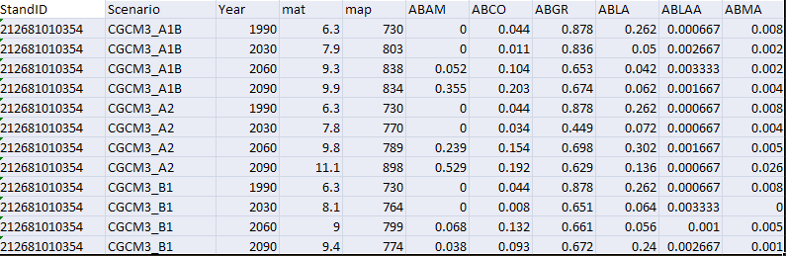
Example of additional input file needed
Filename: FVSClimAttrs.csv
A source of the climate and species viability data file is at this web address: http://forest.moscowfsl.wsu.edu/climate/customData/fvs_data.php.
Notes:
This is an example of the input file FVS reads. It contains the stand name, and the climate attributes over time for each GCM scenario, along with the viability scores by species. On the web site, instructions are present. But basically you submit to the site a text file with the stand identifier, longitude, latitude and elevation. With in 24 hours typically you receive through email a package of data including the necessary comma delimited file that fvs needs (typically named FVSClimAttrs.csv). The data is based on Nick Crookston’s work along with Jerry Rehfeld’s and others. If a user preferred to use another researchers work that predicted species viability, all a user would have to do was format a file in the same way.

Slide 22
Four Optional Keywords
AutoEstb: Signal that Climate-FVS automatic establishment logic is turned on and that the base FVS automatic establishment features are turned off.
GrowMult :Specify a species-specific adjustment of the growth-rate multiplier computed by Climate-FVS.
MortMult :Specify a species-specific mortality multiplier.
MxDenMlt: Specify an adjustment of the maximum density multiplier computed by Climate-FVS.
Notes:
With each one of these features you can turn the keyword off, so that FVS-Climate doesn’t effect that specific part of the model. This is useful if you want to be able to zero in on what climatic variables are effecting what parts of the model.

Slide 23
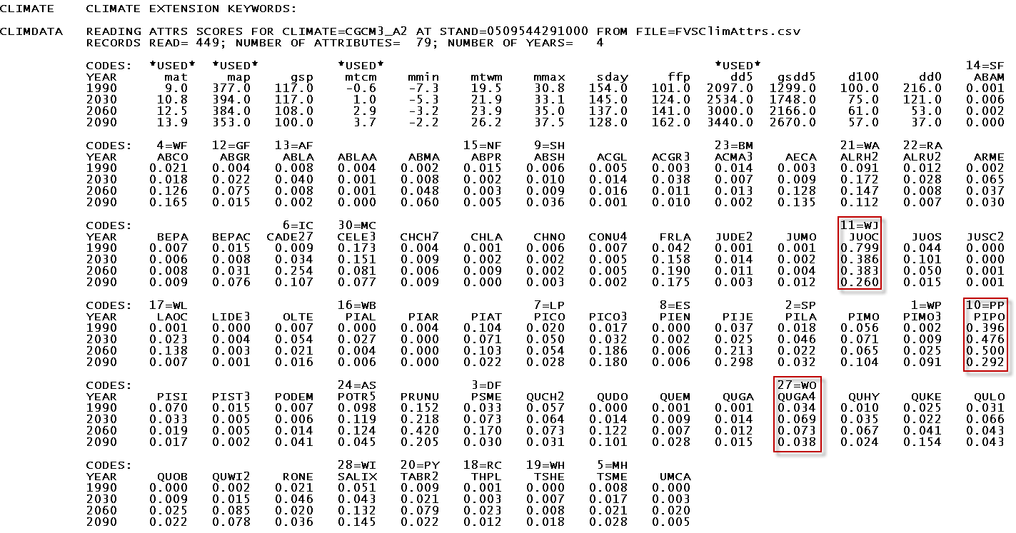
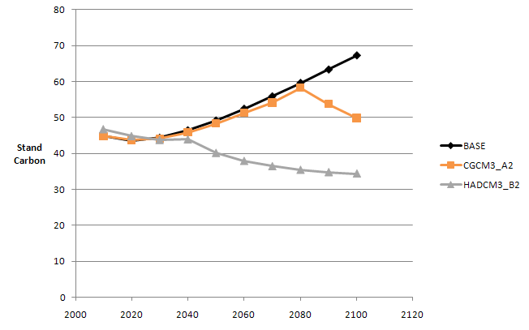
Climate-FVS Reports
Main Output File – Options Selected by input
  lists viability scores by species
Climate Reports
  none yet developed
  see effects in standard output reports

Slide 24
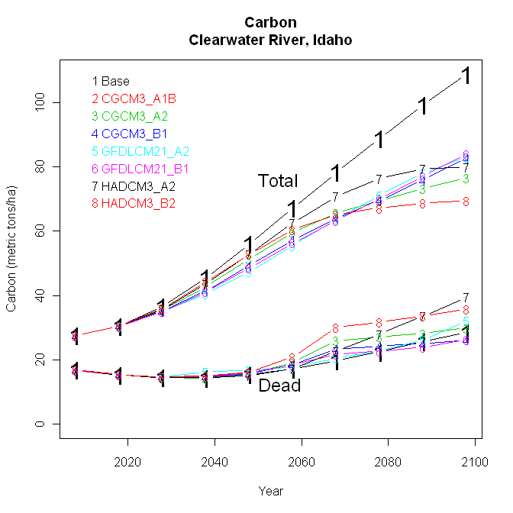
Compare Climate Scenarios
Notes:
The original intent of FVS and the growth and yield models that it was based and developed from (such as Prognosis), was to create a tool for forest managers to be able to compare management scenarios with the understanding that the predictions had some error associated with them. The purpose of Climate-FVS is the same. It is a model to help forest managers and practitioners compare management scenarios under the assumptions of changing climate. The following slides are examples of comparisons of no management under the seven climate change models. This particular slide shows total metric tons of live and dead carbon per hectare based on the 7 climate change scenarios. In all these scenarios the black line is base FVS under the no climate change assumption.

Slide 25
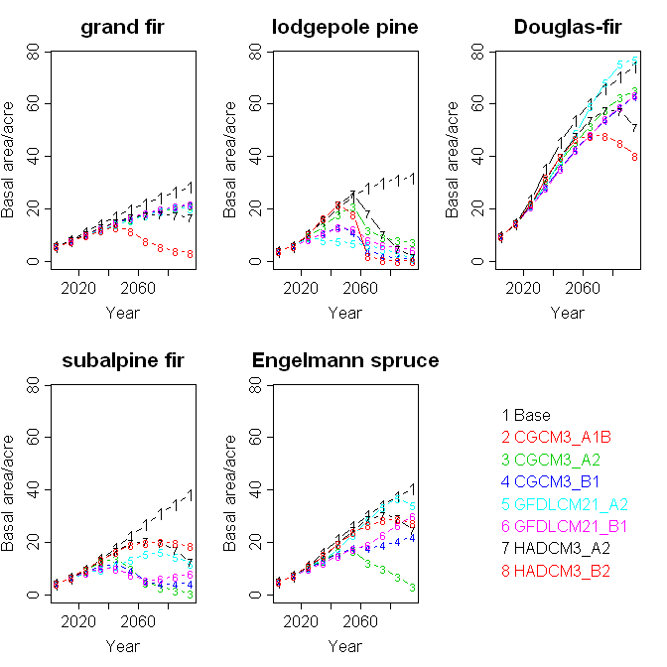
Compare Species by Climate Scenarios
Notes:
These graphs are also for the same site on the Clearwater NF, but looks at the change in Basal Area for 5 different species.
For example you can see that under most of the scenarios Grand fir and Douglas-fir basal area is slightly reduce for most of the GCM scenarios, but under the Hadley B2 scenario both of these species have a drastic reduction in basal area.
You can also see from the graphs that all of the GCM scenarios show a large reduction of Lodgepole pine basal area, in other words, the scenarios agree that Lodgepole pines’s ability to grow, survive and reproduce at this site in the future is unlikely. In other words this site in the future under climate change will be different than sites regionally that we presently find lodgepole.

Slide 26
Compare Scenarios
BASE
GCM Scenario
Notes:
Climate-FVS is still in the testing phase
However, its intent is the same as base FVS, a model that allows the user to compare management scenarios..
Although in this example we see that Douglas Fir still remains the dominant species, we can see that Western Hemlock and Western Red cedar are predicted to no longer be viable species on these site, and instead we see the introduction of White Pine, Grand Fir.
This could be used by managers when they begin to think about what species they want to be plant, and that planting a variety of species, rather than one leaves your options open under the assumption of climate change

Slide 27

Climate-FVS
Questions?
Nicholas L. Crookston
USDA- Forest Service
Rocky Mountain Research Station,
Moscow, Idaho
ncrookston@fs.fed.us
Forest Management Service Center
USDA- Forest Service
Fort Collins, CO
wo_ftcol_fvs@fs.fed.us
Notes:
The test version of the model is available. If you would like to look into you can contact the Forest Management Service Center. The only thing we ask is that any comments or feedback are given to Nick so he can incorporate peoples suggestions and concerns at this early stage of model development.

