Slide 1
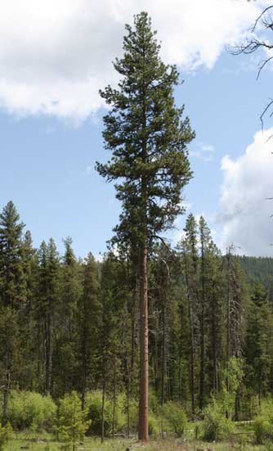
A relative approach to stand table construction
Zane Haxton
Forest Engineering, Resources & Mgmt.
Oregon State University
GMUG Meeting
Vancouver, WA
June 2, 2010

Slide 2
Table of contents
Introduction
Applications
Sampling theory
Case study

Slide 3
Introduction
Stand table – shows abundance of trees across diameter classes in tabular form.
AKA “stock table” when volume/ac is variable of interest.
Used by silviculturists to characterize the allocation of growing space across diameter classes.
Diam. class | Trees/ac | BA/ac
2.5 | 26 | 0.9
7.5 | 67 | 20.6
12.5 | 87 | 74.5
17.5 | 61 | 101.7
22.5 | 12 | 34.5
27.5 | 6 | 25.8
32.5 | - | -
37.5 | - | -
Total | 260 | 258

Slide 4
“All stocking procedures are essentially tools for allocating growing space” (O’Hara 2005).
E.g. planting density, D + x or D * x thinning rules.
O’Hara (1996) designed an approach for quantifying stand structure that defined available growing space in terms of leaf area index (LAI).
But… why not describe growing space in terms of space itself?

Slide 5
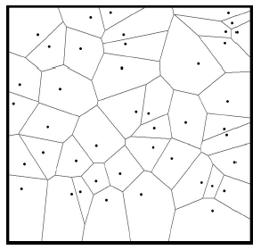
Area potentially available
Voronoi polygons: A single-tree approach for defining potential available growing space.
Has been used to quantify the degree of competition experienced by individual trees (Husch et al. 2003, p187).
Source: Kleinn and Vilcko 2006

Slide 6
This is what at “APA table” would look like…
DBH class(in) | APA (%)
2.5 | 3
7.5 | 11
12.5 | 15
17.5 | 43
22.5 | 12
27.5 | 6
32.5 | 5
37.5 | 5
Total | 100
Anyone interested in this sort of thing?

Slide 7
Applications
Silviculture
Forest ecology

Slide 8
Silviculture
Not very interesting for even-aged plantation management.
May be more useful for uneven-aged management.
  Describe stands and aid management plans.
  Determine whether D * x or D + x rules are successfully implemented.
  Model and examine effects of “variable density groupy, clumpy, gappy” type thinning treatments.
  Downside: may be difficult to integrate into marking guides (J. Bailey, pers. comm. 5/7/2010).

Slide 9
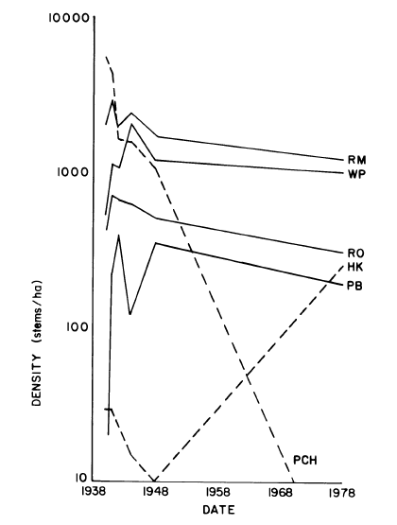
Forest ecology
Studies of succession tend to describe species abundance in terms of density or basal area.
Why not describe changes in APA by species?
Could quantify changing structure in ponderosa pine forests following fire suppression.
Downside: implicitly assumes that between-tree competition is primary driver of forest structure.
Source: Hibbs 1983

Slide 10
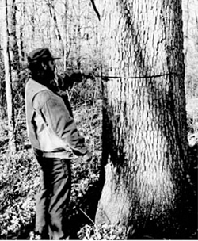
Sampling considerations
Source: http://pubs.ext.vt.edu/420/420-085/420-085.html

Slide 11
Selecting the “nearest tree”
Problematic for estimating density or basal area (Iles 2009).
Inclusion probability of tree i:
where a_{i} = APA to tree i
A = total area of tract
n = number of sample points
Horvitz-Thompson estimators:
Ugly to compute!
Source: Kleinn and Vilcko 2006

Slide 12
But when we are specifically interested in the APA…
The question is not, “how big is the inclusion zone?”,
but rather, “are we in the inclusion zone or not?”
“Bitterlich found a way to tell when he was inside an invisible circle that was a multiple of the stem area without distance measurements or calculations, by simply using an angle to view the tree” (Iles 2009).

Slide 13
Selecting the “nearest tree”
Trees are selected in proportion to the area potentially available to them.
Each tree sampled represents the same proportion of the tract.
If n sample points are located on a tract, the nearest tree to each sample point will represent
of the tract area.
Source: Kleinn and Vilcko 2006

Slide 14
Some math…
where p_{i} = inclusion probability of tree i
a_{i} = area potentially available to tree i
A = total area of tract
n = number of sample points installed in the tract
Horvitz-Thompson estimator for the proportion of land area potentially available to tree i:

Slide 15
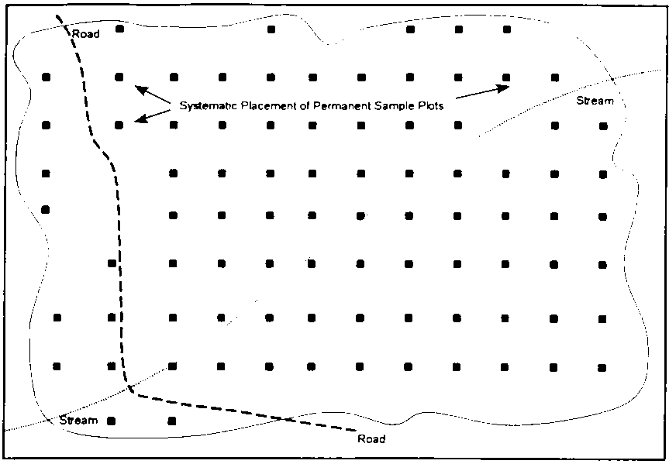
A simple example
Locate sample points on a 1-ac grid across a 60-ac tract.
Each sample point represents 1 ac = 1/60th of tract.
The nearest tree to each sample point represents 1/60th of the land base.
Source: http://www.fao.org/docrep/w8212e/w8212e0q.gif

Slide 16
Stand-level compilation
For trees i = 1, …, n, the area potentially available to trees in the j^{th} size class can be computed as:
where y_{i} is 1 if tree i is in the j^{th} size class, and 0 otherwise.
Proportions of area available to other categories of trees (e.g. species) can be computed similarly. The proportion can be presented as a percentage if desired.

Slide 17
Edge correction
Two potential problem situations:
A tree that is nearest to the sample point, and is inside the stand, has its inclusion zone cut off by the stand boundary.
A tree that is nearest to the sample point is outside the stand.

Slide 18
Solution – problem #1
Define APA as area potentially available to a tree within the stand.

Slide 19
Solution – problem #1
The attribute of interest will be reduced in proportion to the probability of selection, and the terms will still cancel out.

Slide 20
Solution – problem #2
Allow sampling of all trees that potentially occupy space within the stand, even if they are located outside of it.

Slide 21
Solution – problem #2
Same as before: the attribute of interest will be reduced in proportion to the probability of selection, and the terms will still cancel out.

Slide 22
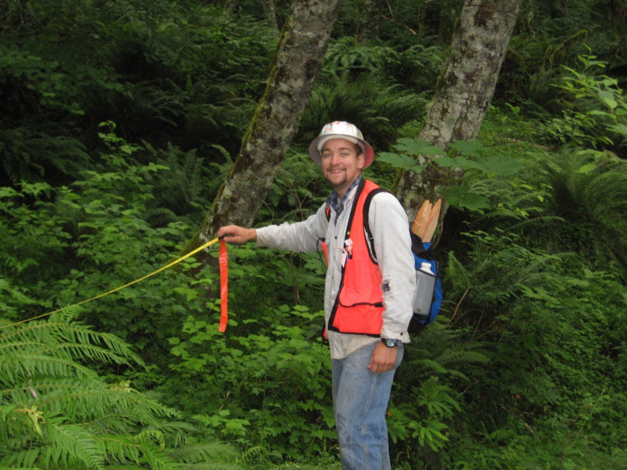
A case study
Thesis project: quantifying riparian forest structure in the
headwaters of the Trask River, Oregon Coast Range.

Slide 23
Sampling protocol
Located sample points systematically, with a random start, throughout riparian area.
Used nested fixed/variable combination (13ft fixed plot and 53.3 ft²/ac BAF) to estimate density and basal area at each sample point.
Recorded the species and diameter of the nearest tree to each sample point.

Slide 24
Stand table

Slide 25
Relative density vs. APA

Slide 26
Relative density vs. APA

Slide 27
Conclusions
APA may be useful where relative measurements are acceptable in place of absolute measurements.
Probability of selection is proportional to the attribute of interest → efficient sampling (Grosenbaugh 1967).
May be a direct measure of growing space allocation among classes of trees.
Flexible – can quantify space allocated to different diameter classes, species or cohorts.
What do you think?

Slide 28
Acknowledgments
Sincere thanks to Dr. Temesgen Hailemariam for assisting with the mathematical proof on Slide 14, and for making me learn the Horvitz-Thompson theorem.
Thanks to Dr. John Bailey for providing some early feedback.

Slide 29

Questions? Comments?
Source: http://shelleyszajner.files.wordpress.com/2010/01/beaver1.jpg

Slide 30
References
Grosenbaugh, L. R. 1967. The gains fom sample-tree selection with unequal probabilities. Journal of Forestry 65(3): 203-206(4).
Hibbs, D. 1983. Forty years of forest succession in central New England. Ecology 64(6): 1394-1401.
Husch, B., T. W. Beers and J. A. Kershaw. 2003. Forest mensuration. John Wiley and Sons. 443pp.
Iles, K. 1993. Relative measurements, a classic idea. Inventory and Cruising Newsletter 21: 4-5.
Iles, K. 2009. “Nearest-tree” estimations: a discussion of their geometry. International Journal of Mathematical and Computational Forestry & Natural-Resources Sciences 1(2): 47-51.
Kleinn, C. and F. Vilcko. 2006. Design-unbiased estimation for point-to-tree distance sampling. Canadian Journal of Forest Research 36(6): 1407-1414(8).
O’Hara, K. 1996. Dynamics and stocking-level relationships of multi-aged ponderosa pine stands. Forest Science Monograph 33.
O’Hara, K. 2005. Multiaged silviculture of ponderosa pine. USDA Forest Service Gen. Tech. Rep. PSW-GTR-198.

