Slide 1
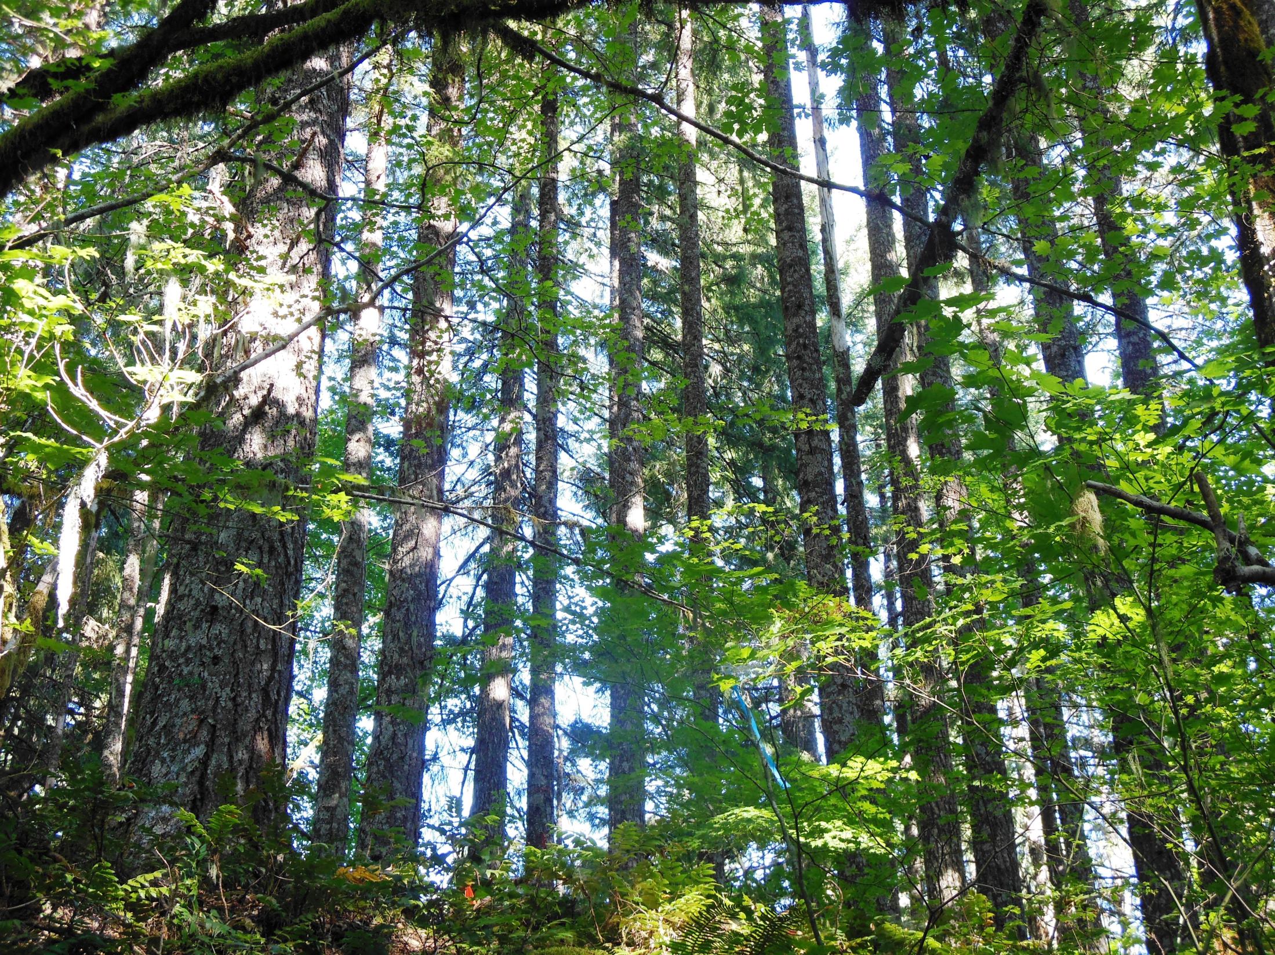
Simulation of Transpiration and Leaf Area Index for Intensively Managed Douglas-fir Forests
Nicole Rogers
Oregon State University
GMUG
October 19th, 2012

Slide 2
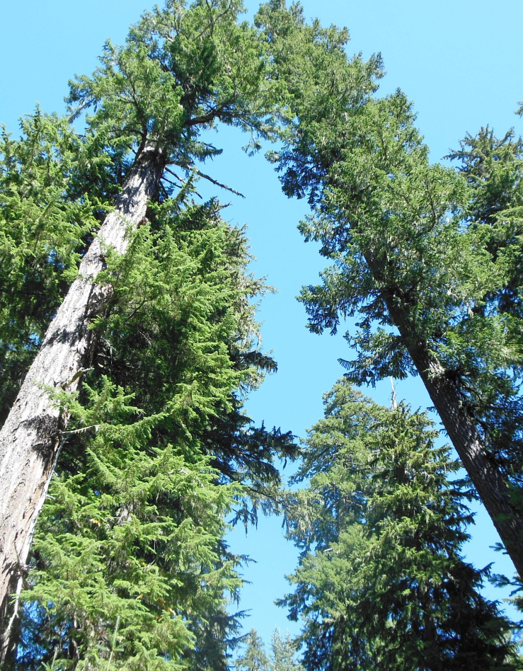
Outline
Goals and Objectives
Study Area
Current Work
  LAI
  Evapotranspiration
Next Steps
Conclusions

Slide 3
Goals and Objectives
Goal: Predict productivity of intensively managed Douglas-fir across varying site characteristics.
Objective 1: Simulate evapotranspiration
Objective 2: Compare methods of estimation for LAI
Objective 3: Validate the model

Slide 4
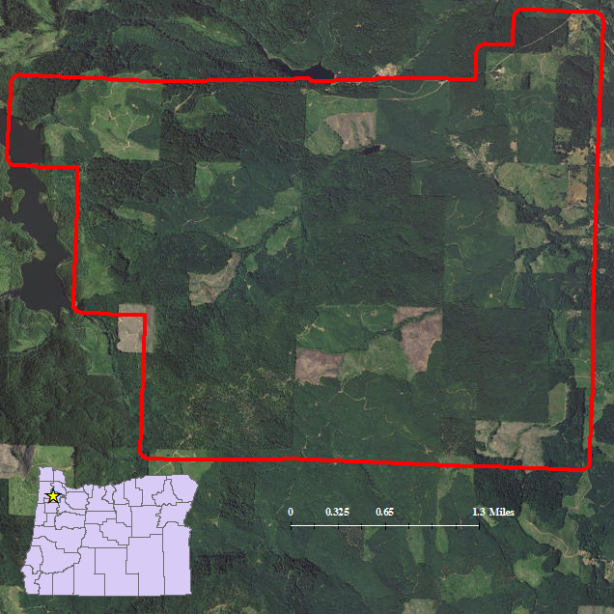
Study Area: Panther Creek
2580 ha area
42 LiDAR ground truthing plots
36 soil test sites
Weather station
Wide range of management

Slide 5
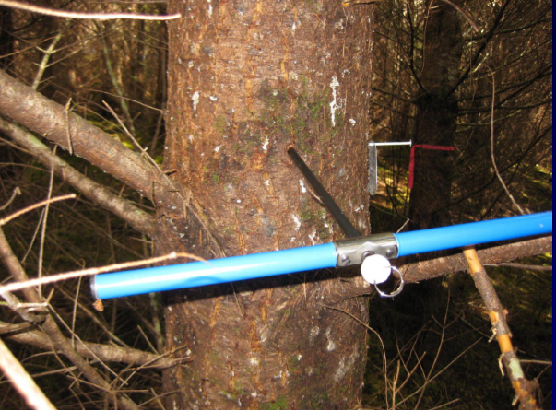
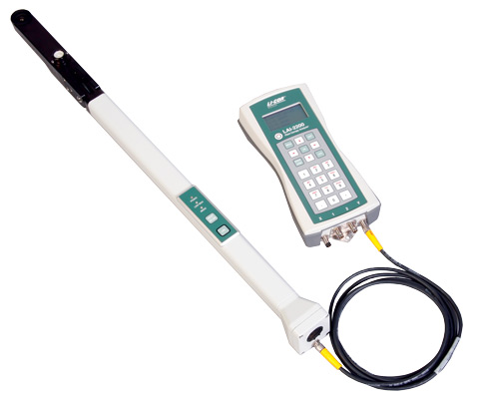
Current Work: LAI
LAI field work:
Mid-August to mid-September 2012
LiCOR readings
Sapwood thickness

Slide 6
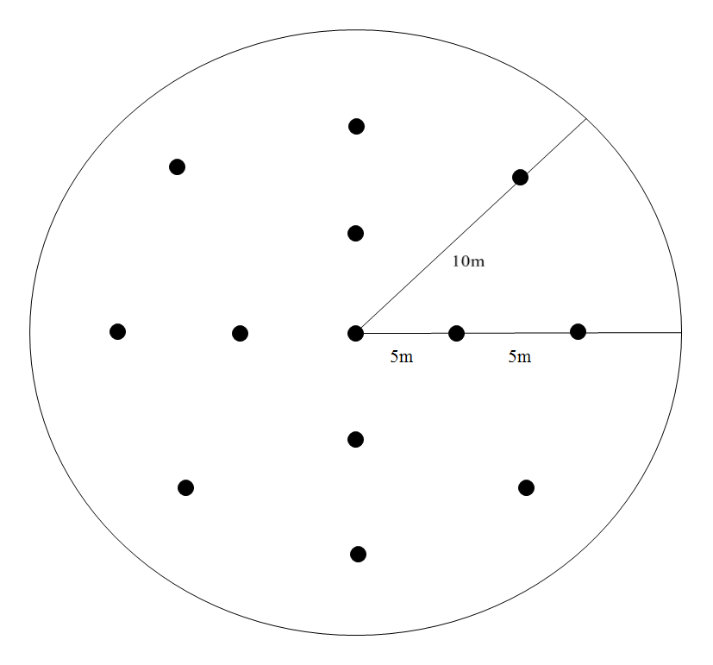
LAI: LiCOR Measurements
Soil research plots
Douglas-fir BA 80% or greater
Early morning
A and B readings

Slide 7
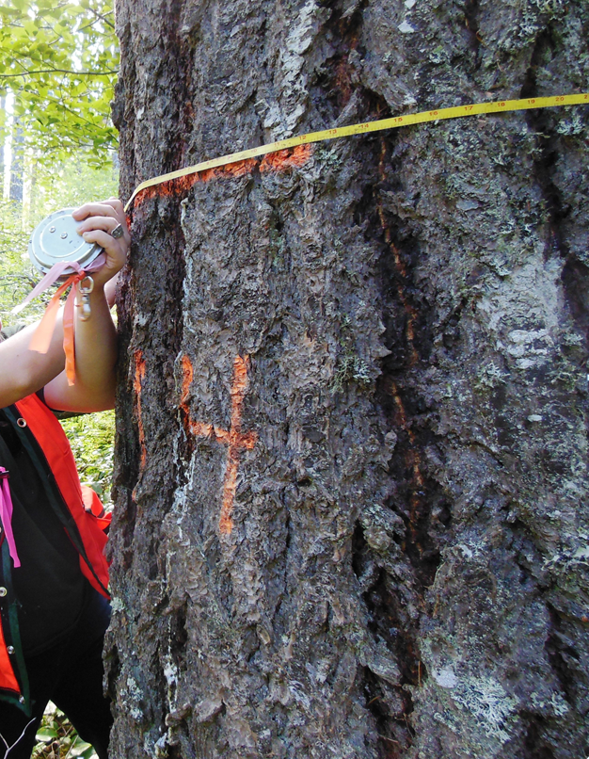
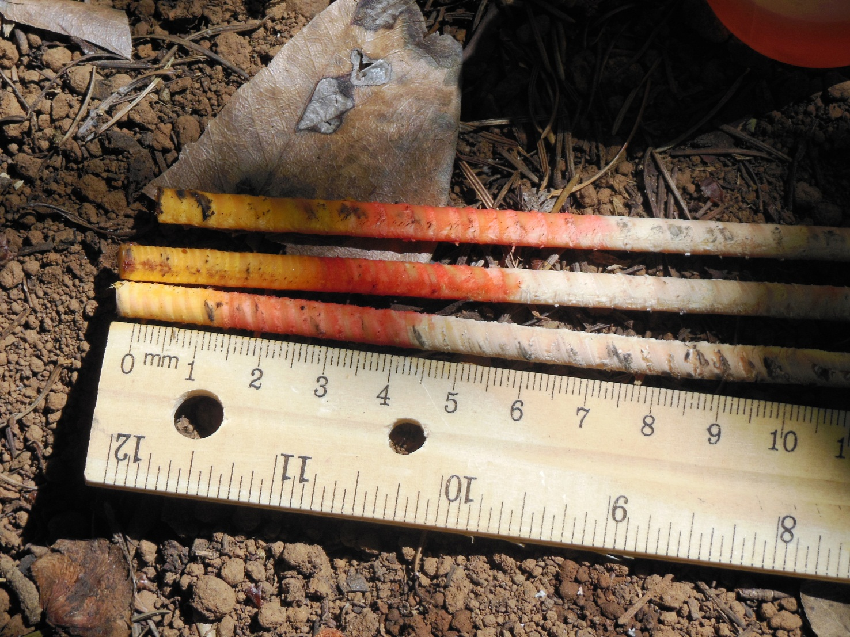
LAI : Sapwood Measurements
Corresponding to LiCOR measurements
15 to 20 trees at each plot
DBH and sapwood thickness

Slide 8
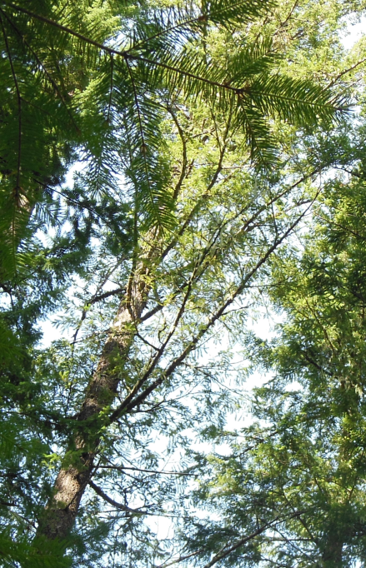
LAI : Data Analysis
2009 full tree inventory
Change in DBH from 2009 and 2012
DBH 2009 and height 2009
  Apply DBH-HT relationship to 2012
Basal area and sapwood basal area
  Predicted sapwood BA for all trees 2012
Kozak sapwood area taper equation at
crown base
  (Maguire and Batista 1996)
Sapwood area at crown base conversion to LA
  (Waring et al 1982)

Slide 9
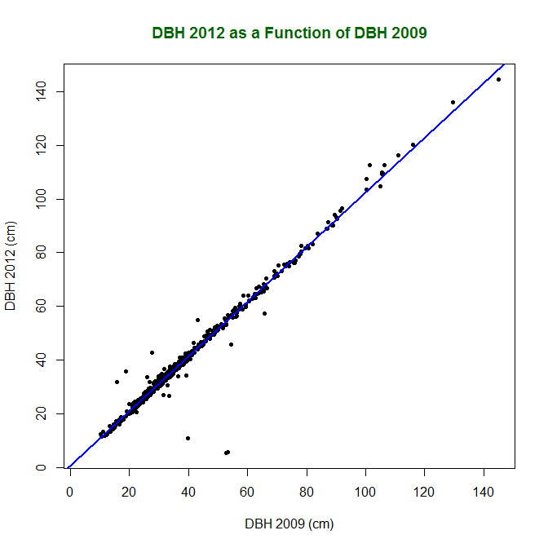
LAI: DBH from 2009 to 2012
Fit linear model to DBH 2012 as a function of DBH 2009

Slide 10
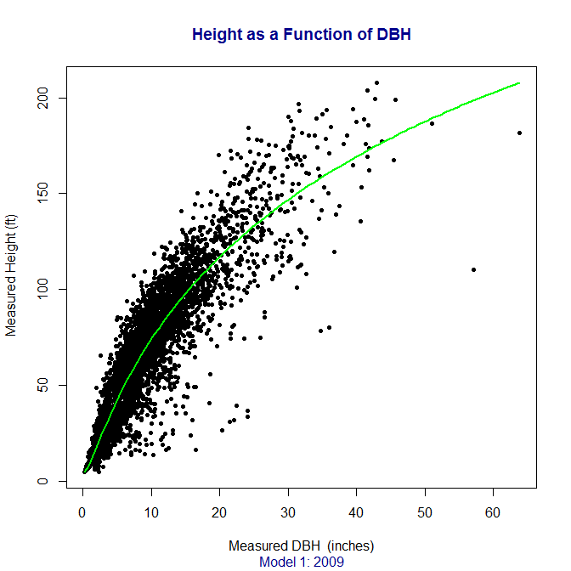

LAI: DBH-Height Curve
Equation from Hanus et al 1999
$Ht=4.5+exp( a_{o}+ a_{1}{DBH}^{a_{2}}$)
Weight = (1/DBH)

Slide 11
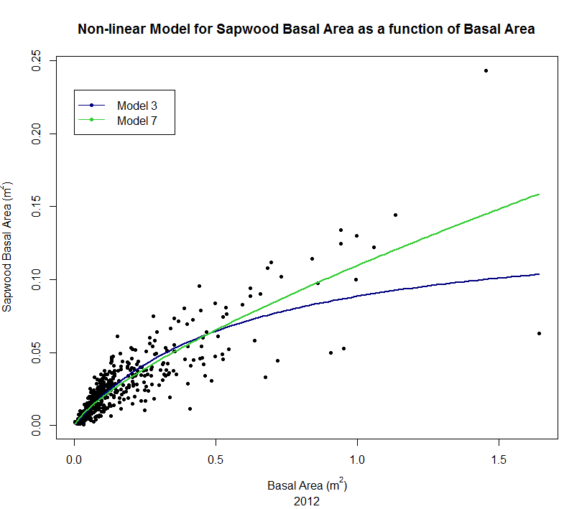
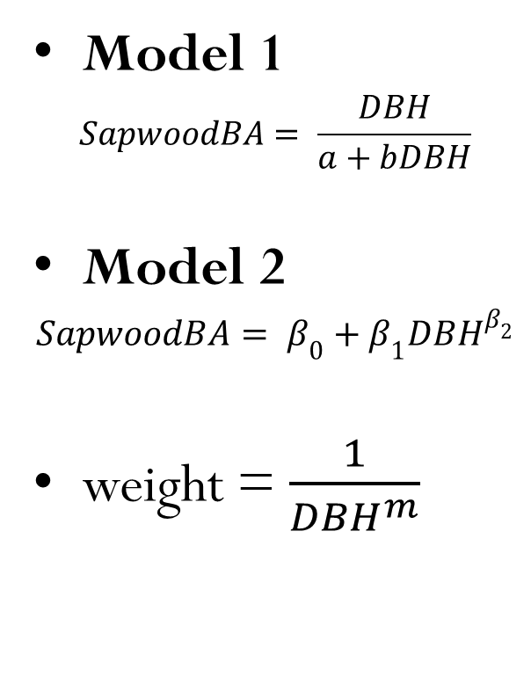
LAI : Sapwood BA vs BA
Model 1
$$SapwoodBA= \frac{DBH}{a+bDBH}$$
Model 2
$$SapwoodBA= β_{0}+{β_{1}DBH}^{β_{2}}$$
weight = $\frac{1}{{DBH}^{m}}$

Slide 12

LAI : Sapwood Taper Model
Kozak Taper Model
$${ sapwood area=X}^{c}$$
$$x=\frac{\left(1−sqrt\left(z\right)\right)}{\left(1−sqrt\left(p\right)\right)}$$
$$z=\frac{h}{H}$$
$$p=\frac{1.37}{H}$$
$$c=k_{1}z+k_{2}sqrt\left(z\right)+k_{3}\left(\frac{D}{H}\right)+k_{4 }CL+ k_{5}CR+K_{6}CB$$

Slide 13
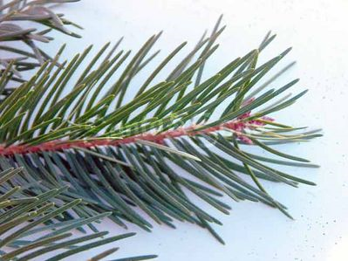
LAI
Ratio of LA (m²)/Sapwood Area at Crown Base(cm²) = .54
16 m radius plot
  804.22 m² plot area

Slide 14
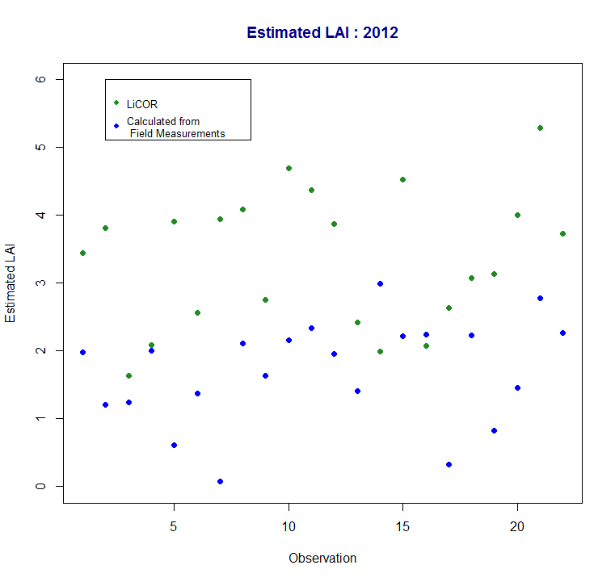
LAI : LiCOR vs Calculated Values

Slide 15
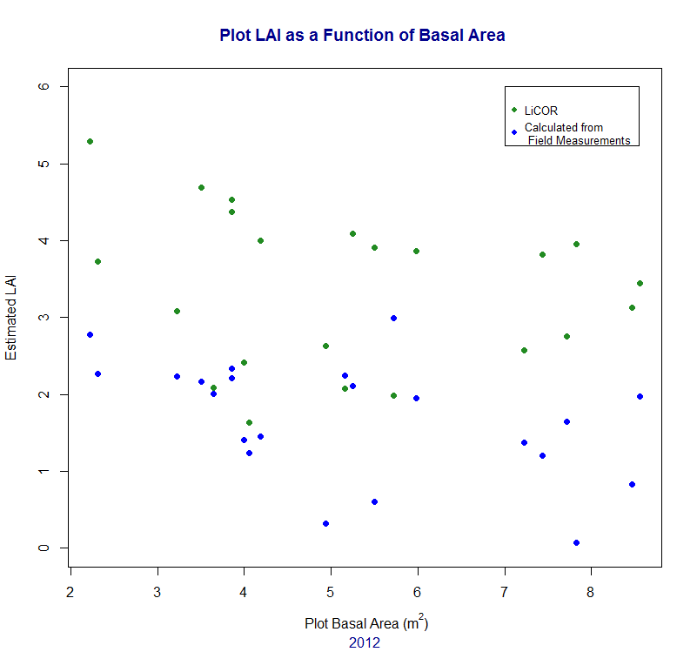
LAI : LiCOR vs Calculated Values

Slide 16
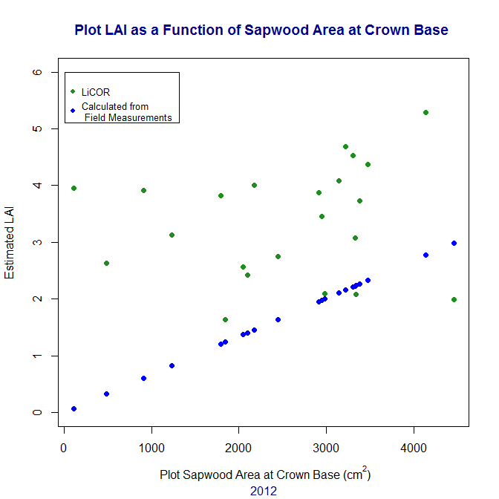
LAI : LAI vs Sapwood Area

Slide 17
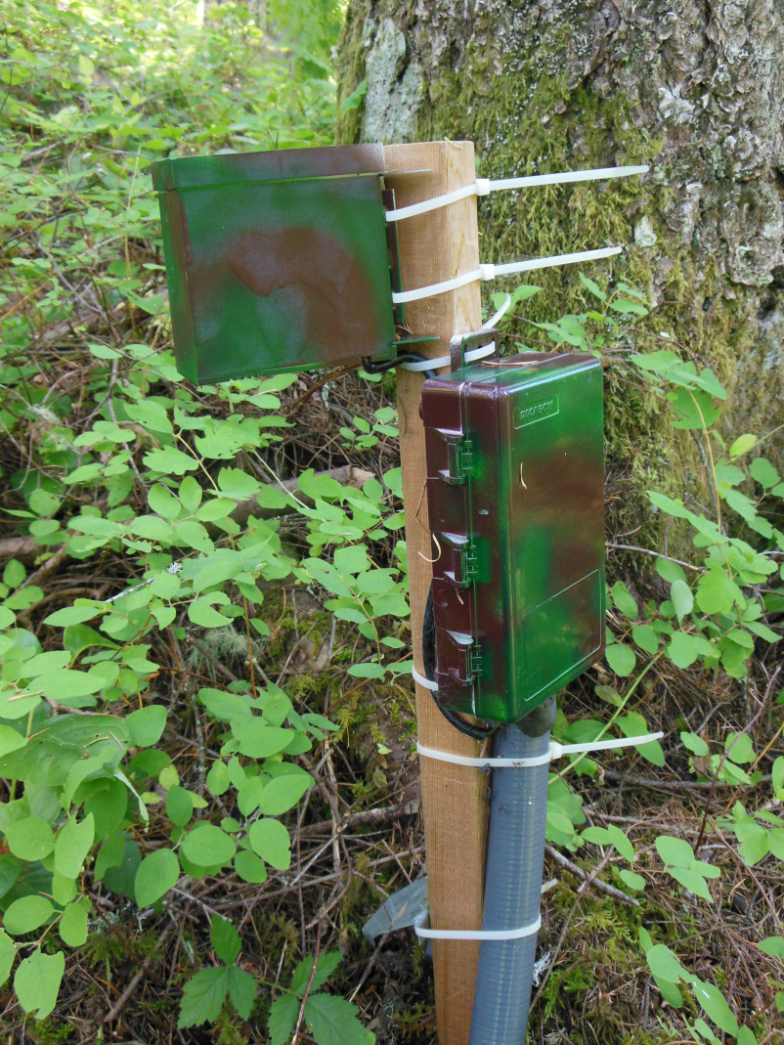
Current Work: Evapotranspiration
Mini-Meteorological weather stations
Preliminary ET calculations
  (Waring and Schlesinger 1985)

Slide 18
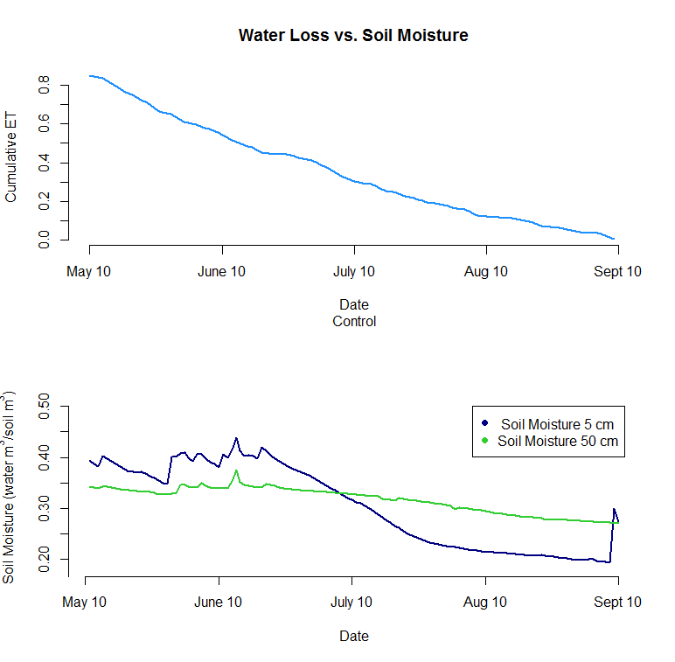
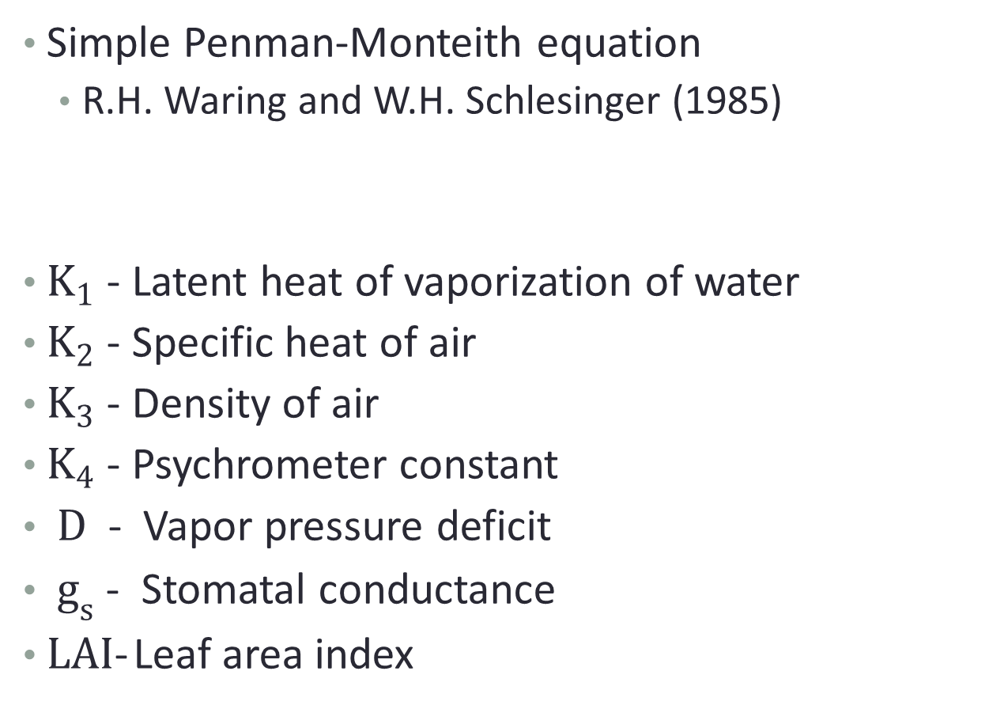

Evapotranspiration

Slide 19
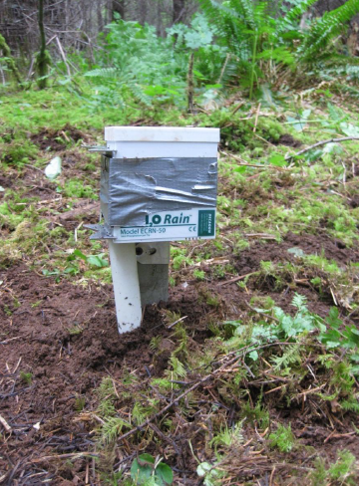
Future Directions
Comparison of LAI estimates from multiple models
Calibration of LAI with actual measurements
Additional ET calculations
Model validation
    Guistina and Beyond N

Slide 20
Conclusions
Create a growth model for intensively managed Douglas-fir
  Focus on simulation of evapotranspiration and LAI
Predictions of productivity for a site under varying soil and climatic properties

Slide 21
Acknowledgments
Bureau of Land Management
City of Carlton
Forest Capitol Partners, LLC
Jim Flewelling
McMinnville Water & Light
Oregon Dept. of Geology and Mineral Industries
U.S. Environmental Protection Agency
USDA Natural Resource Conservation Service
USFS Pacific Northwest Research Station
Watershed Sciences, Inc.
Weyerhaeuser Company
Yamhill Basin Council

Slide 22
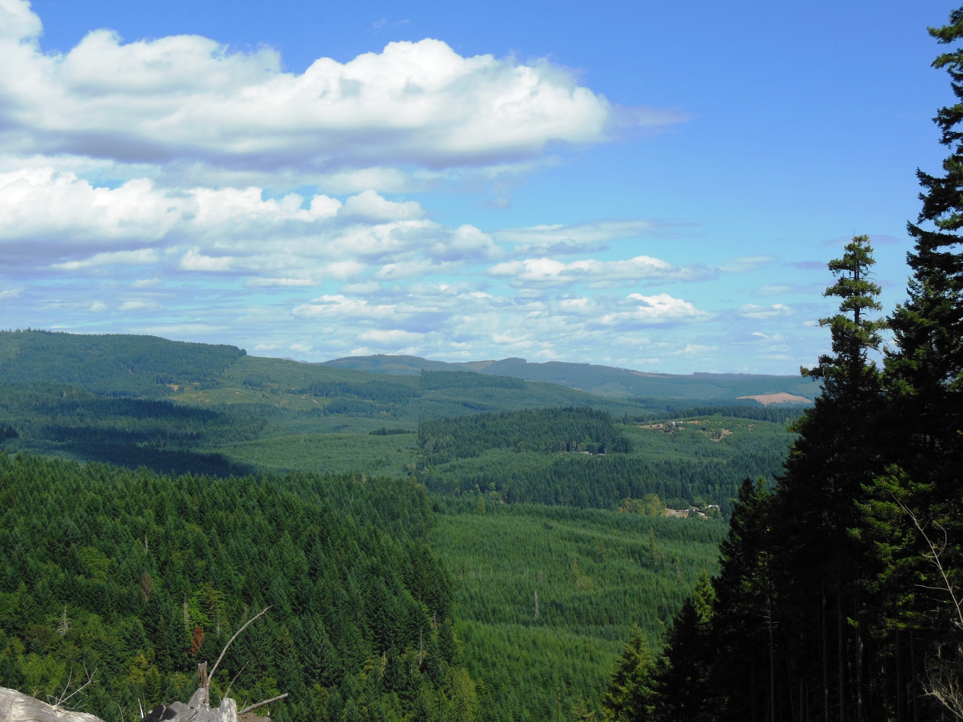
Questions?

