Slide 1
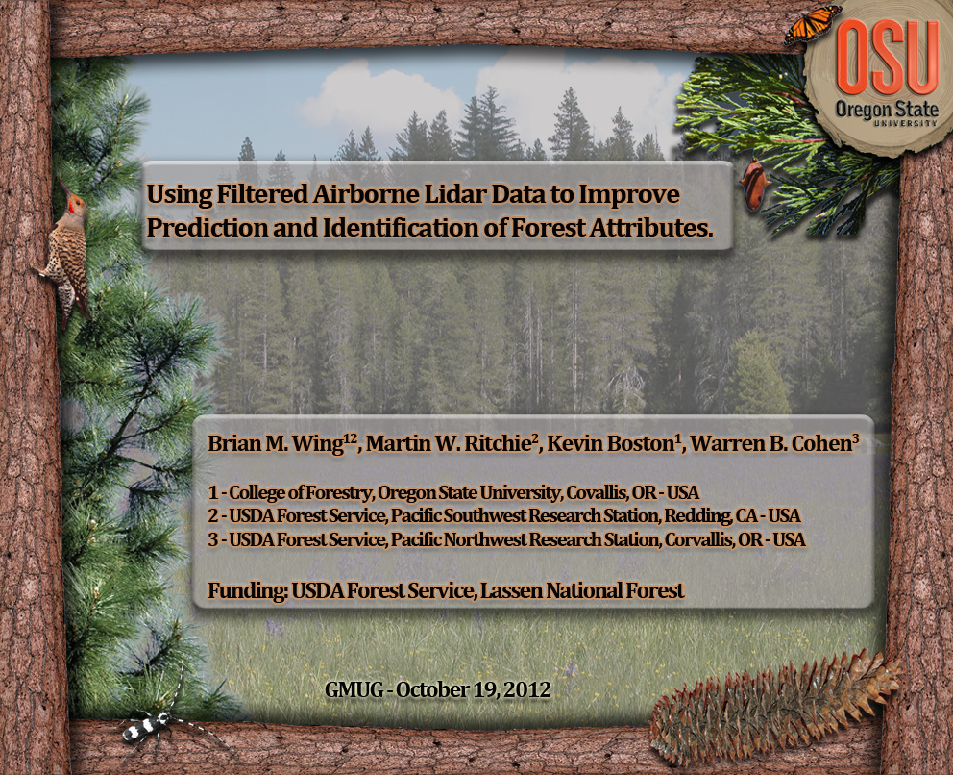

Slide 2

Presentation Outline
Introduction
  Lidar Overview
  Study Areas
  Field Data Summary
  Lidar Data Summary
Applications
  Understory Vegetation Cover Prediction
  Individual Snag Detection
  Improving Plot-Level Standing Biomass Prediction
Current Work
  Towards Using Lidar Derived Information in a Forest Planning & Monitoring Setting

Slide 3
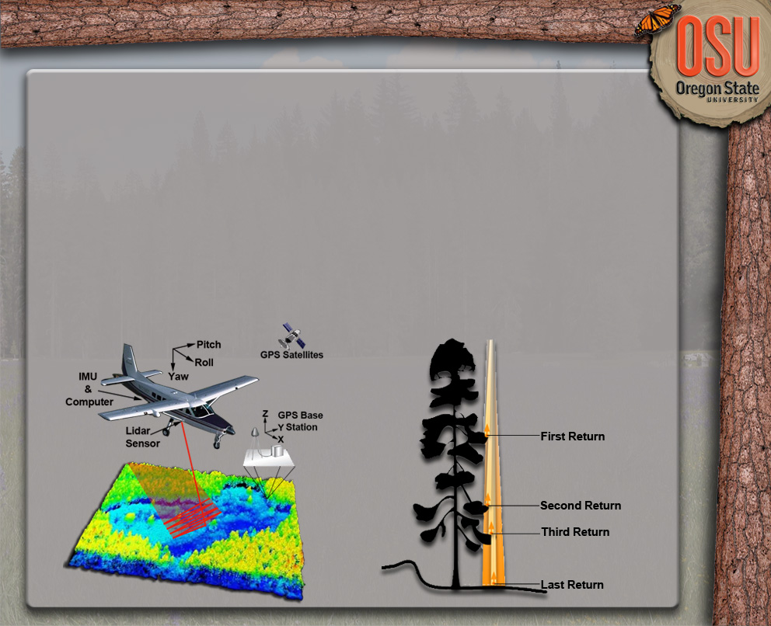
Airborne Lidar Scanning
Active Remote Sensing Technology
  Directly Measures Heights
Two Types
  Full-Waveform
  Discrete-Return

Slide 4
Airborne Lidar Scanning
Active Remote Sensing Technology
  Directly Measures Heights
Two Types
  Full Waveform
  Discrete-Return

Slide 5
Airborne Discrete-Return Lidar
Small-Footprint
  Beam Diameter: 10-100 cm
Multiple Returns per Pulse
  Typically 2-3 returns max.
Accuracy
  Vertical < 30 cm
  Horizontal < 30 cm
Products
  Precise X, Y, Z Points
  Intensity

Slide 6
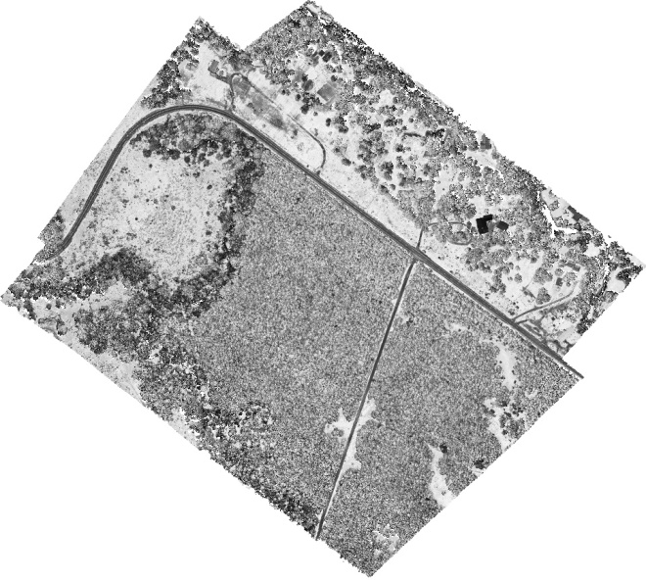
Airborne Discrete-Return Lidar
Intensity
  Power of Returned Light
    Power Emitted
    Path Distance
    Intersected Object Surface Characteristics
  Commonly Not Utilized
    Calibration Variability
  Displayed Promise

Slide 7
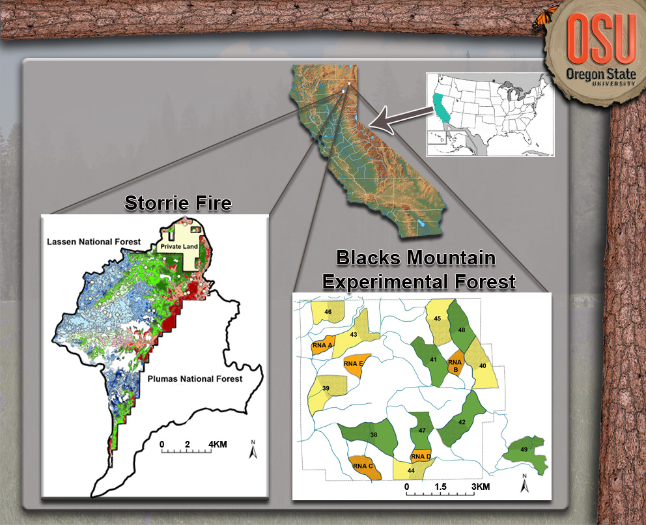
Study Locations

Slide 8
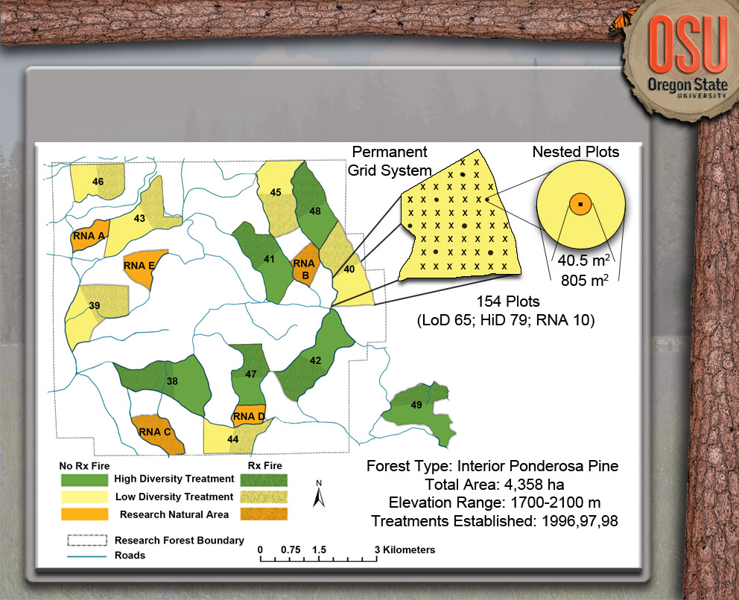
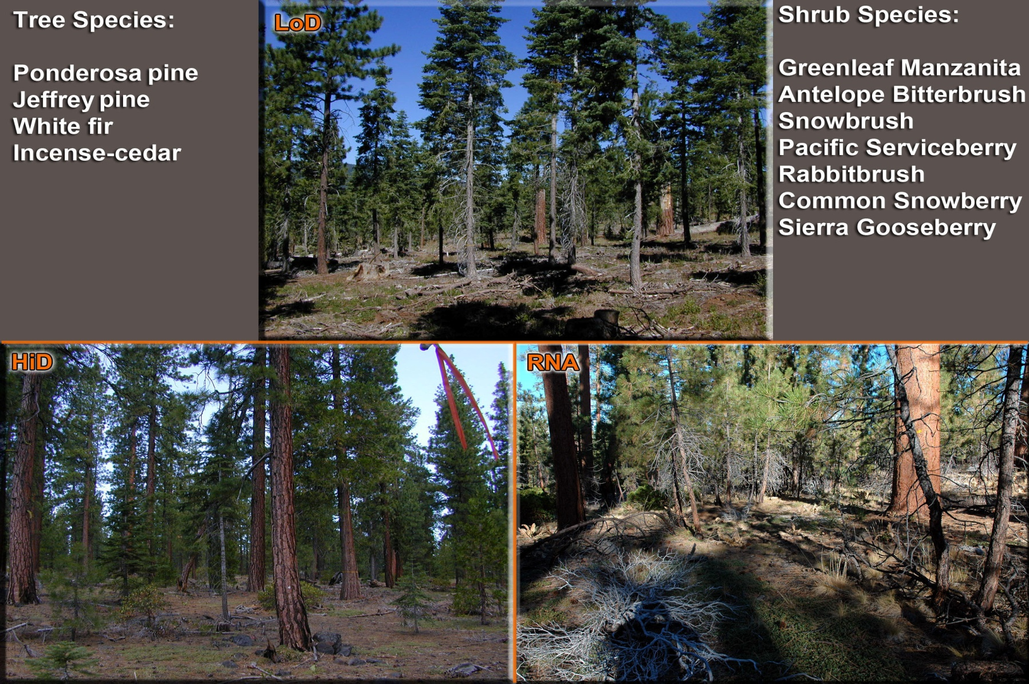
Blacks Mountain Experimental Forest (BMEF)

Slide 9
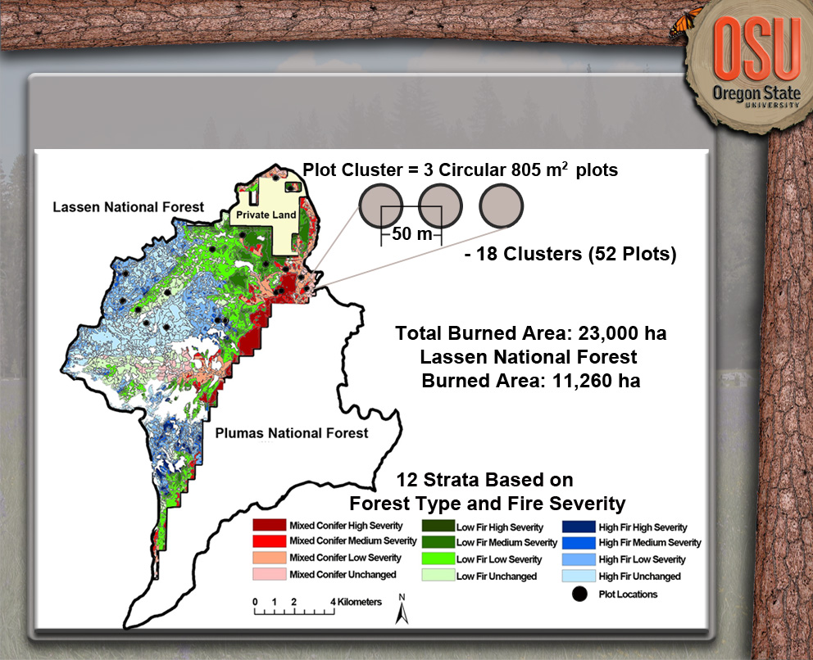
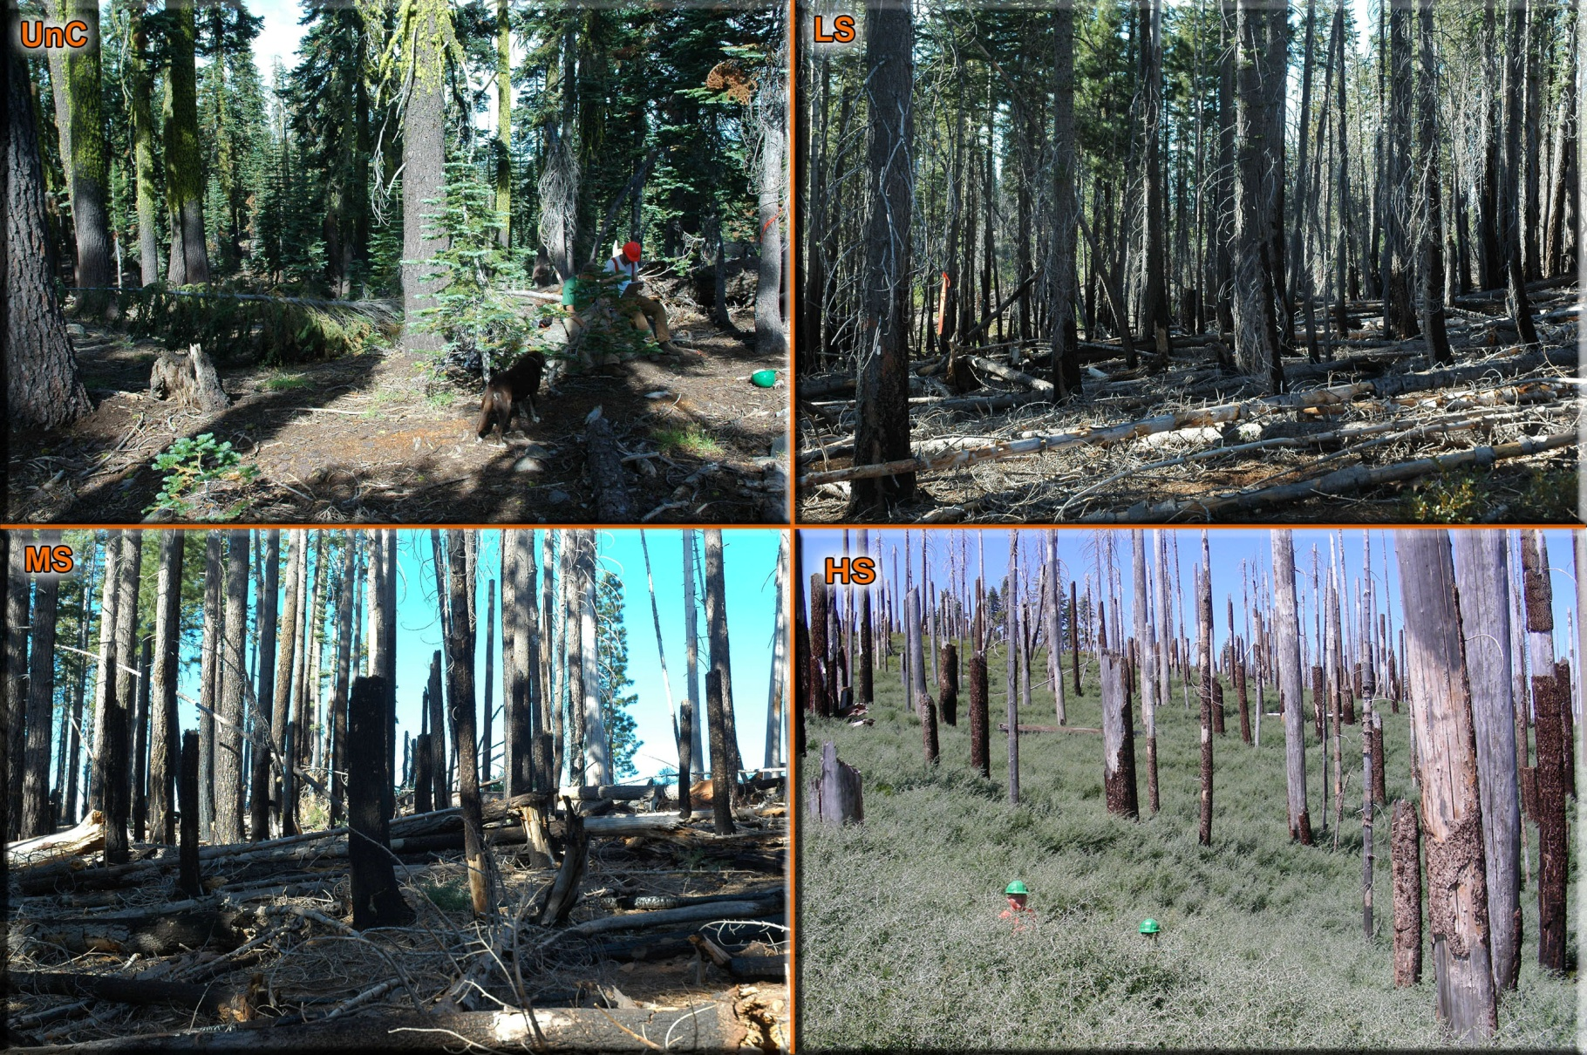
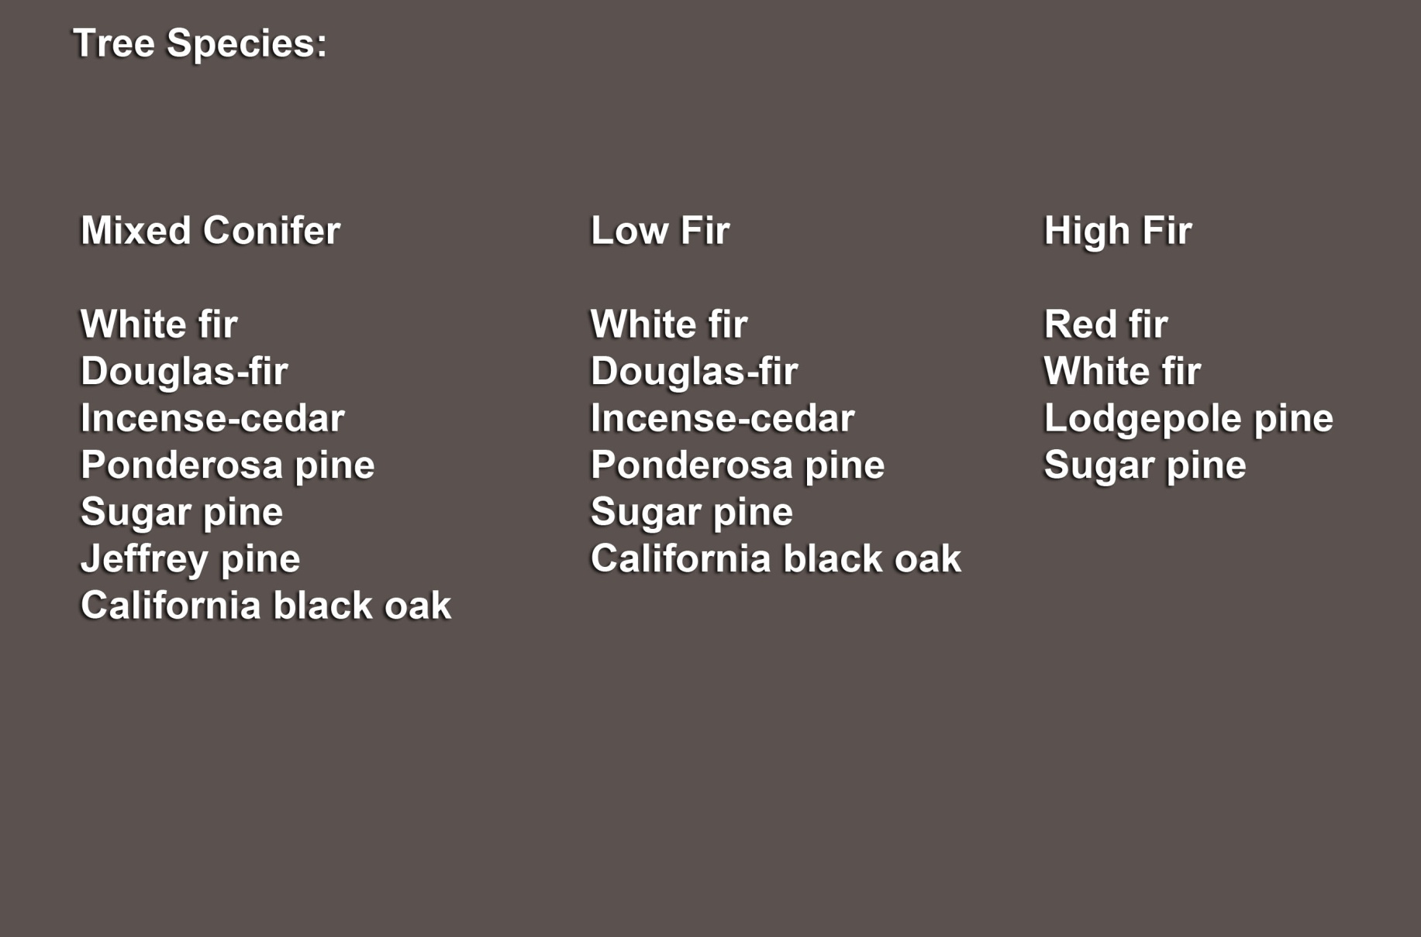
Storrie Fire (SF)

Slide 10
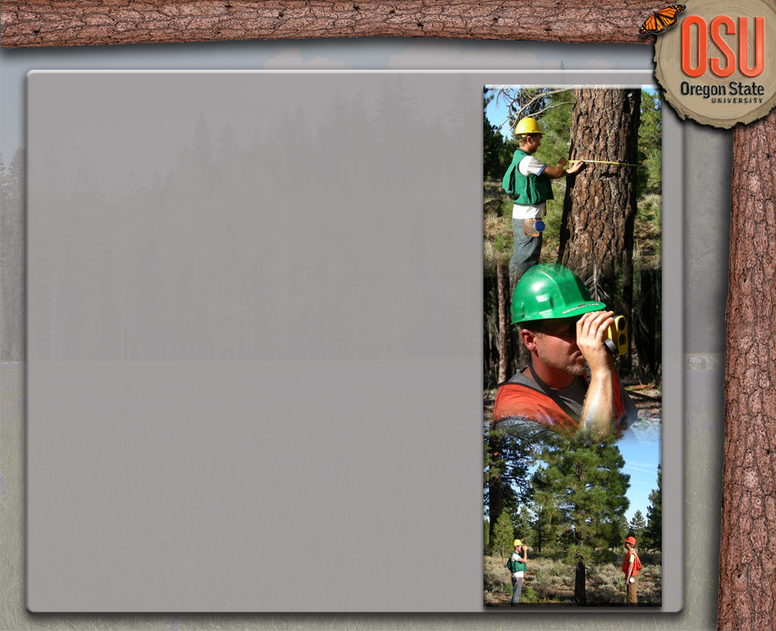
Field Data Summary (2009)
Standing Trees (805 m²)
  DBH (cm)
  Height (m)
  Species
  Risk Rating
  Seedlings & Saplings Tallied (40.5 m²)
Understory Vegetation (40.5 m²)
  Crown Width (m)
  Aver. Height (m)
  Location
  Crown Width (m)
  Ht. Live & Dead Crown
  Condition Codes
  Location
  Max. Height (m)
  Species

Slide 11
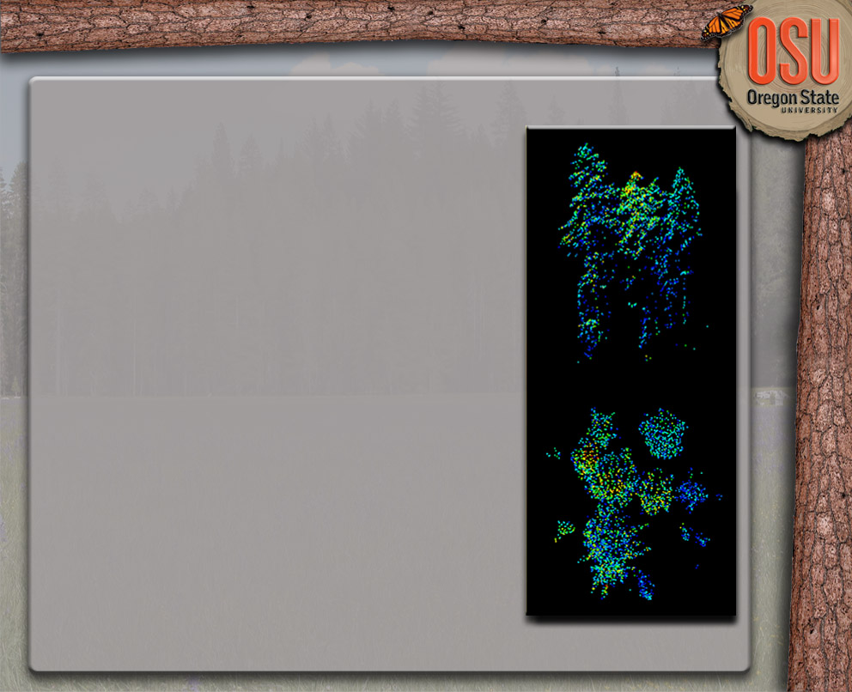
Lidar Data Summary
Acquisition Survey Design (July, 2009)
  AGL: 900 m
  Scan Angle: ± 14º
  Side Lap > 50%
  Intensity Range: 1-255
  Variable Gain Setting
  > 105,000 pulses sec⁻¹
BMEF Specifications
  Average Point Density: 6.9 m⁻² (sd: 5.6)
  Vertical Accuracy: < 10 cm
  First & Single Returns: 90.2%
SF Specifications
  Average Point Density: 6.7 m⁻² (sd: 5.9)
  Vertical Accuracy: < 15 cm
  First & Single Returns: 89.9%
  Beam Diameter:
  ~24 cm (narrow)
  Up to 4 returns pulse⁻¹

Slide 12
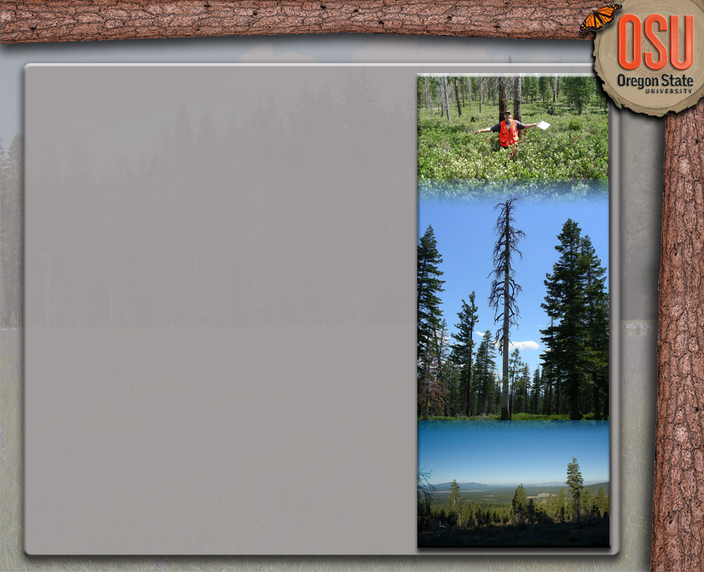
Applications
Understory Vegetation Cover
  Traditionally Difficult to Estimate & Predict (R² < 0.4)
  Filtered Lidar Metric Increases Explanatory Power (R² > 0.7)
  Cover Prediction ± 22%
Individual Snag Detection
  Traditionally Difficult to Quantify
    Irregular & Sparse Distribution
  Filtering Algorithm Identifies Snag Pts.
  Overall Detection Rate of 70.6% (± 2.9)
    Snags w/ DBH ≥ 38 cm
Live Above-Ground Biomass
  Filtered Point Cloud Improves Prediction

Slide 13
Applications
Understory Vegetation Cover
  Traditionally Difficult to Estimate & Predict (R² < 0.4)
  Filtered Lidar Metric Increases Explanatory Power (R² > 0.7)
  Cover Prediction ± 22%
Individual Snag Detection
  Traditionally Difficult to Quantify
    Irregular & Sparse Distribution
  Filtering Algorithm Identifies Snag Pts.
  Overall Detection Rate of 70.6% (± 2.9)
    Snags w/ DBH ≥ 38 cm
Live Above-Ground Biomass
  Filtered Point Cloud Improves Prediction

Slide 14
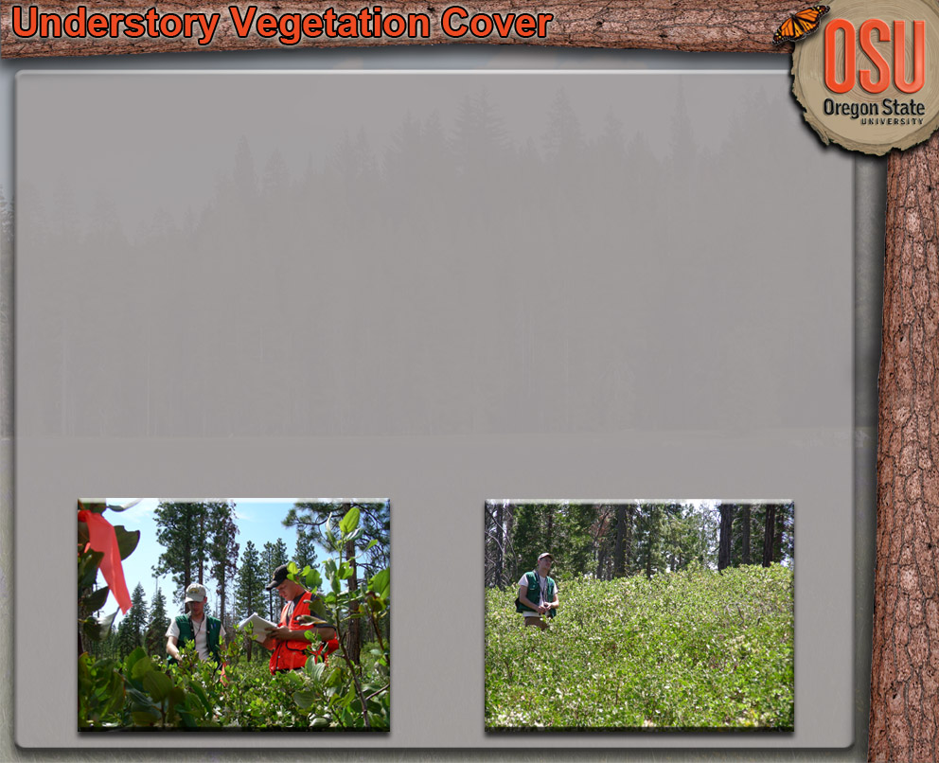
Introduction
Importance
  Wildlife Habitat
  Fuel Loading & Behavior
  Nutrient Cycling
  Competition Dynamics & Overstory Structure
Been Difficult to Predict
  Standing Tree Variables
    Canopy Cover, Basal Area
  Topographic Variables
    Slope; Aspect
  R² Range: 0.2-0.45
Common Sampling Methods
  Ocular Estimation
  Line-Intersect
  Fixed Plot
Lidar Methods
  Very Limited

Slide 15
Method Overview
Derive Field Understory Vegetation Cover Estimates
Derive Lidar Predictor Variables
Model Selection & Fitting
Leave-One-Out Cross Validation

Slide 16
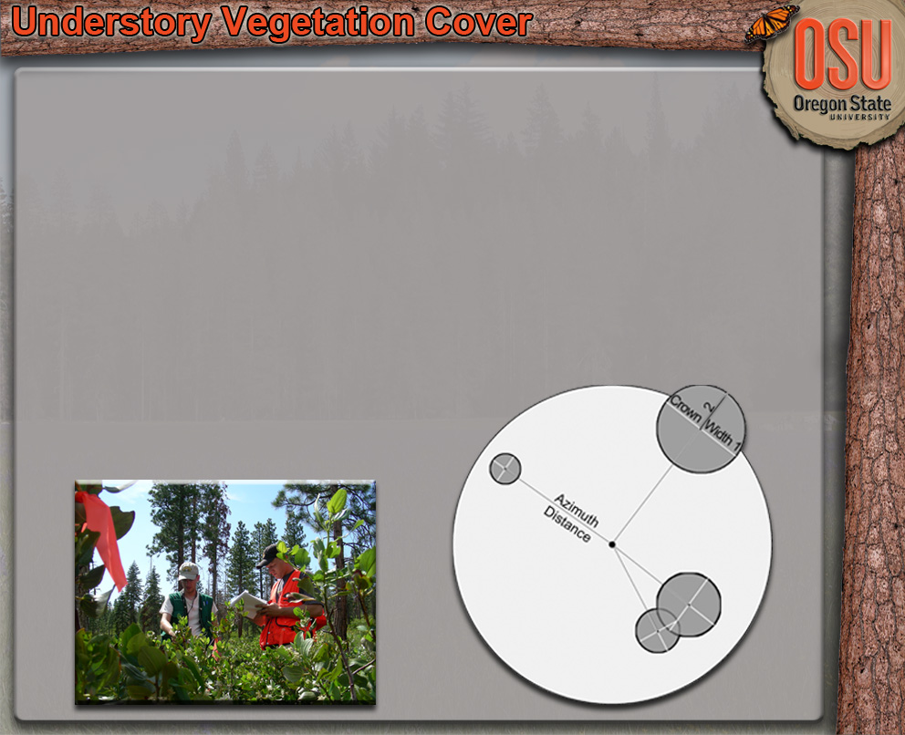
Field Methods
BMEF Only (All Plots Combined)
40.5 m² Circular Plots (n = 154)
Individual Shrubs
  Two Crown Widths
  Average Crown Height
  Maximum Crown Height
  Location (Azimuth & Distance)
Seedlings & Saplings
  Seedlings > 0.3 m Height
  Saplings into Two DBH Classes (2.54 & 5.08 cm)
Understory Vegetation Cover
  GIS Shrub Layer
  Saplings:
    2.54 cm = 0.5 m²
    5.08 cm = 1.0 m²
  Seedlings: 0.15 m²

Slide 17
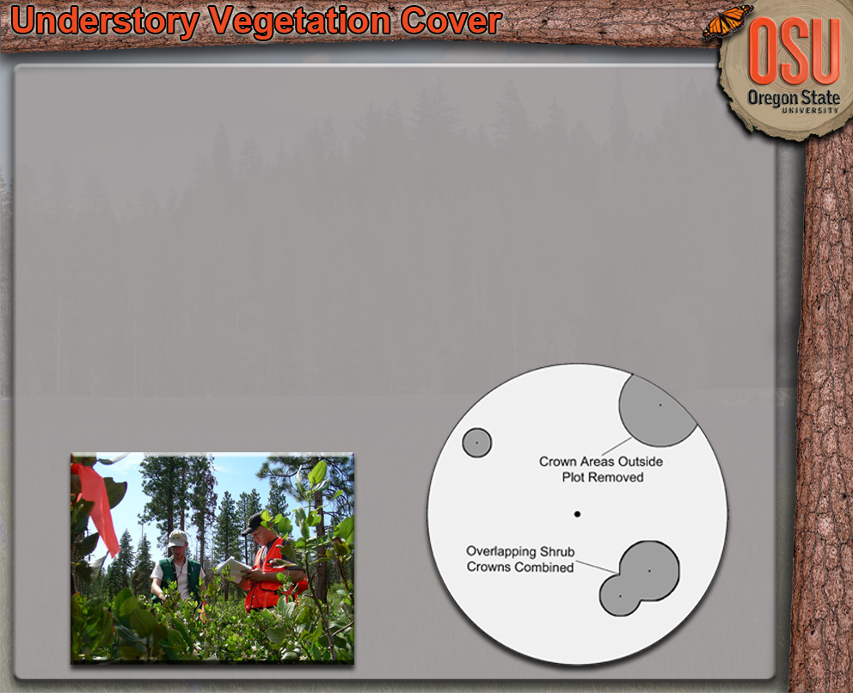
Field Methods
BMEF Only
40.5 m² Circular Plots (n = 154)
Individual Shrubs
  Two Crown Widths
  Average Crown Height
  Maximum Crown Height
  Location (Azimuth & Distance)
Seedlings & Saplings
  Seedlings > 0.3 m Height
  Saplings into Two DBH Classes (2.54 & 5.08 cm)
Understory Vegetation Cover
  GIS Shrub Layer
  Saplings:
    2.54 cm = 0.5 m²
    5.08 cm = 1.0 m²
  Seedlings: 0.15 m²

Slide 18
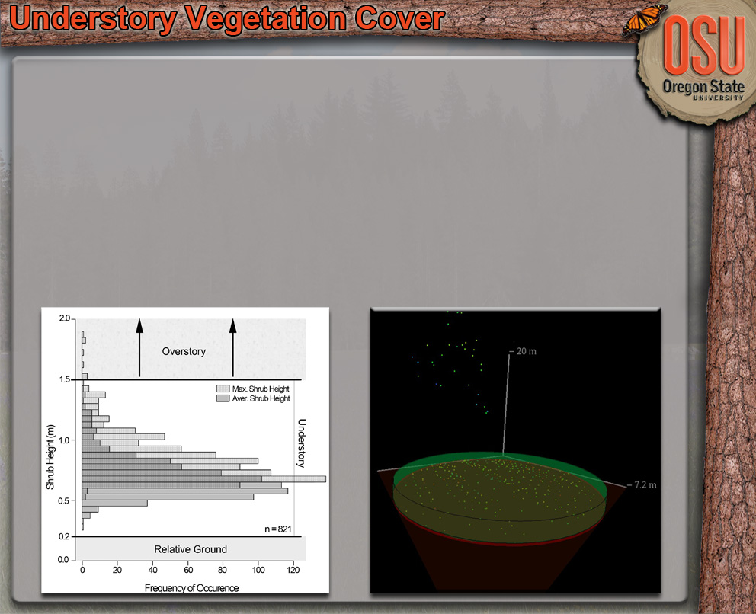

Lidar Methods
Normalize Point Heights
Extract Plot Point Cloud
Derive Lidar Predictor Variables
  3 Understory Metrics
  40 Overstory Metrics
  7 Topographic & Stand Attribute Metrics
Understory Lidar Cover Density
  Define Understory Layer
  Extract Understory Points
  Apply Intensity Filter
  Apply Formula:

Slide 19
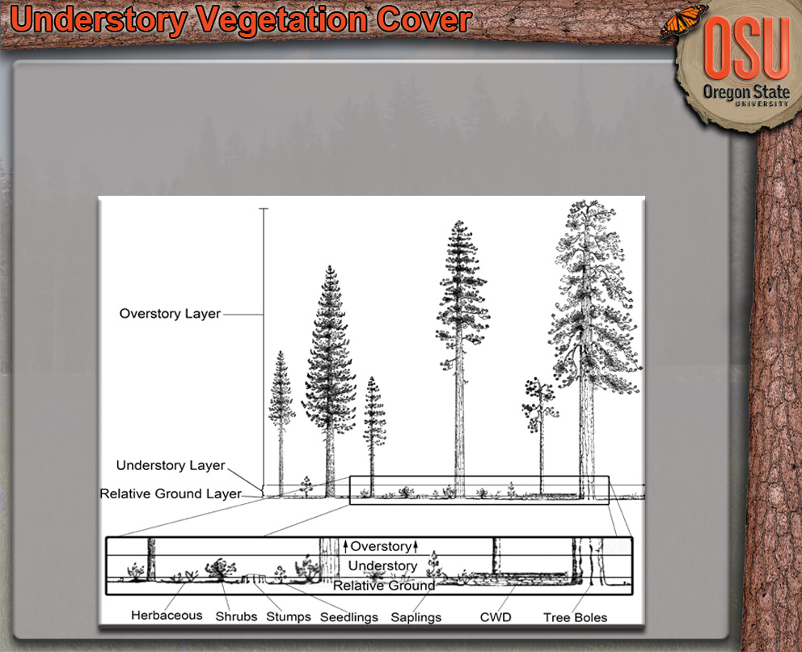
Lidar Methods
Understory Lidar Cover Density
  Define Understory Layer
  Extract Understory Points
  Apply Intensity Filter
  Apply Formula:

Slide 20
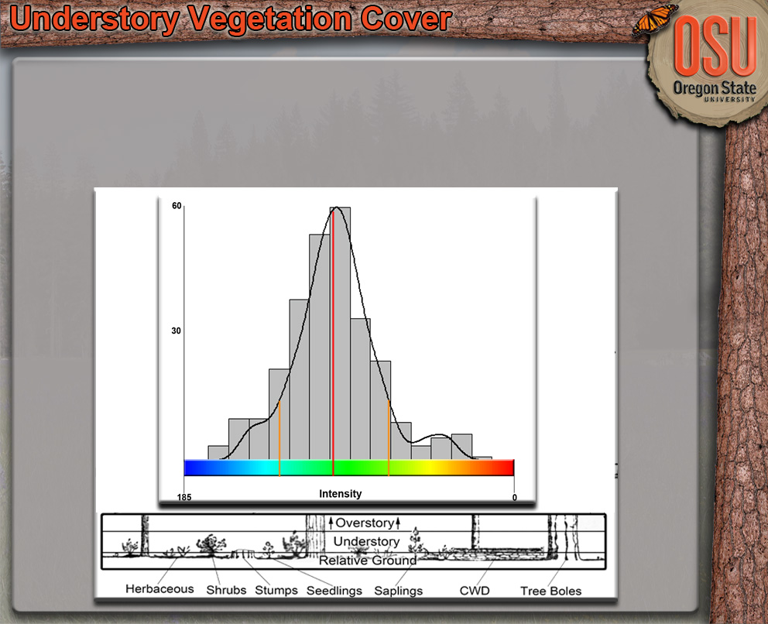
Lidar Methods
Understory Lidar Cover Density
  Define Understory Layer
  Extract Understory Points
  Apply Intensity Filter
  Apply Formula:
0
255

Slide 21
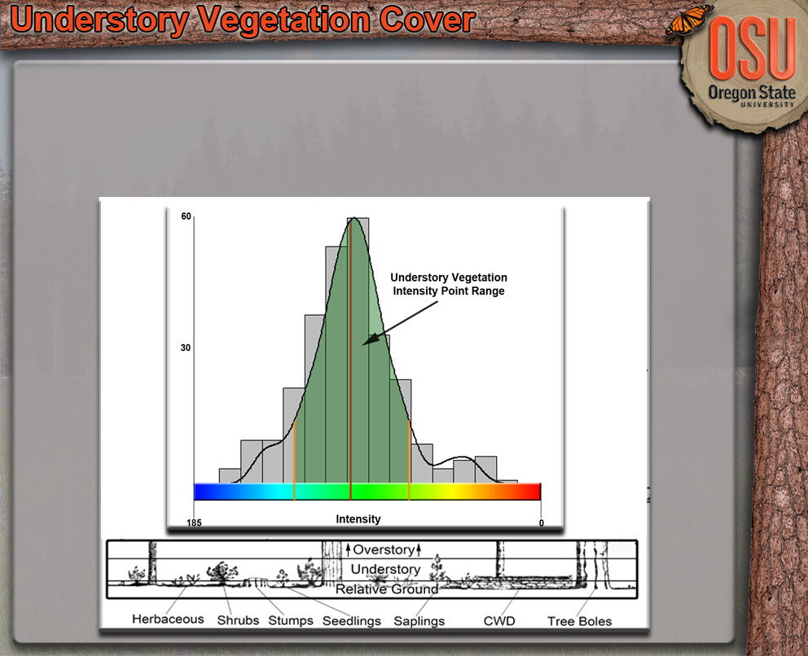
Lidar Methods
Understory Lidar Cover Density
  Define Understory Layer
  Extract Understory Points
  Apply Intensity Filter
  Apply Formula:
0
255

Slide 22
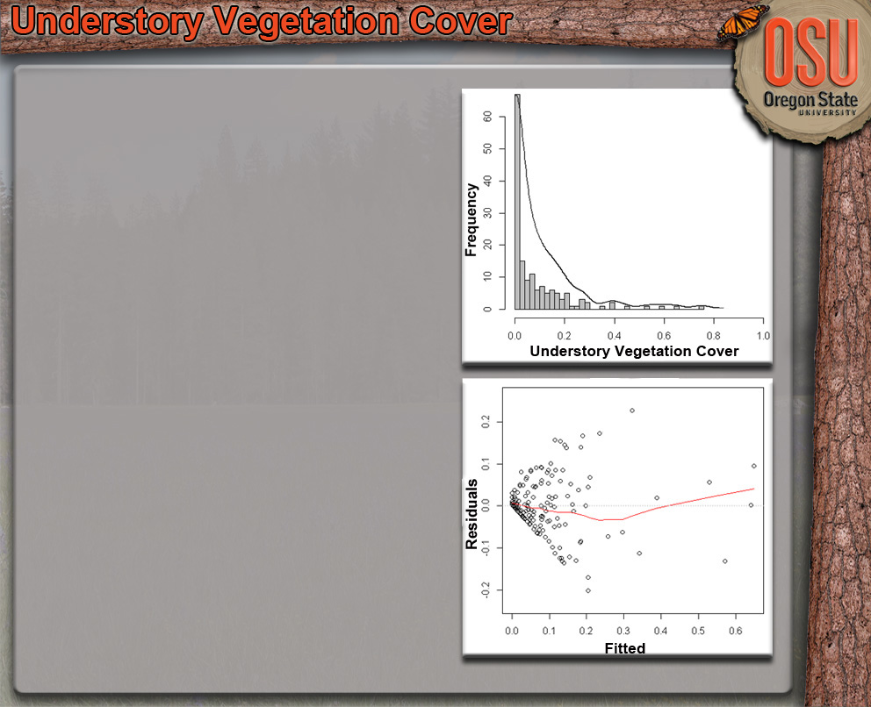
Modeling
Cover Data
  Bounded Between 0 and 1
  Heterskedasticity
Weighted Regression
  Weights Provide Proper Amount of Influence for Each Data Point
  Weights Estimated using Iterative Procedure
Beta Regression
  Well Suited for Proportions
  Extended Generalized Linear Model Approach

Slide 23
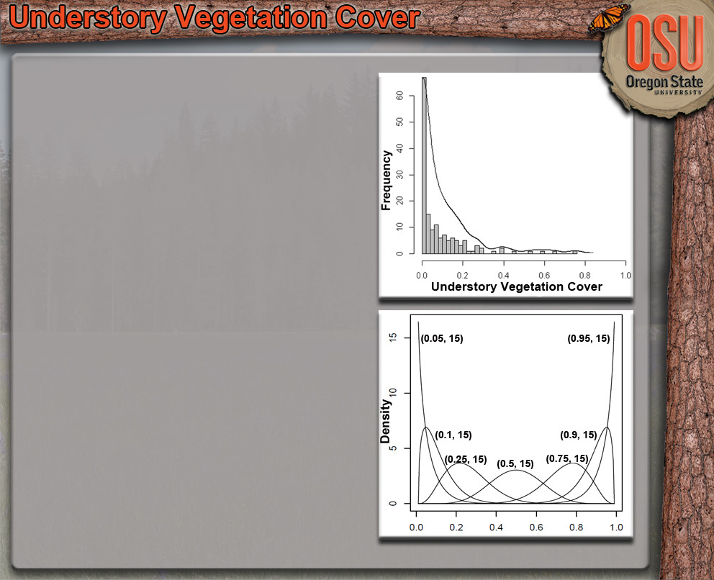
Modeling
Cover Data
  Bounded Between 0 and 1
  Heterskedasticity
Weighted Regression
  Weights Provide Proper Amount of Influence for Each Data Point
  Weights Estimated using Iterative Procedure
Beta Regression
  Well Suited for Proportions
  Extended Generalized Linear Model Approach

Slide 24
Model Comparison
Leave-One-Out Cross Validation
  Absolute Bias
  Root Mean Square Error

Slide 25
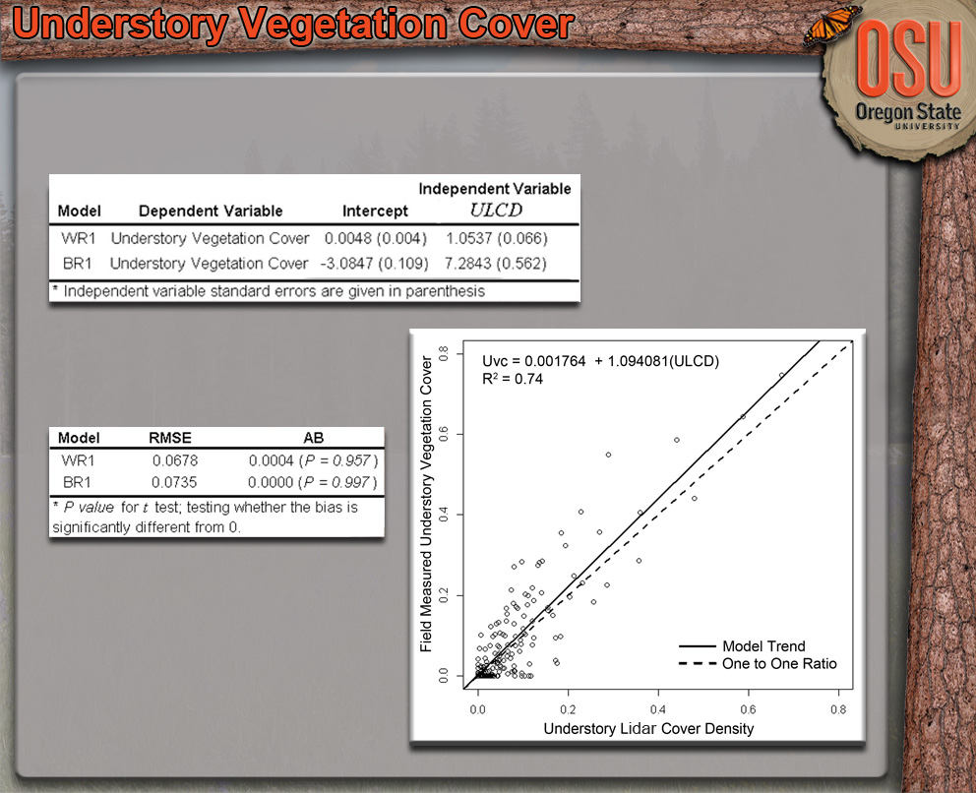
Results
Models
LOO Cross Validation
Overall Prediction
Accuracy: ± 22%

Slide 26
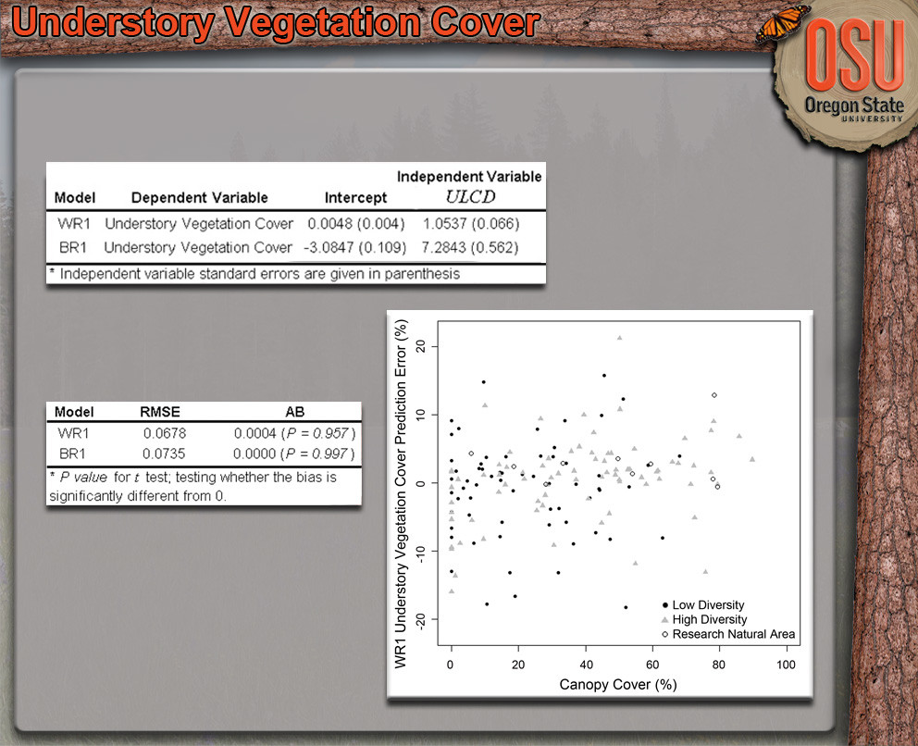
Results
Model Performance Remains Stable to Canopy Cover
  Two Most Likely Causes:
    ULCD, is relative to the number of points that reach the understory.
    The likelihood of encountering understory vegetation decreases with increasing canopy cover for this forest type
Models
LOO Cross Validation
Overall Prediction
Accuracy: ± 22%

Slide 27
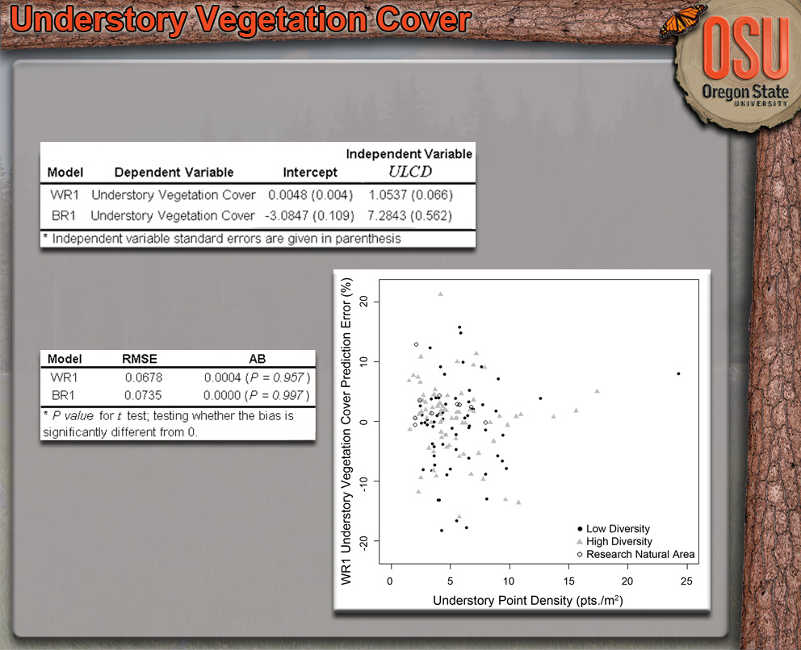
Results
Model Performance Remains Stable to Canopy Cover
  Two Most Likely Causes:
    ULCD, is relative to the number of points that reach the understory.
    The likelihood of encountering understory vegetation decreases with increasing canopy cover for this forest type
Models
LOO Cross Validation
Overall Prediction
Accuracy: ± 22%

Slide 28
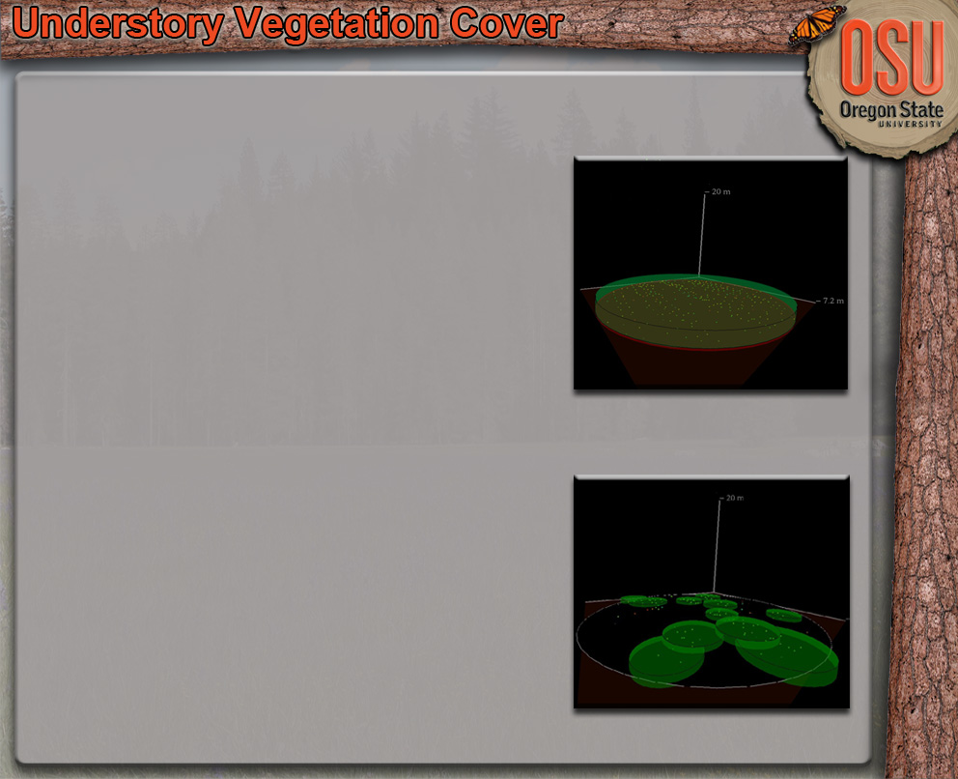
Discussion
Model Comparison
  Both Performed Well
  WR Simpler to Implement
  Might Perform Better w/ Different Models
    Zero-Inflated Beta Regression
Performance Dependent Upon
  Forest Type and Structure
  Intensity Data Quality
    Calibration
    Proportion of First & Single Returns
  Lidar Point Densities
Possible Improvements
  Field Derived Cover Estimates
  New Filtering Methods

Slide 29
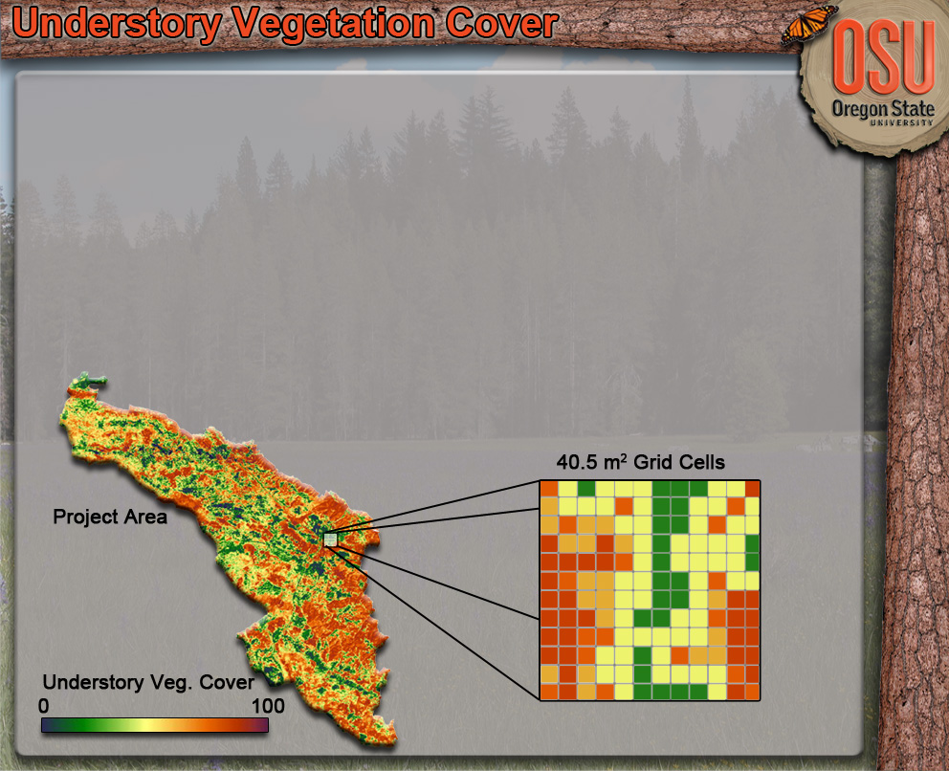
Products
Understory Vegetation Cover Maps
  Traditional Lidar Two-Stage Procedure
  Method Extends into Biomass, Volume and Fuel Characterizations

Slide 30
Applications
Understory Vegetation Cover
  Traditionally Difficult to Estimate & Predict (R² < 0.4)
  Filtered Lidar Metric Increases Explanatory Power (R² > 0.7)
  Cover Prediction ± 22%
Individual Snag Detection
  Traditionally Difficult to Quantify
    Irregular & Sparse Distribution
  Filtering Algorithm Identifies Snag Pts.
  Overall Detection Rate of 70.6% (± 2.9)
    Snags w/ DBH ≥ 38 cm
Live Above-Ground Biomass
  Filtered Point Cloud Improves Prediction

Slide 31
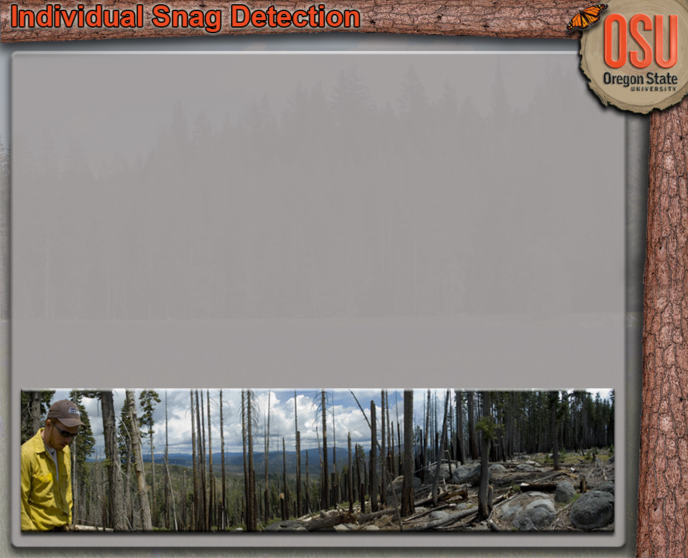
Introduction
Importance
  Wildlife Habitat
  Nutrient Cycling
  Long-Term Carbon Storage
  Key Indicator for Biodiversity
Minimum Stocking Standards
  Common Snag Thresholds: DBH ≥ 25 or 38 cm
Difficult to Quantify
  Distribution Highly Variable
  Requires Intensive Sampling
  Expensive to Sample

Slide 32
Method Overview
Collect Field Snag Stem Map Data
  805 m² Circular Plots (n= 206)(843 Snags)
Extract Height Normalized Plot Lidar Point Clouds
Apply Snag Filtering Algorithm
Create Lidar-Based Snag Stem Map
Compare Snag Stem Maps (Field vs. Lidar)
  Detection & Error Rates

Slide 33
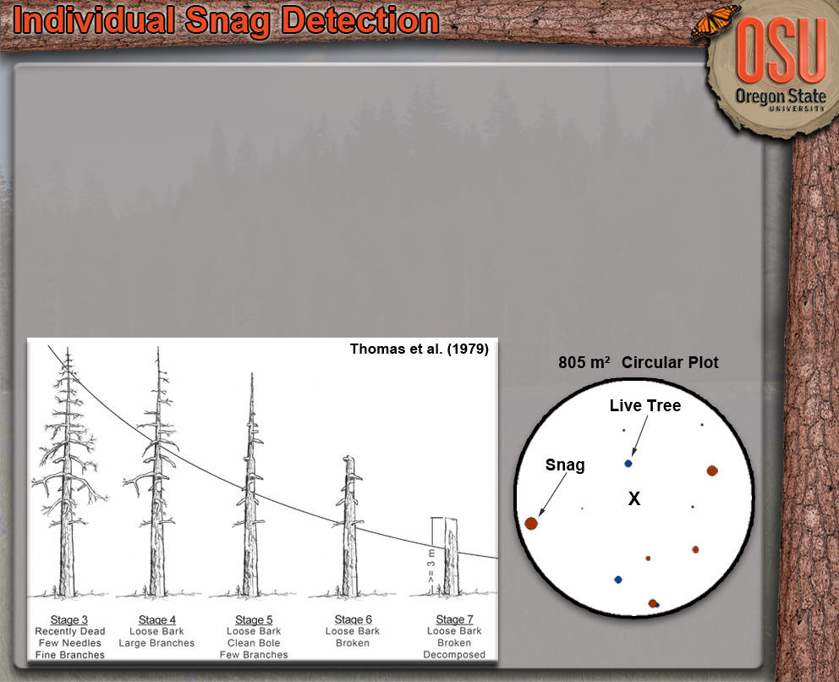
Field Methods
Both BMEF & SF
  BMEF Total Area Sampled: 12.5 ha (805 m² Plots = 154)
  Storrie Total Area Sampled: 4.2 ha (805 m² Plots = 52)
Individual Tree Measurements (DBH ≥ 9 cm) (Height ≥ 3 m)
  Species
  DBH (cm)
  Height (m)
  Location
  Condition Codes
  Snags: Decay Stage

Slide 34
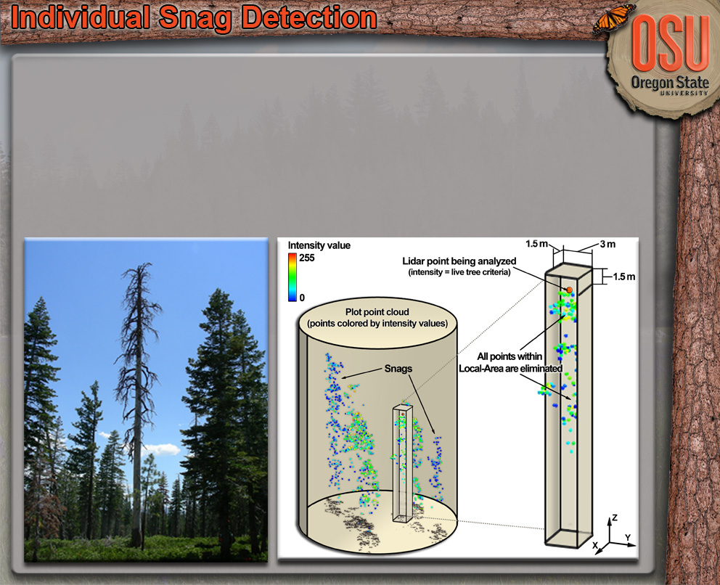
Snag Filtering Algorithm
Identifies Snag Points & Removes Live Tree Points
Local-area 2D & 3D Filters Based on Location and Intensity Values
Final Result: Point Cloud Containing Only Snag Points in the Overstory

Slide 35
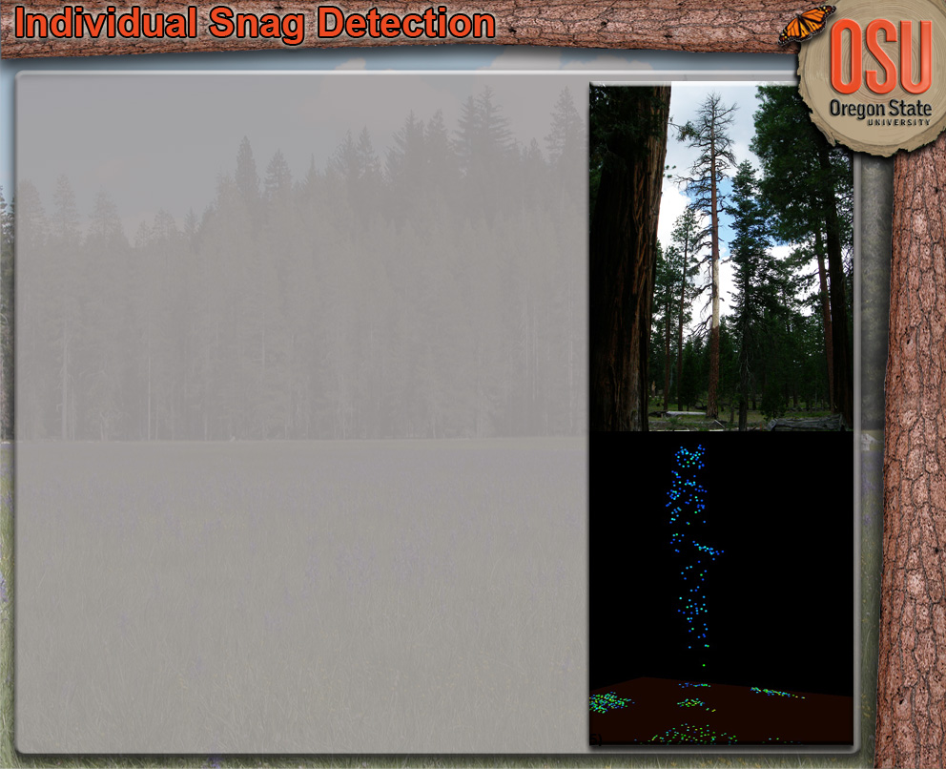
Snag Filtering Algorithm
Intensity Value Characteristics
  Snags
    High Percentage (> 90%) Low Intensity Points
    (0 – 75 i)
      Solid Woody Material (Bark, Bare, Charred)
    Some Snags had Small Percentage ( < 10%) High Intensity Points (> 135 i)
      Solid Bare Seasoned Wood (Light Colored – Reflective)
    Some Snags had Very Small Percentage of (< 10%) of Mid-Range Intensity Points (75 – 135 i)
      Dead Needles or Leaves, Fine Branches, Witches Broom
  Live Trees
    Mix of Low- and Mid- Range Intensity Values (0 – 135 i)
    Small Number of Live Trees had High Intensity Points (> 135 i)
      Trees with Sparse Crowns or Leader Growth

Slide 36
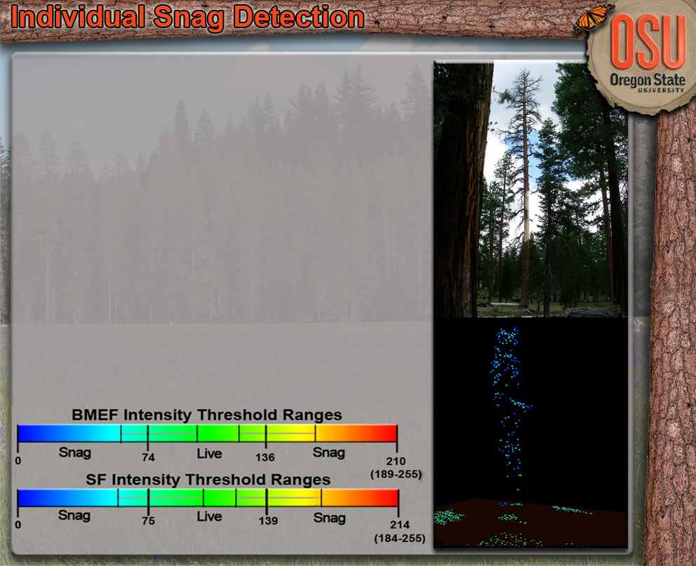
Snag Filtering Algorithm
Lower & Upper Intensity Thresholds
Two Stages with Multiple Filters
  Elimination Stage
    Three 3D Filters to Remove Live Tree Points
  Reinstitution Stage
    Coarse-Scale 2D & 3D Filter
    Fine-Scale 2D Filter

Slide 37
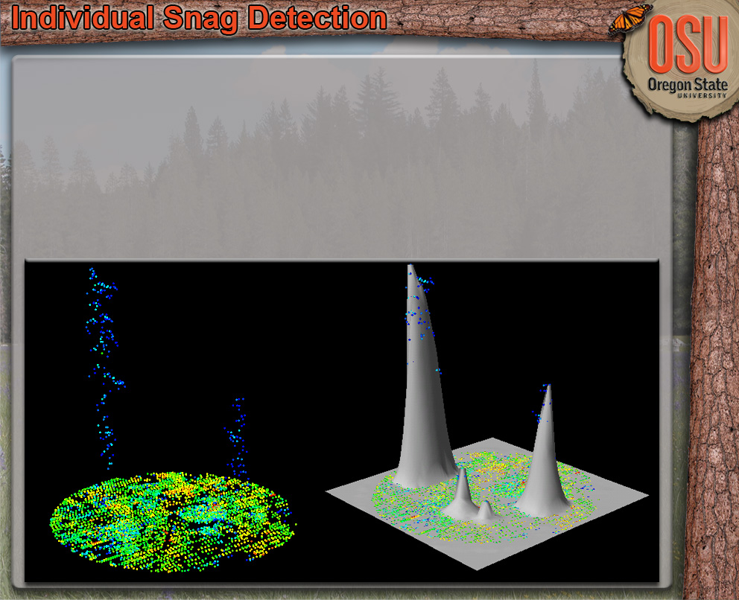
Individual Snag Detection
Create Canopy Height Surface Model
  ‘CanopyModel’ Program in Fusion Software Package
Locate & Measure Individual Snags
  ‘CanopyMaxima’ Program in Fusion Software Package

Slide 38
Individual Snag Detection
Detection Criteria
  Within 2.5 m for Snags with Height < 9 m
  Within 4 m for Snags with Height ≥ 9 m
Error Rates
  Commission Error = Detected Snag when No Snag
  Omission Error = Undetected Snag

Slide 39
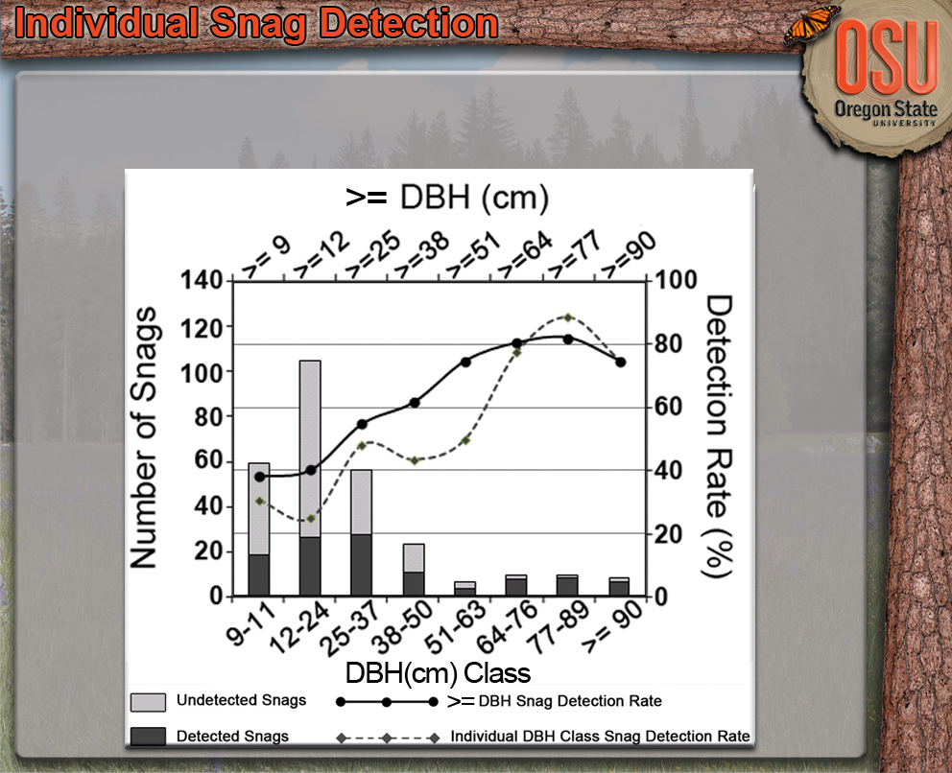
BMEF Detection Rates
  ≥ 25 cm DBH Minimum Stocking Threshold 58% (± 4.3%)
  ≥ 38 cm DBH Minimum Stocking Threshold 62% (± 5.8%)

Slide 40
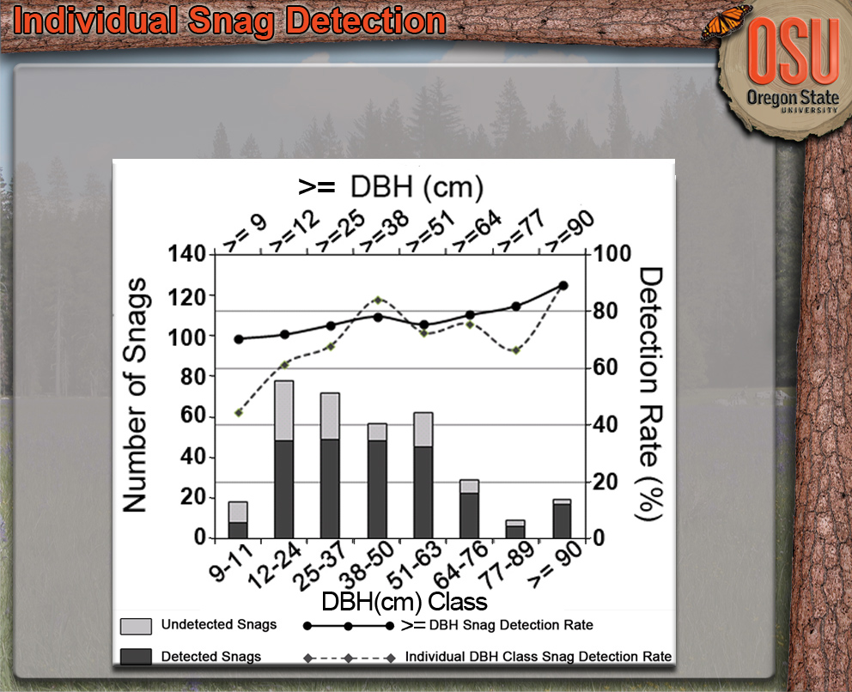
Storrie Fire Detection Rates
  ≥ 25 cm DBH Minimum Stocking Threshold 76% (± 3.5%)
  ≥ 38 cm DBH Minimum Stocking Threshold 79% (± 4.6%)

Slide 41
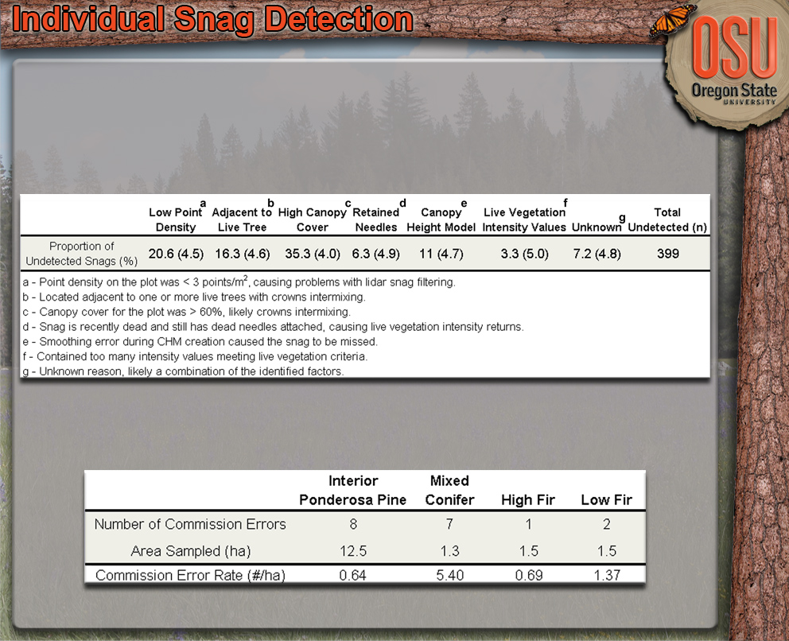
Results
Omission Errors
Commission Errors

Slide 42
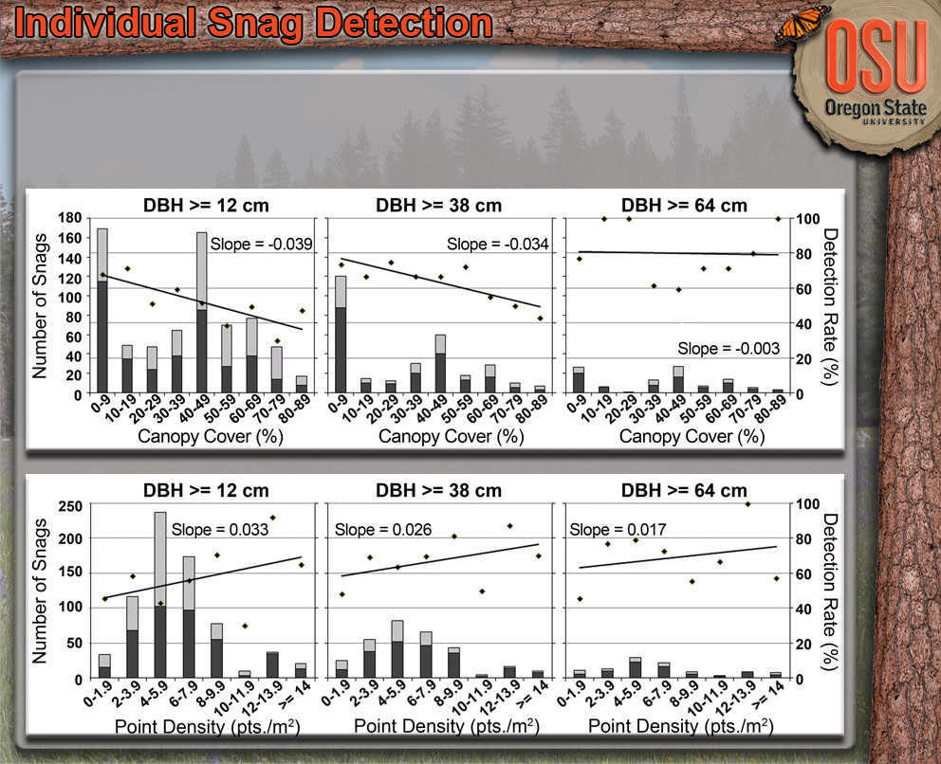
Detection Rate Trends

Slide 43
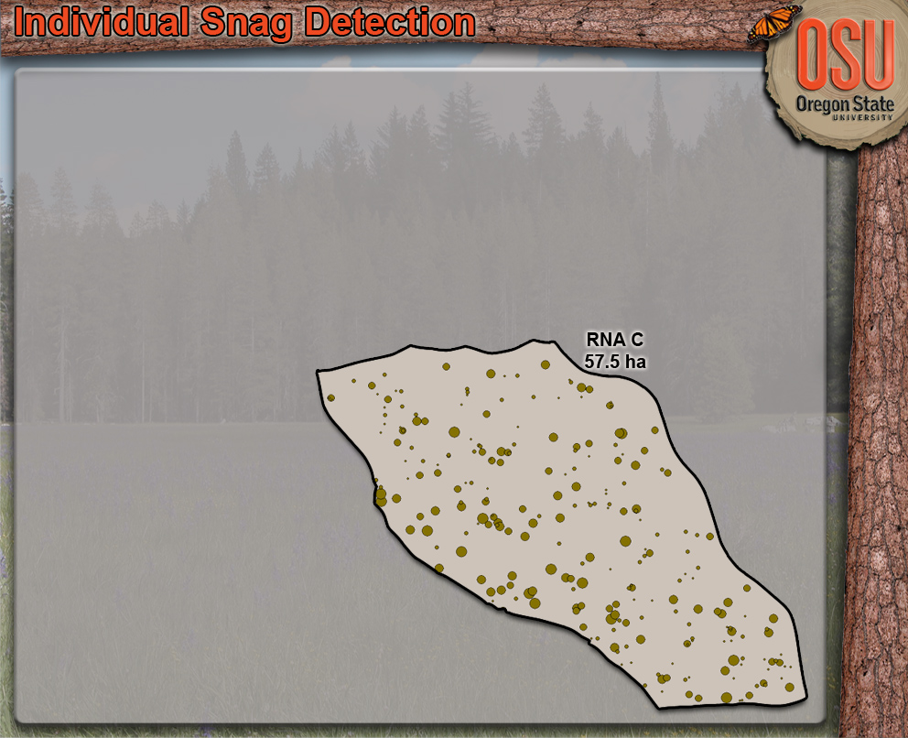
Products
Snag Spatial Distribution
  Never Been Available w/out Intensive Sampling
  Many Forest Management & Assessment Applications
    Spatial Arrangement Assessments
    Wildlife Interactions
    Changes Over Time
Snag Density Estimates
  Stocking Standard
  Assessments & Clarity

Slide 44
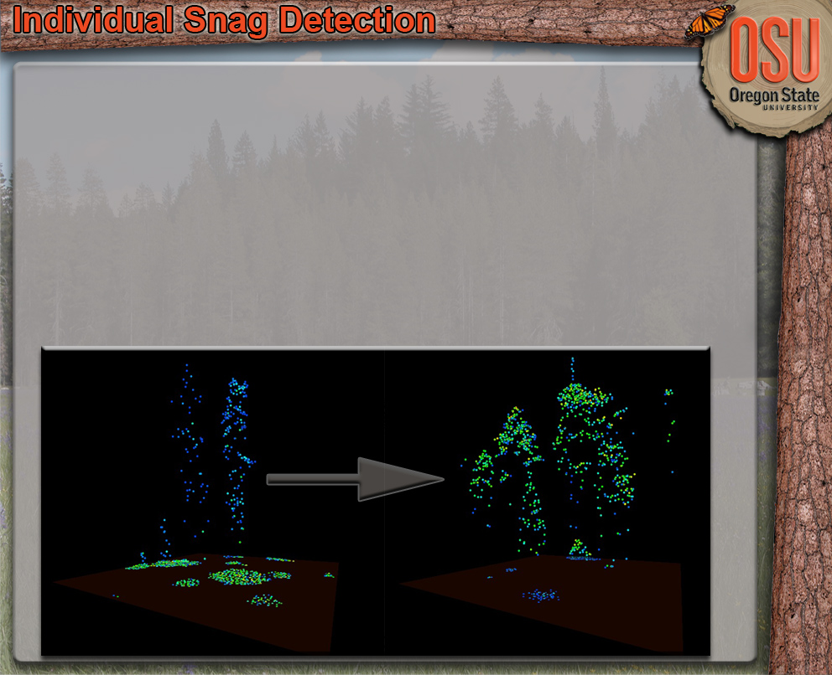
Conclusions
Filtering Affected By:
  Lidar Intensity Data Quality & Point Density
  Forest Structure & Canopy Density
New Filtering Methods Abound
Interesting Bi-Product: “Live Tree” Points

Slide 45
Applications
Understory Vegetation Cover
  Traditionally Difficult to Estimate & Predict (R² < 0.4)
  Filtered Lidar Metric Increases Explanatory Power (R² > 0.7)
  Cover Prediction ± 22%
Individual Snag Detection
  Traditionally Difficult to Quantify
    Irregular & Sparse Distribution
  Filtering Algorithm Identifies Snag Pts.
  Overall Detection Rate of 70.6% (± 2.9)
    Snags w/ DBH ≥ 38 cm
Live Above-Ground Biomass
  Filtered Point Cloud Improves Prediction

Slide 46
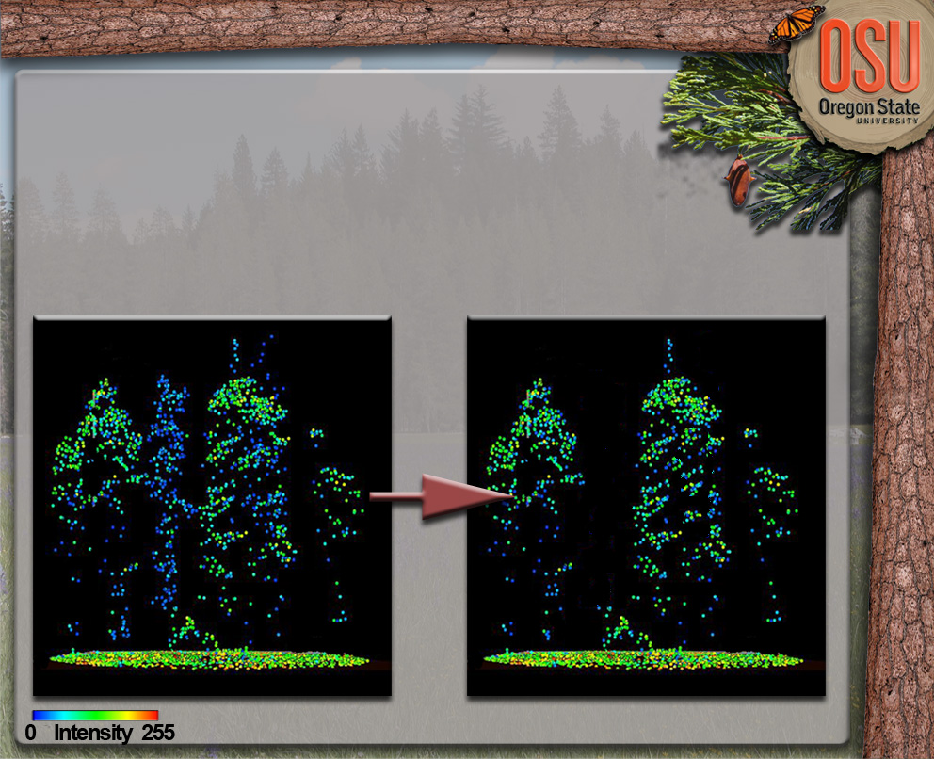
Methods
Compare Two Lidar Derived Metric Sets in Prediction of Live AGB
  Traditional
  Live-Tree (Dead Tree Points Filtered & Removed)
Regression Models Compared using Selection & Cross-Validation Statistics

Slide 47
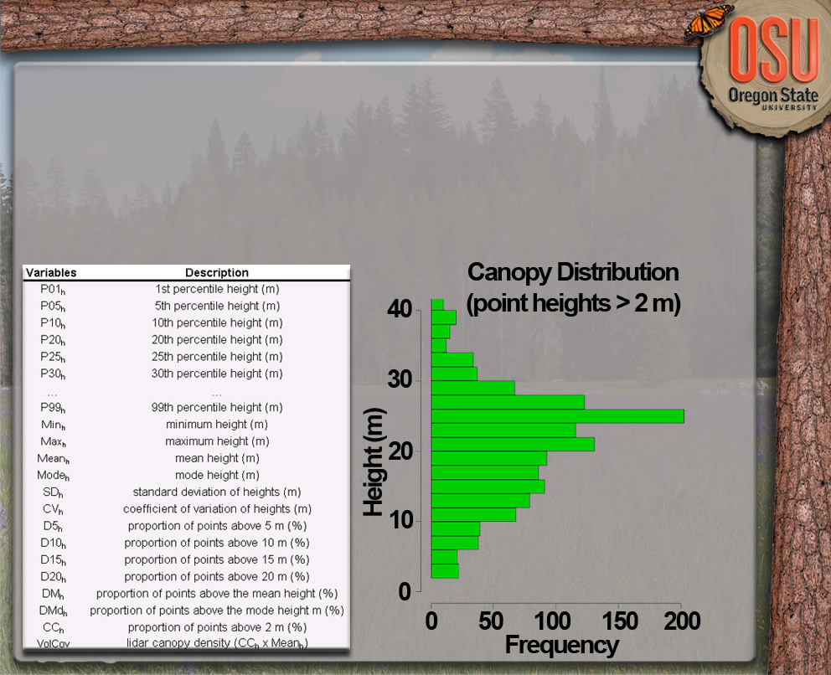
Lidar Biomass Methods
Airborne LiDAR Plot-Level AGB Prediction
  Derive a Myriad of Lidar Canopy Point Height Distribution Metrics
  Fit, Select, & Apply the Models

Slide 48
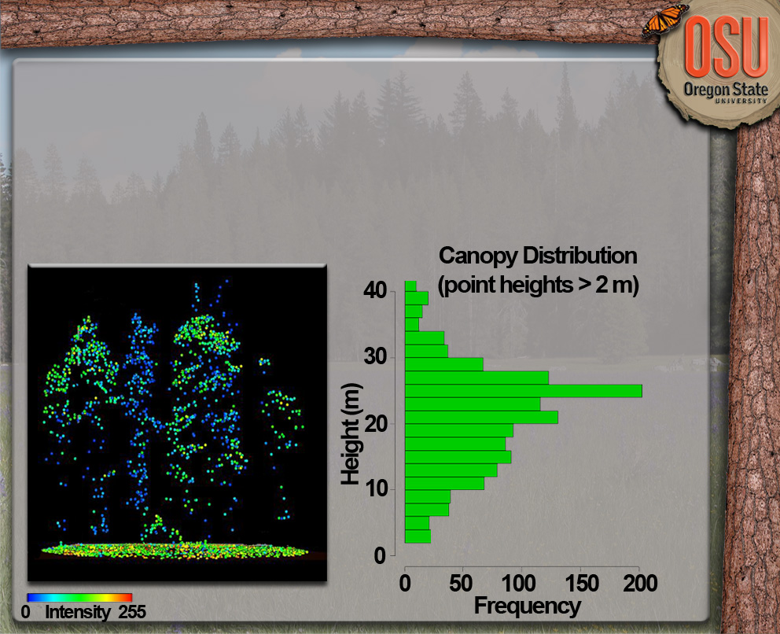
Lidar Biomass Methods
Airborne LiDAR Plot-Level AGB Prediction
  Dead Tree Lidar Points Introduce Variability into Live AGB Models

Slide 49
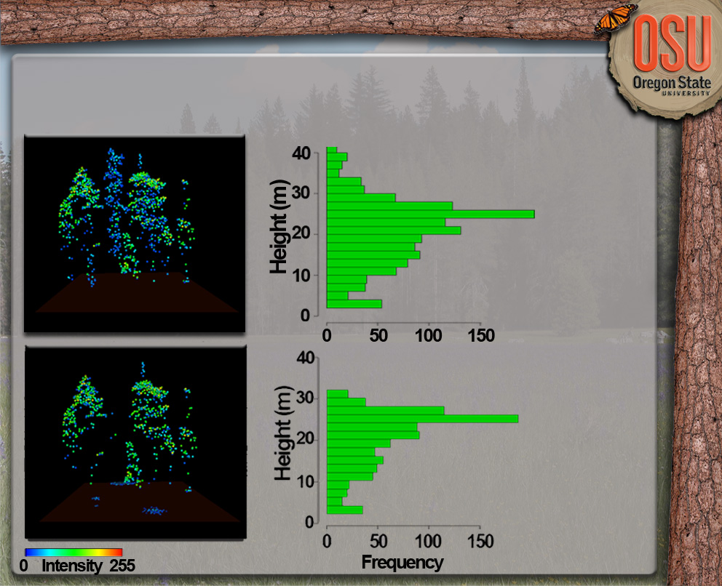
Results
ln(LiveAGB) = β₀ + β₁ln(VolCov) + ε
VolCov = Lidar Canopy Cover * Lidar Mean Height
VolCov = 615
VolCov = 444

Slide 50
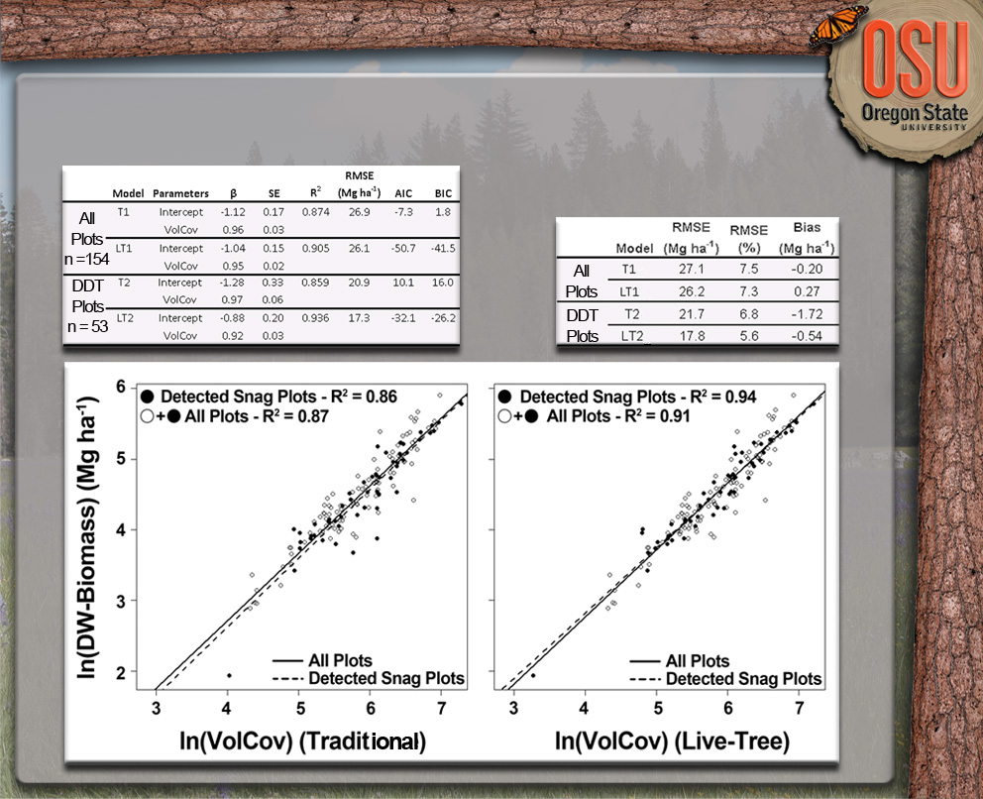
Results
Model Fit Statistics
LOO Cross Validation Statistics

Slide 51
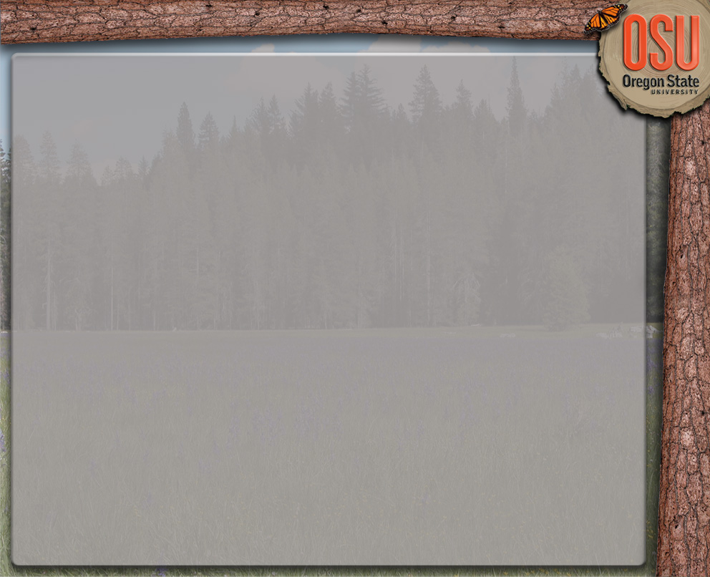
Discussion
Point-Filtered Lidar Metrics (‘Live-Tree’) Reduced Variability
First Try… New Point-Filtering Methods Possible
Ability to Filter Points is Dependent on:
  Intensity Data Quality
    First & Single Returns Only!
  Point Density
  Forest Structure & Canopy Density
Future Work: Edge Point Filters & Weighting Schemes

Slide 52
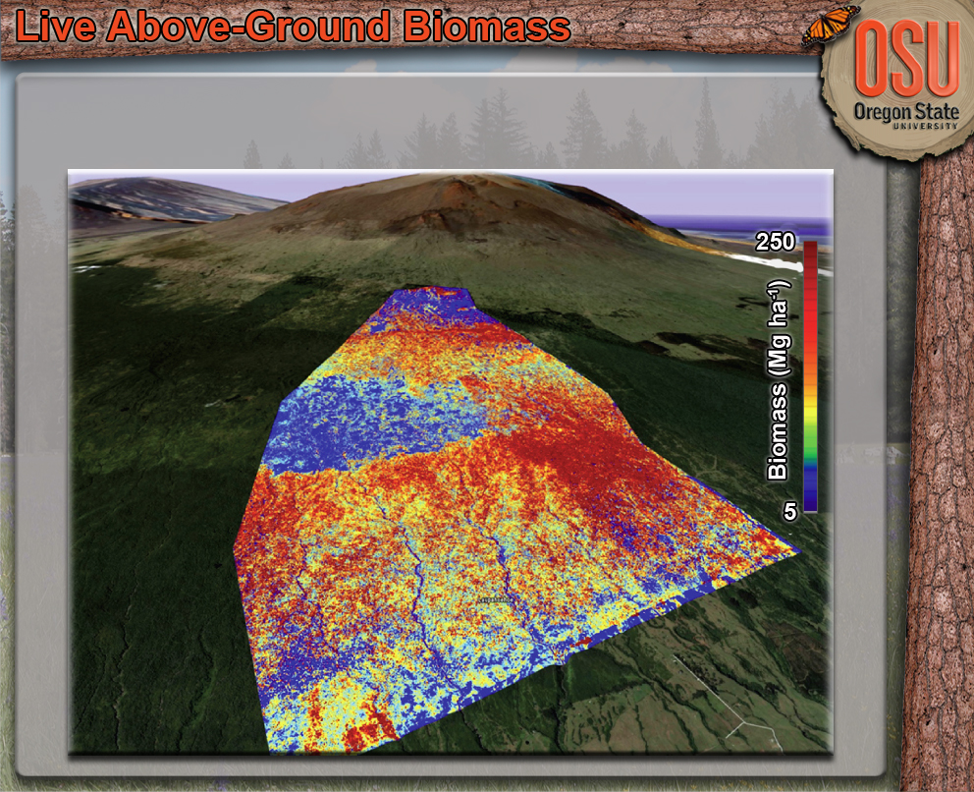
Products

Slide 53
Applications Summary
Demonstrates the Ability of Airborne Discrete-Return Lidar to Identify & Predict Unique Forest Attributes
Filtering Point Clouds Using Intensity and Location Information Provides Enhanced Framework
Possible Improvements:
  Calibrated Intensity Information
  New Filtering Methods
  Hyper- or Multi-spectral Imagery
  Small-Footprint Full-Waveform Lidar

Slide 54
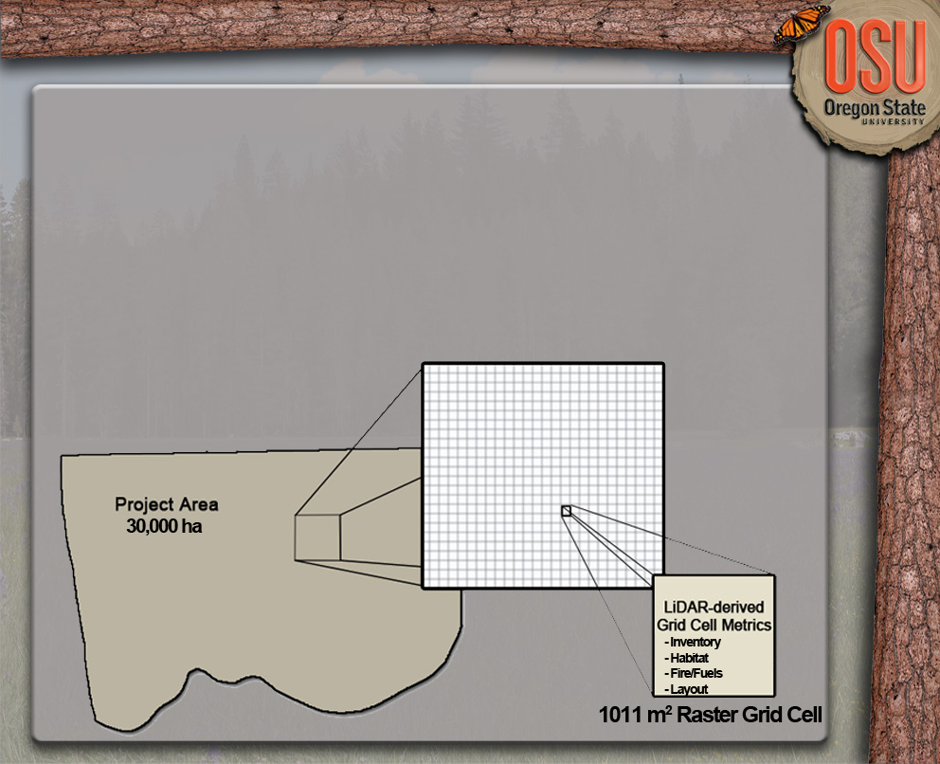
Current Work
Lidar Derived Information Can Successfully Predict Numerous Forest Attributes of Importance
  More Applications Developing Rapidly
Time to Incorporate into Forest Planning & Monitoring

Slide 55
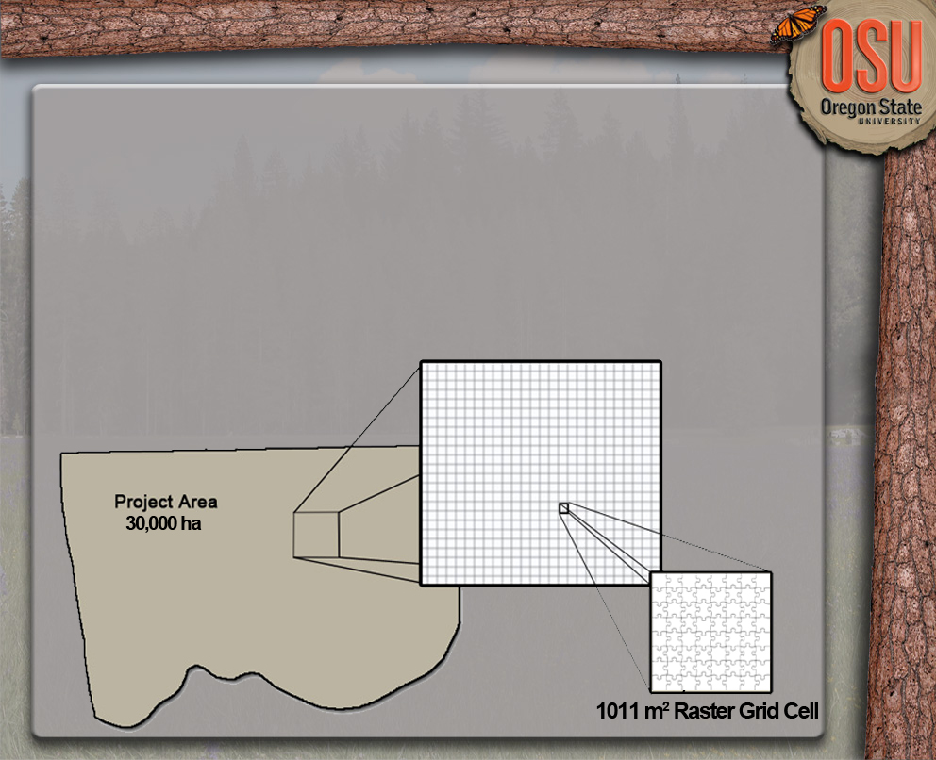
Current Work
Lidar Derived Information Can Successfully Predict Numerous Forest Attributes of Importance
  More Applications Developing Rapidly
Time to Incorporate into Forest Planning & Monitoring

Slide 56
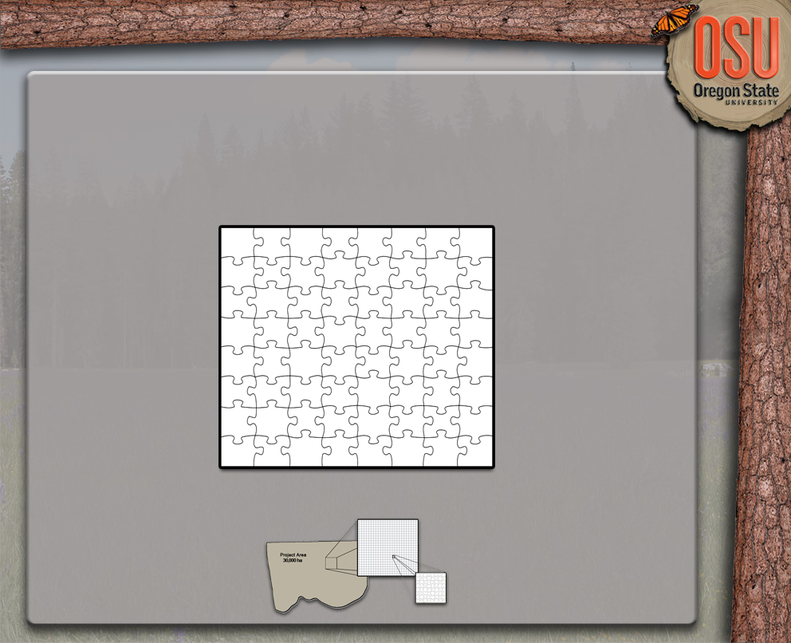
0.1011 ha Raster Grid Cell

Slide 57
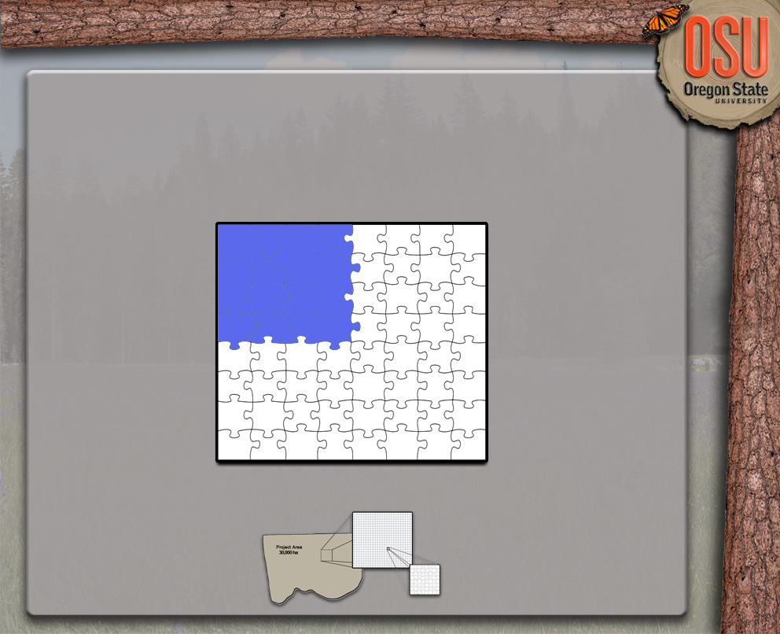
Forest Inventory
  Biomass / Volume
  BA
  Mean & Max Tree Height
  Canopy Cover & Closure
  Crown Class
  LAI
  QMD
  TPA
  FVS Tree List
  …
0.1011 ha Raster Grid Cell

Slide 58
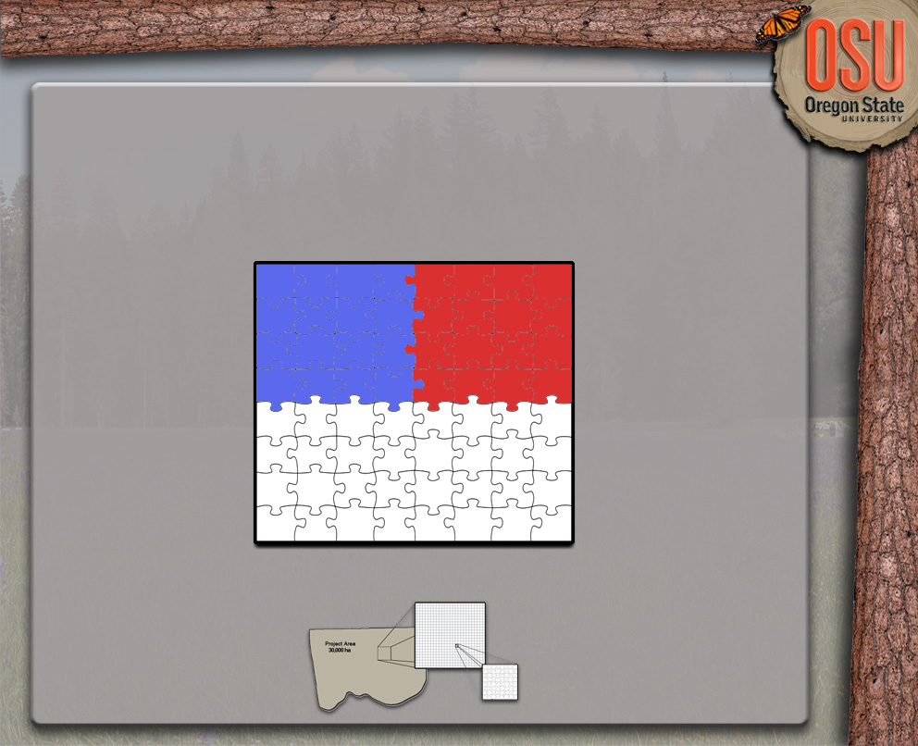
Forest Inventory
  Biomass / Volume
  BA
  Mean & Max Tree Height
  Canopy Cover & Closure
  Crown Class
  LAI
  QMD
  TPA
  FVS Tree List
  …
Fire/Fuels
  Canopy Fuel Weight
  Canopy Bulk Density
  Canopy Base Ht.
  Canopy Cover
  Mean & Max Ht.
  Ladder Fuels
  Surface Fuels
  …
0.1011 ha Raster Grid Cell

Slide 59

Forest Inventory
  Biomass / Volume
  BA
  Mean & Max Tree Height
  Canopy Cover & Closure
  Crown Class
  LAI
  QMD
  TPA
  FVS Tree List
  …
Fire/Fuels
  Canopy Fuel Weight
  Canopy Bulk Density
  Canopy Base Ht.
  Canopy Cover
  Mean & Max Ht.
  Ladder Fuels
  Surface Fuels
  …
0.1011 ha Raster Grid Cell
Wildlife Habitat
  Canopy Cover
  Canopy Structure
  Large Tree Counts (Live & Dead)
  Understory Shrub Cover
  CWD Presence
  Suitability Rating
  …

Slide 60

Forest Inventory
  Biomass / Volume
  BA
  Mean & Max Tree Height
  Canopy Cover & Closure
  Crown Class
  LAI
  QMD
  TPA
  FVS Tree List
  …
Fire/Fuels
  Canopy Fuel Weight
  Canopy Bulk Density
  Canopy Base Ht.
  Canopy Cover
  Mean & Max Ht.
  Ladder Fuels
  Surface Fuels
  …
0.1011 ha Raster Grid Cell
Other
  Topographic
  Ecological
  Operational
  …
Wildlife Habitat
  Canopy Cover
  Canopy Structure
  Large Tree Counts (Live & Dead)
  Understory Shrub Cover
  CWD Presence
  Suitability Rating
  …

Slide 61
Current Work
High-Resolution Lidar-Derived Raster Dataset
  Provides Foundation to Optimize Forest Planning While Meeting Multiple Goals
  Possible to Add New Applications to Older Lidar Datasets
  Multiple Flights Will Likely Provide New Opportunities for G&Y Modeling

Slide 62

Email: brianwing@fs.fed.us

