Slide 1


Model Validation using the SMC Database
Growth Model Users Group
November 15, 2013
Greg Johnson
Weyerhaeuser NR Company

Slide 2
Acknowledgements
Eric Turnblom (SMC)
David Marshall (WY)
Erin Smith-Mateja (USFS)
Peter Gould (WA DNR)

Slide 3
Objectives
Illustrate one of many potential valuable uses of the SMC Database.
Validate two commonly used and publically available growth models against the largest cooperative dataset on Douglas-fir and western hemlock growth and yield.
Spark a discussion.

Slide 4
Approach
Use the SMC Database to extract complete growth records for untreated plots retaining the longest continuous period of remeasurement without treatment.
  Treatments excluded include: thinning and fertilization.
  Remeasurement intervals can be any length.
  There must be complete tree measurements (or a sufficient sub-sample to impute missing measurements).
Validate the growth models using a First-to-Last validation scheme.
  Growth Models considered:
    ORGANON v9.1 SMC Variant
    FVS PN Variant Region 612

Slide 5
First-to-Last Validation
What is it?
  Passes initial plot measurements to the growth model and projects the plot through time, periodically comparing the projected plot to remeasurement data without re-informing the model with new measurement data.
Why use it?
  Most challenging test for a growth model.
  Mimics many typical applications:
    Harvest planning
    Appraisal
  Test the SMC data set and uncover inconsistencies.

Slide 6
Example
Model gets progressively
further off over time for this
plot.
Oops!
Model stays relatively
unbiased over time
Every plot starts here

Slide 7
The Data
“Control” Plots: 2,482
“Control” Plots after filtering for known treatments: 1,770
Plots after merging with age, site index, and location information: 485
Plots greater than 10 years old: 451
Plots that made it through the models (no heavy in-growth, no unrecorded thinnings): 393
Growth Intervals to test: 2,532

Slide 8
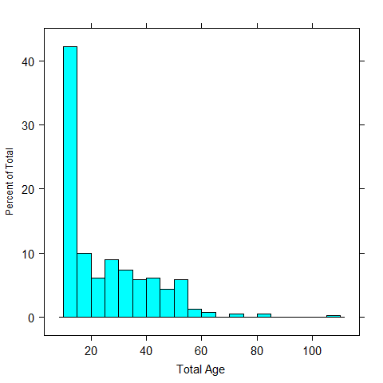
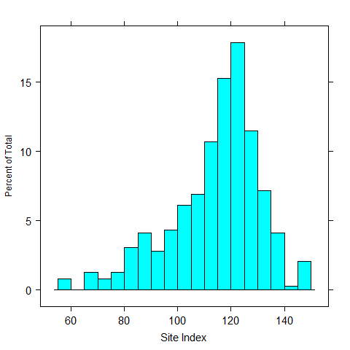
Initial Conditions

Slide 9
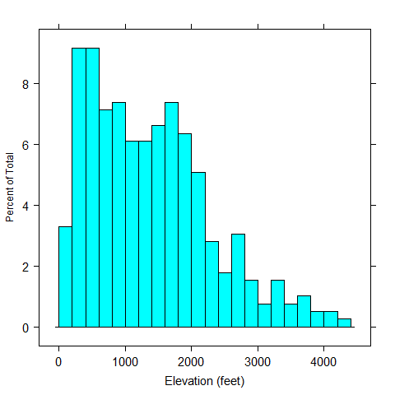
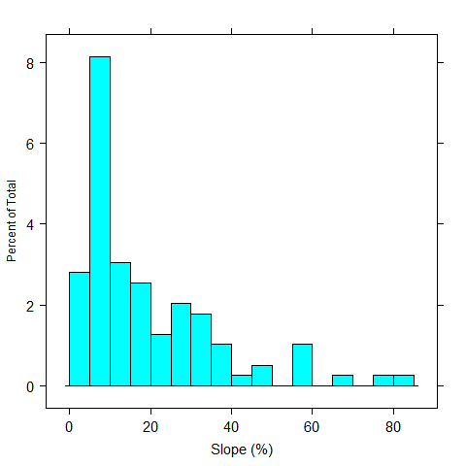
Initial Conditions

Slide 10
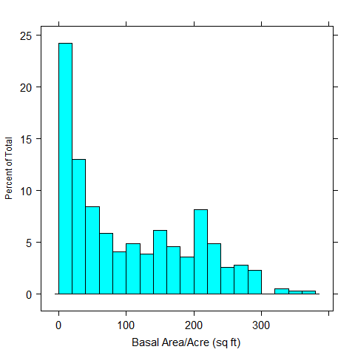
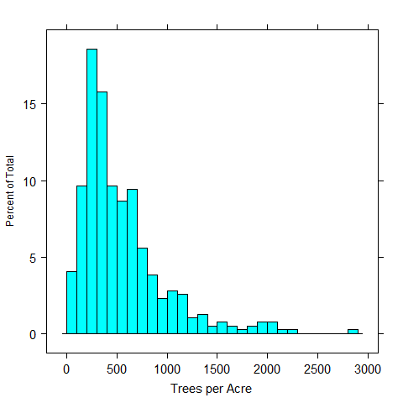
Initial Conditions

Slide 11
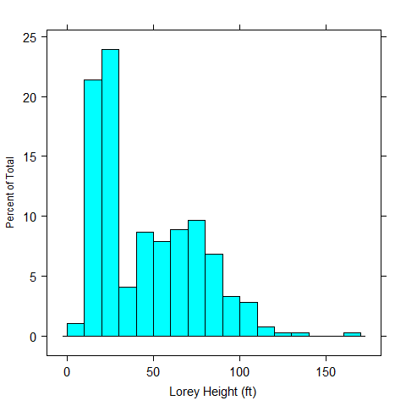
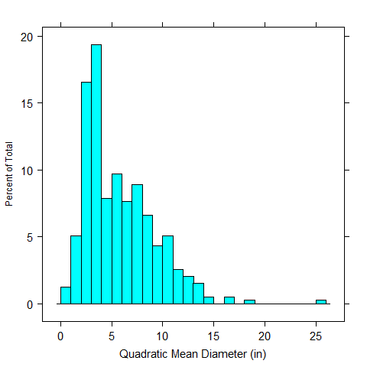
Initial Conditions

Slide 12
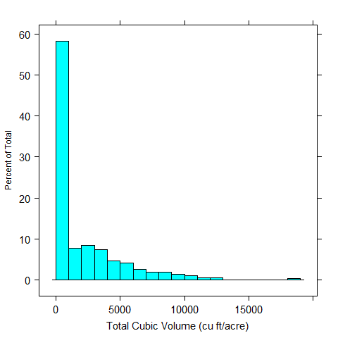
Initial Conditions

Slide 13


The Models
Model variants tested:
  ORGANON v9.1 SMC Variant
  FVS PN Variant region 612 (compiled from Open-FVS repository)
Coded an R interface to each model and the SMC database.
Imputed height and height-to-live-crown for trees with missing measurements.
Plots with measurement records where no heights or crowns were measured were dropped.
Used elevation, slope, aspect, and Douglas-fir 50 year site index as needed for each model.

Slide 14
Results

Slide 15
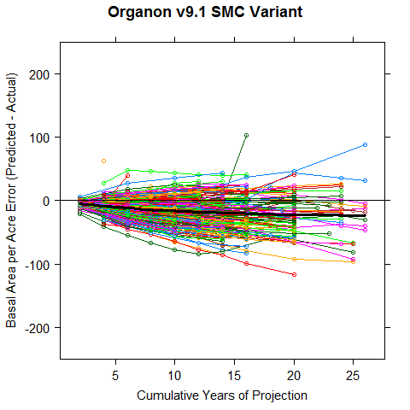
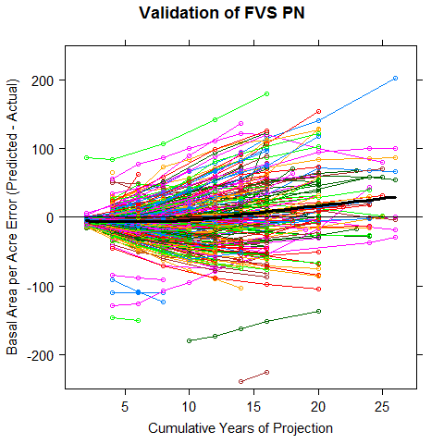
Results – Basal Area

Slide 16
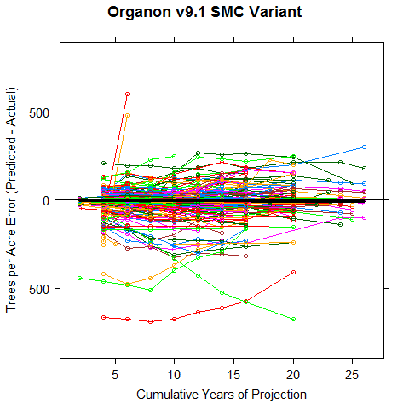
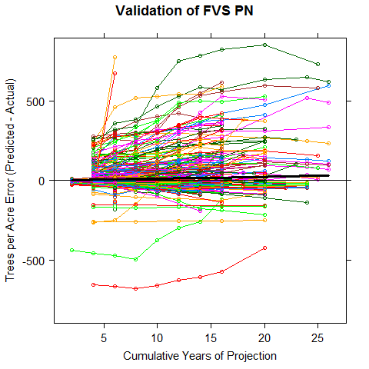
Results – Trees per Acre

Slide 17
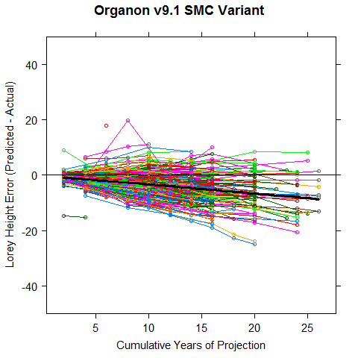
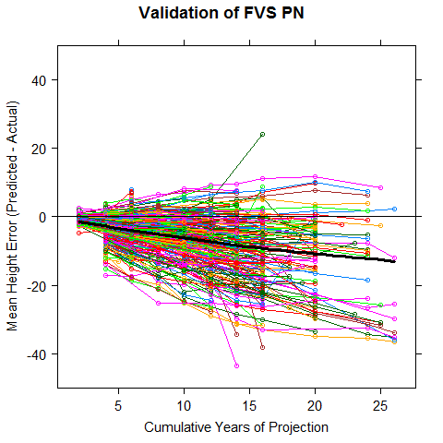
Results - Height
Note that the ORGANON results use Lorey Height and FVS uses Mean Height

Slide 18
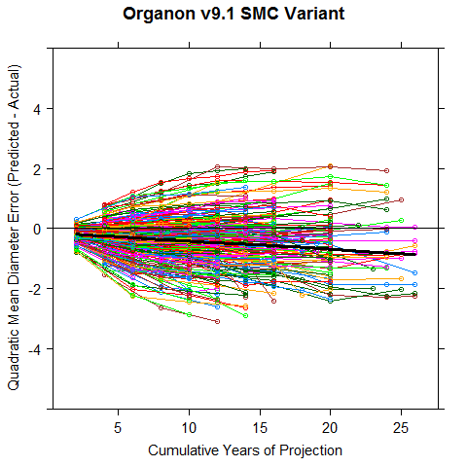
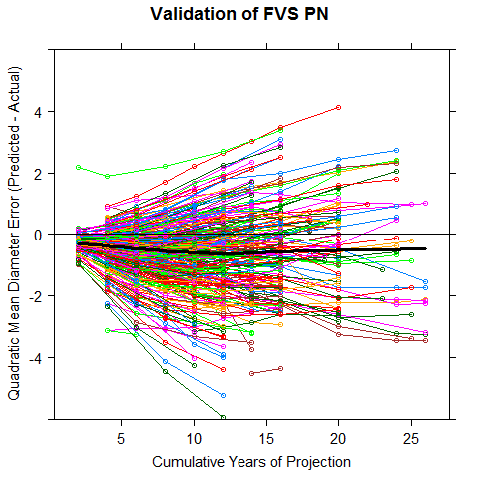
Results – Dq

Slide 19
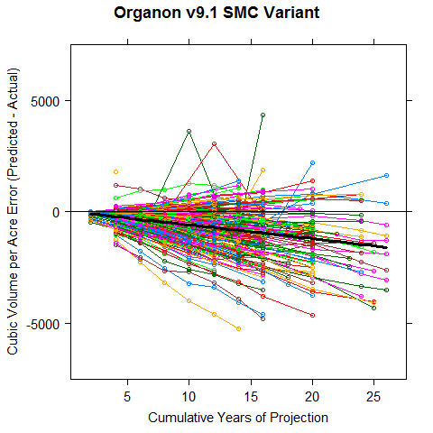
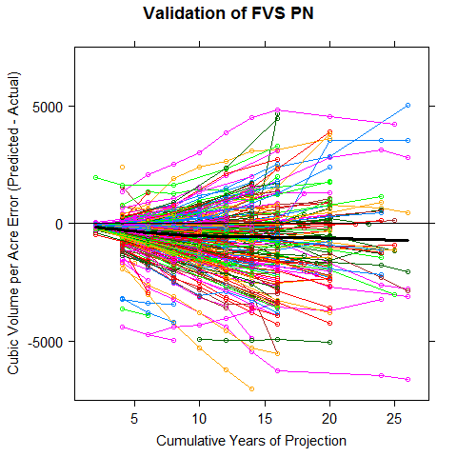
Results – Total Cubic Volume

Slide 20
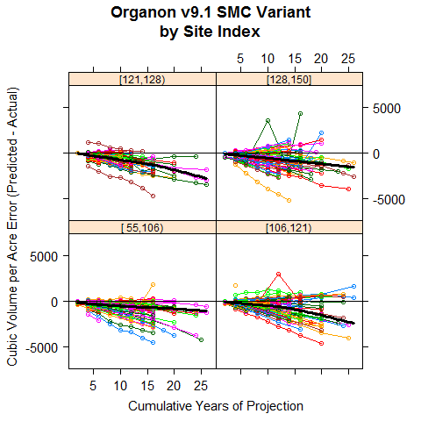
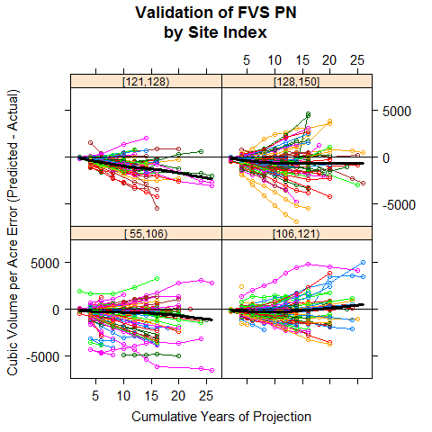
Results – Total Cubic Volume

Slide 21
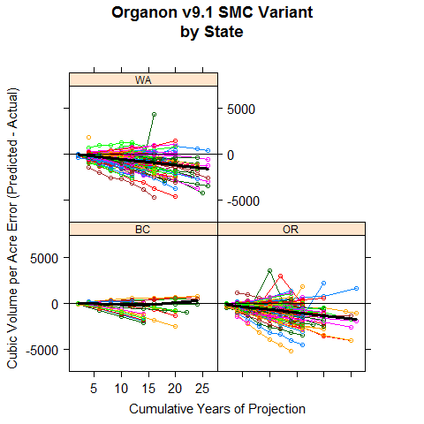
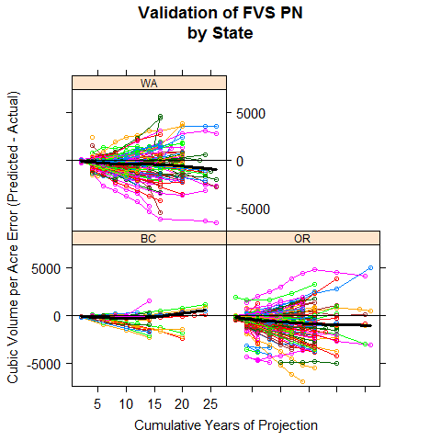
Results – Total Cubic Volume

Slide 22
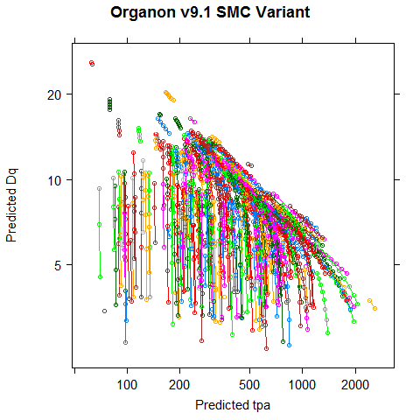
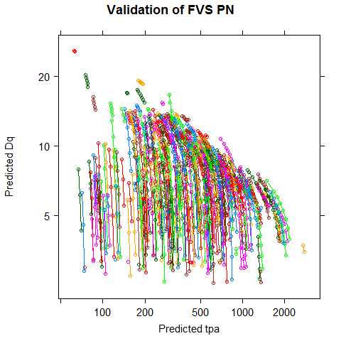
Results –
Stand Density Management Diagram

Slide 23
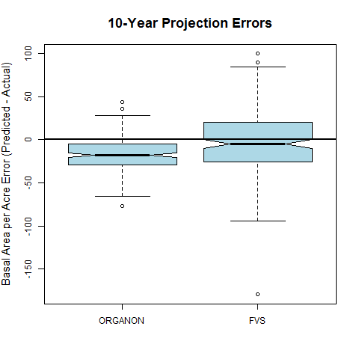
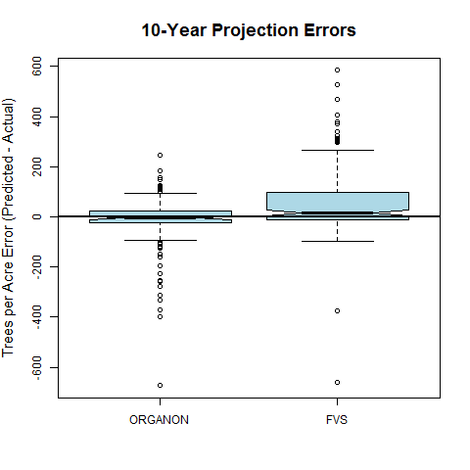
Results – 10-Year Projection Errors

Slide 24
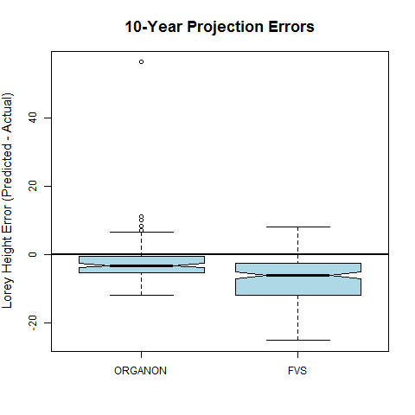
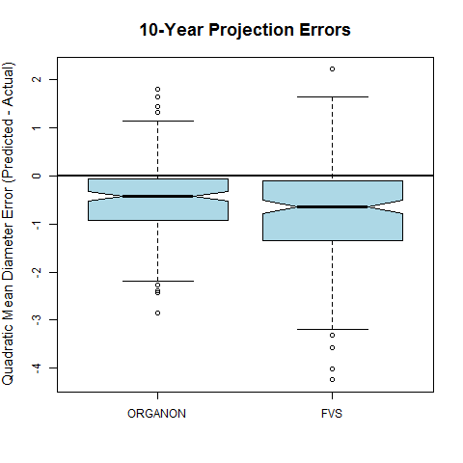
Results – 10-Year Projection Errors

Slide 25
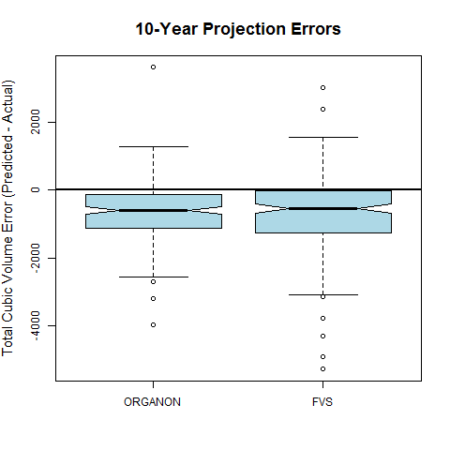
Results – 10-Year Projection Errors

Slide 26
Model Error Comparison
Do the models commit the same errors on the same plots?
Are the magnitude of the errors similar?

Slide 27
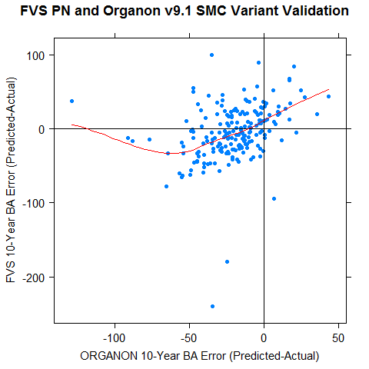
Model Error Comparison

Slide 28
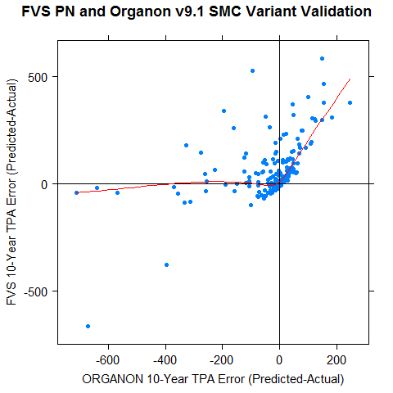
Model Error Comparison

Slide 29
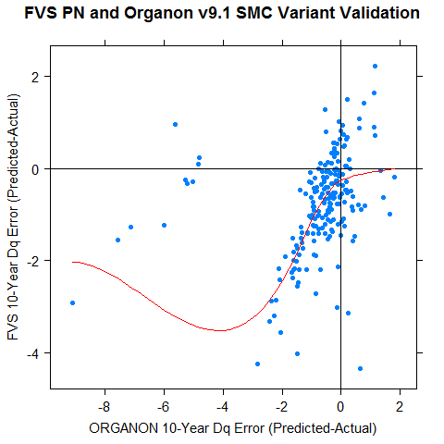
Model Error Comparison

Slide 30
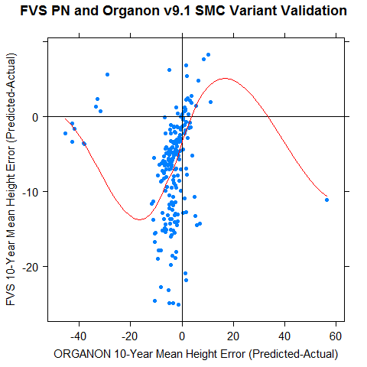
Model Error Comparison

Slide 31
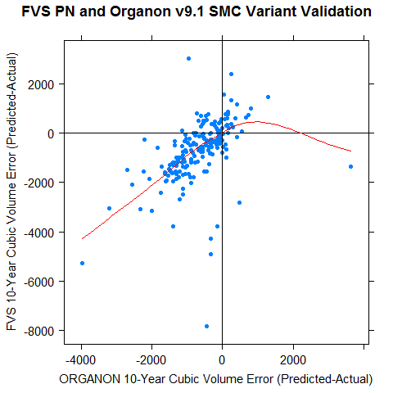
Model Error Comparison

Slide 32
Conclusions
The SMC data base:
  is a significant resource for Douglas-fir growth under management.
  has a number of inconsistencies in treatment records, site index, and other details that should be fixed and would enhance the value of the data base.

Slide 33
Conclusions
The Models:
  Both models are relatively stable over long projection periods, with ORGANON slightly more precise than FVS.
  Biases in height growth are common to both models and may in part be a reflection of site index errors.
  Mortality is low in managed Douglas-fir stands and is predicted well by both models, with FVS exhibiting a higher effective Max SDI.
  Both models produced a under-estimate of volume growth over time with larger height growth errors in FVS balancing over-predictions of diameter growth.
  The biases in both models argue for an new model-building effort based on currently available data.
Thinning and Fertilization need to be validated next!

Slide 34

The End / What’s Next
To Infinity and Beyond!

