Slide 1
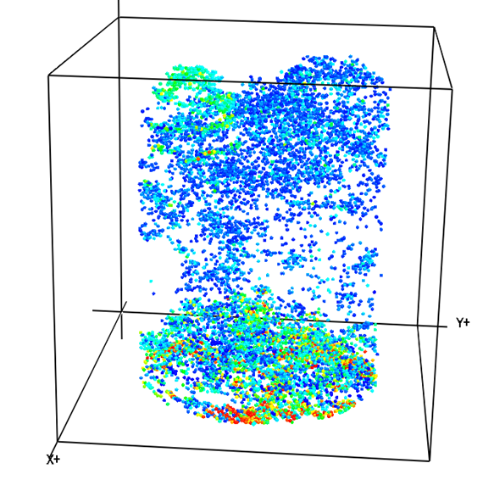
Properties of a kNN tree-list imputation strategy for prediction of diameter densities from lidar
Jacob L Strunk
Jacob.Strunk@oregonstate.edu
Nov 15, 2013

Slide 2
Note
“Diameter Density” in this context is referring to the probability density function
  Proportion of trees in a diameter class (dcl)
p(d)
dcl (cm)

Slide 3
Please!
Share your critiques
It will help the manuscript

Slide 4
Overview
Conclusion
Context
kNN Tree List – some background
Study objectives
Indices of diameter density prediction performance
Results
Conclusion Revisited

Slide 5
Conclusion
kNN diameter density estimation with LiDAR was comparable with or superior (precision) to a Post-stratification approach with 1600 variable radius plots
  Equivalent: Stratum, Tract
  Superior: Plot, Stand
Mahalanobis with k=3, lidar P30 and P90 metrics worked well
Stratification did not help – may be due to sample size (~200)

Slide 6
Aside: Brief Survey
Who uses diameter distributions in day to day work?
For distribution users: Inventory type? - Stand, Stratum, 2-stage, lidar …
Approach? – parametric, non-parametric
Sensitivity to noise in distribution? – Very, not very, what noise
What measure of reliability do you use for diameter information?
  Index of fit
  P-value
  None
  CIs for bins
  Other
p(d)
dcl (cm)

Slide 7
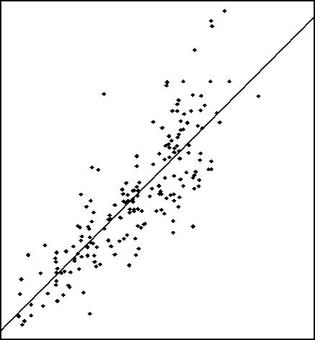
Study Context
Lidar approaches can support many applications in forest inventory and monitoring
But
- Diameter densities are required for forestry applications
- Lidar literature (on diameters) unclear on performance
Problems:
  Performance measures: p-values & indices*
  No comparisons with traditional approaches
  No Asymptotic properties
Field-Derived y
Lidar x
*I am OK, with indices, but the suggested indices may not be enough

Slide 8
kNN – a flexible solution
Multivariate
Conceptually simple
Works well with some response variables
Realistic answers (can’t over-extrapolate)
Can impute a tree list directly (kNN TL)
  No need for theoretical distribution

Slide 9
KNN weaknesses
Error statistics often not provided
Sampling inference not well described in literature
People don’t understand limitations in results
Can’t extrapolate
Imputed values may be noisier than using mean…
Poorer performance than OLS (NLS) usually

Slide 10

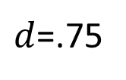
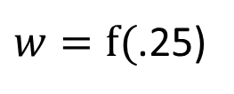
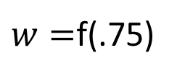
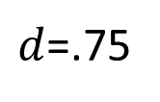
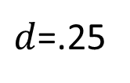
kNN TL Imputation
  Plot Color = x values
Impute: Substitute for a missing value
Measure X everywhere (U)
Measure Y on a sample (s)
Find distance from s to U
  In X space – height, cover, etc.
Donate y from sample to nearest (X space) neighbors
  Bring distance-weighted tree list
Auxiliary Data
Forest (e.g.)
$w=$f(.75)
$d$=.75
$d$=.75
$d$=.25
$w=f($.25)

Slide 11
kNN Components
k (number of neighbors imputed)
Distance metric (Euc., Mah., MSN, RF)
Explanatory variables
  Age, Lidar height, lidar cover, FWOF (modeled)
Response variables (only for MSN and RF)
  Vol, BA, Ht, Dens., subgroups (> 5 in., > …)
Stratification – dominant species group (5)
  Hardwood, Lobl. Pine, Longl. Pine, Slash P.,

Slide 12
Distance Metrics
I assume this means shifted and rescaled.
yaImpute documentation:
“Euclidean distance is computed in a normalized X space.”
“Mahalanobis distance is computed in its namesakes space.”
“MSN distance is computed in a projected canonical space.”
“randomForest distance is one minus the proportion of randomForest trees where a target observation is in the same terminal node as a reference observation”
normalized
Notes:
“Normalized”: I assume this means shifted and rescaled.

Slide 13
Study Objectives
Enable relative, absolute, comparative inference for diameter density prediction
Contrast kNN and TIS performances
Evaluate kNN strategies for diameter density prediction
“Traditional” inventory system
TIS
Notes:
Define TIS

Slide 14
“Enable relative, absolute, comparative inference”
I will argue that we have already settled on some excellent measures of performance:
  Coefficient of determination (R²)
  Root mean square error (RMSE)
  Standard error (sample based estimator of sd of estimator)
Very convenient for inference
Straight forward to translate to diameter densities…

Slide 15
Indices – Residual Computation
Computed with Leave One Out (LOO) cross-validation
LOO cross-validation
  Omit one plot
  Fit model
  Predict omitted plot
  Compute error metric (observed vs predicted)
  Repeat n-1 times
  After LOO cross-validation
  Compute indices from vector of residual

Slide 16
Proposed Indices – index I
Similar to coefficient of determination
  Relative inference
Variability of predictions around observed densities
Variability around population density

Slide 17
Proposed Indices – index K
Similar to model RMSE
  absolute (and comparative) inference

Slide 18
Proposed Indices – index k_{n}
Similar to standard error (estimated sd of estimator)
  comparative inference

Slide 19
Why these indices
Index I
  Intuitive inference: how much variation did we explain
  Doesn’t work well when comparing 2 designs…
Index K
  an absolute measure of prediction performance that to compare models from different sampling designs
Index k_{n}
  Look at asymptotic estimation properties with different designs and modeling strategies

Slide 20
Study Area
Savannah River Site – South Carolina
  200 k acres & wall to wall lidar
  ~200 FR plots (40 trees / plot on average)
  1600 VR plots (10 trees / plot on average)

Slide 21
FR Design
200 Fixed radius 1/10th or 1/5th acre plots
Distributed across size and species groups
Survey-grade GPS positioning

Slide 22
Traditional Inventory System (TIS)
“Traditional” –i.e. a fairly common approach
Design:
~200K acres of forest on Savannah River Site
1607 Variable Radius Plots ~gridded
Post-stratification on field measurements
  <Best-case scenario for reference method>
  Height
  Cover
  Dominant Species Group
  ->63 Strata
7000+ Stands (~30 acres each)
Serves as baseline or reference approach
  Lots of people familiar with its performance

Slide 23
Results
Compare kNN with TIS
  Plot
  Stratum
  Stand
  Tract
kNN components
  K & distance metric
  predictors
  responses
  stratification

Slide 24
Results: Point /Plot
K = Quasi RMSE
(smaller is better)
kNN performance >> TIS performance
  Reasonable result
  kNN can vary with lidar height & cover metrics
  Single density within a stratum for TIS

Slide 25
Results Stratum: Setup
63 Strata
200 FR plots
~ 3 FR plots / stratum
Stratum-level kNN performance:
Single Stratum

Slide 26
Results Stand: Setup
7000+ Stands
200 FR plots
~ 0 FR plots / stand
No asymptotic properties
Stand-level kNN performance:
Stands w/in Single Stratum

Slide 27
TIS vs kNN
K = Quasi RMSE
(smaller is better)
Stratum Level Performance (63 TIS Strata)
K_{kNN}
*Stand* level performance
(7000+ stands)
k_{n} = Quasi Standard Error (smaller is better)
Tract performances (k_{n}) were equivalent for kNN and TIS
Notes:
Inference:
Index K - Point / plot level kNN much better than TIS
Assumption: Effective stratification
Stratum level – need up to 63 * 40 = 2520, or $214,200 at $85 / VR plot

Slide 28
Tract
Equivalent performance kNN and TIS
  k_{n} TIS: 0.12
  k_{n} kNN: 0.10

Slide 29
kNN strategy Components

Slide 30
New Index
Index I
  Similar to coefficient of determination (R²)
  Closer to 1.0 is better

Slide 31
kNN: k & distance metric
Notes:
Best performance with k=3, but 5 also worked fine

Slide 32
kNN: Predictors
Best Performing
Worst Performing

Slide 33
kNN: Responses
Best Performing
Worst Performing

Slide 34
kNN: Stratification
Large n
Small n

Slide 35
Conclusion - Revisited
kNN diameter density estimation with LiDAR is comparable with or superior (precision) to a Post-stratified approach with variable radius plots
  Equivalent: Stratum, Tract
  Superior: Plot, Stand
Mahalanobis with k=3, lidar P30 and P90 metrics worked well
Stratification did not help – may be due to sample size (~200)

Slide 36
Thank you!
Any questions? Comments? Suggestions?
I am planning to submit a manuscript in December

