Slide 1
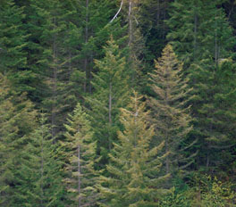
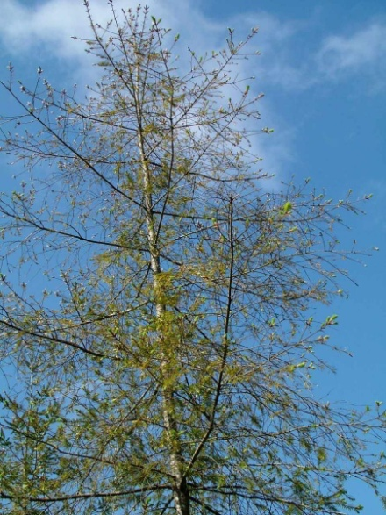
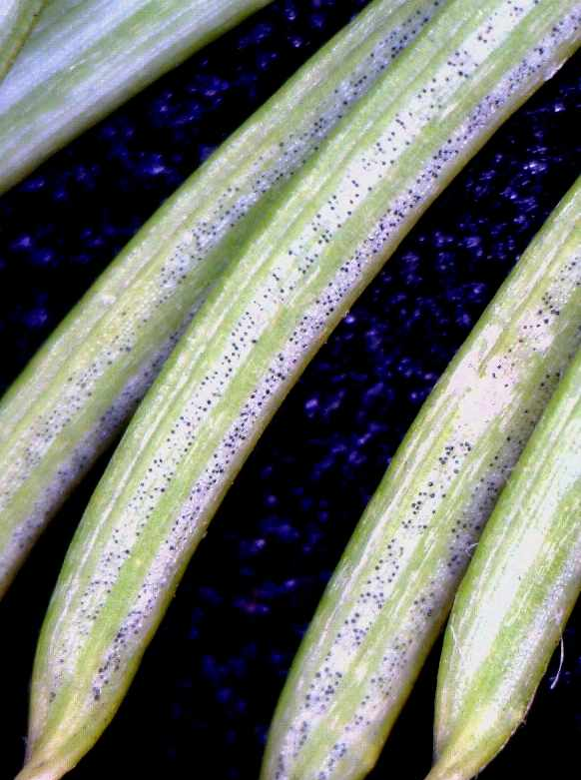
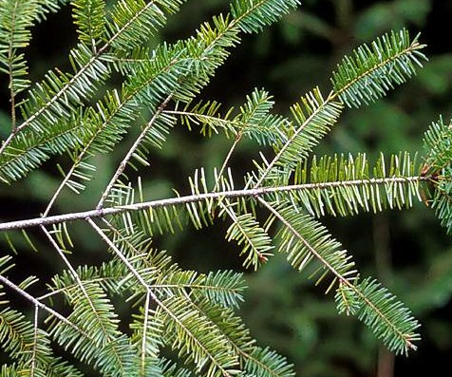
Hemlock growth response to Swiss needle cast intensity and effects of individual-tree Swiss needle cast severity on Douglas-fir growth
Junhui Zhao, Doug Maguire, Doug Mainwaring, Alan Kanaskie

Slide 2
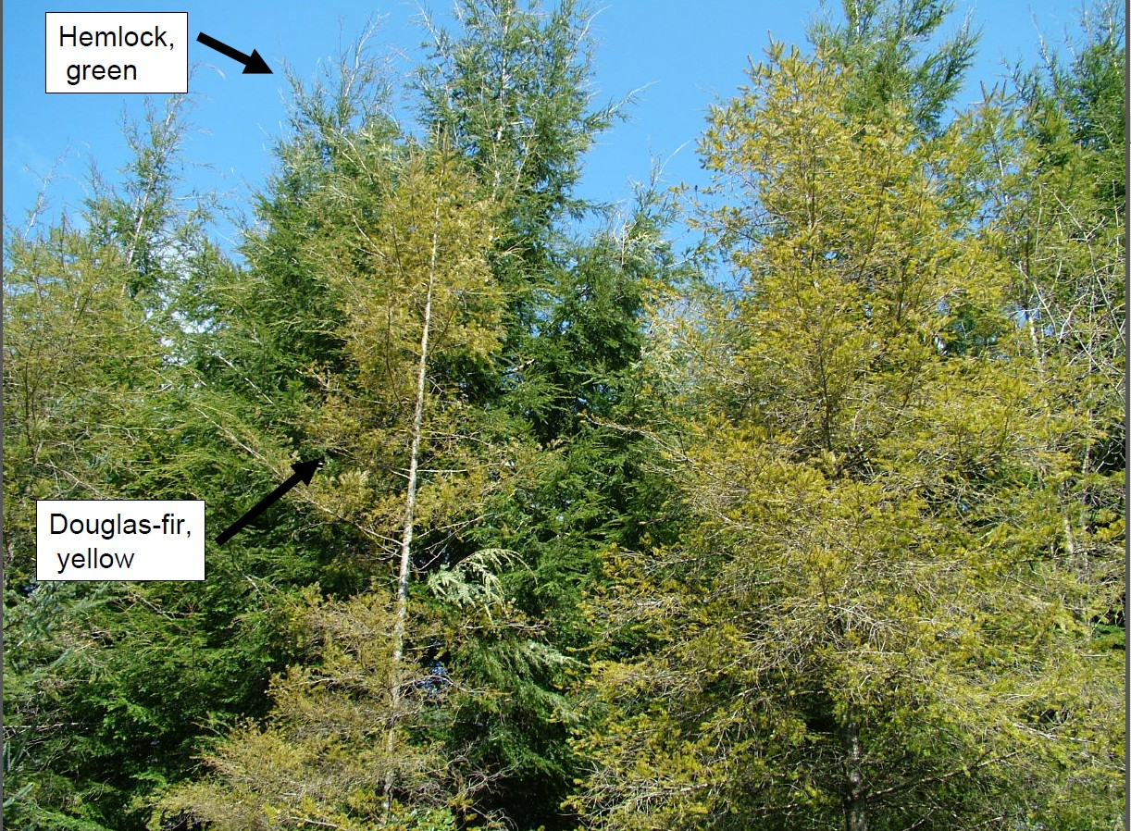
Premature loss of older foliage,
Needle longevity 1-4 years

Slide 3
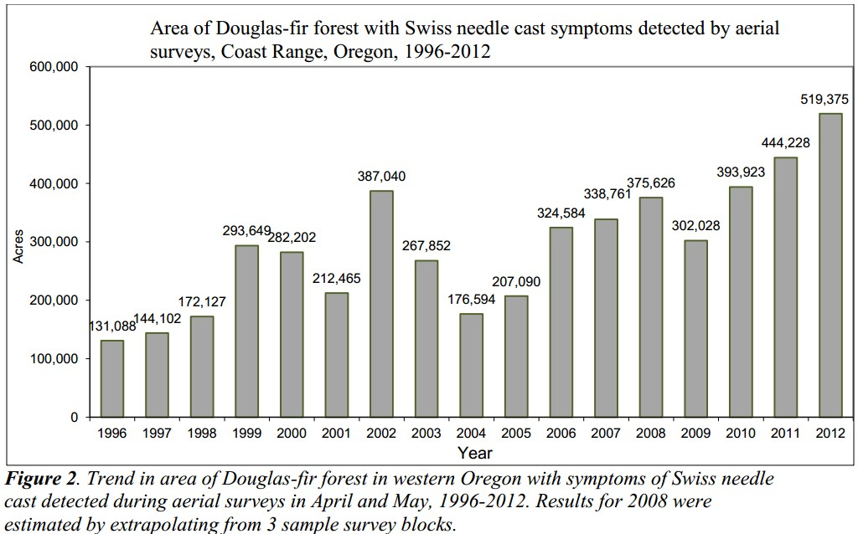
(Alan Kanaskie, 2012)

Slide 4
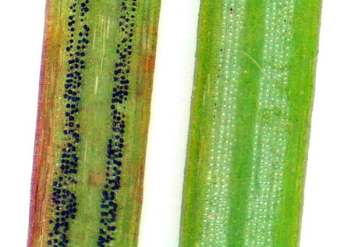
Swiss Needle Cast affect Douglas-fir
Needle on the left showing rows of black fruiting bodies of Swiss needle cast.

Slide 5
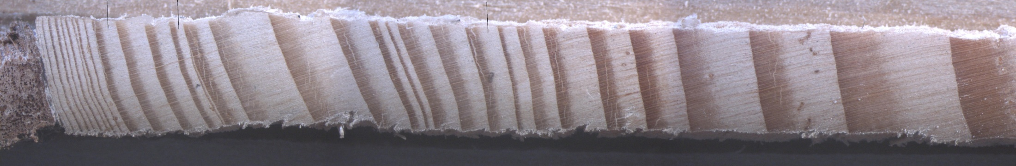
(Photo by Bryan Black)
1983
1980
1970
1961
2008:1984
Direction of growth
The trees’ growth between 1984 and 2008 was packed into just a millimeter.

Slide 6
Two Analyses
Western hemlock growth response to declining Douglas-fir in mixed-species stands across a gradient in Swiss Needle Cast intensity
The effect of within-stand variation in Swiss needle cast intensity on Douglas-fir stand dynamics

Slide 7
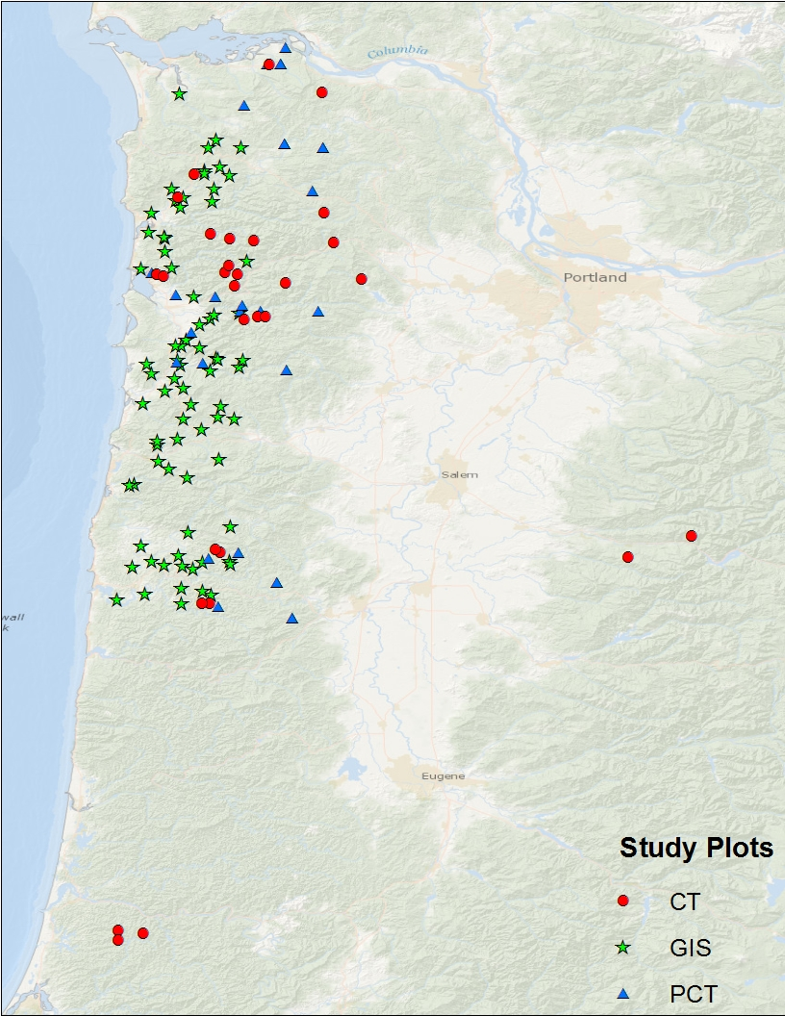
Study plots
Western hemlock analysis
  39 GIS plots
  9 PCT plots
  15 CT plots
Tree level SNC analysis
    76 GIS plots

Slide 8
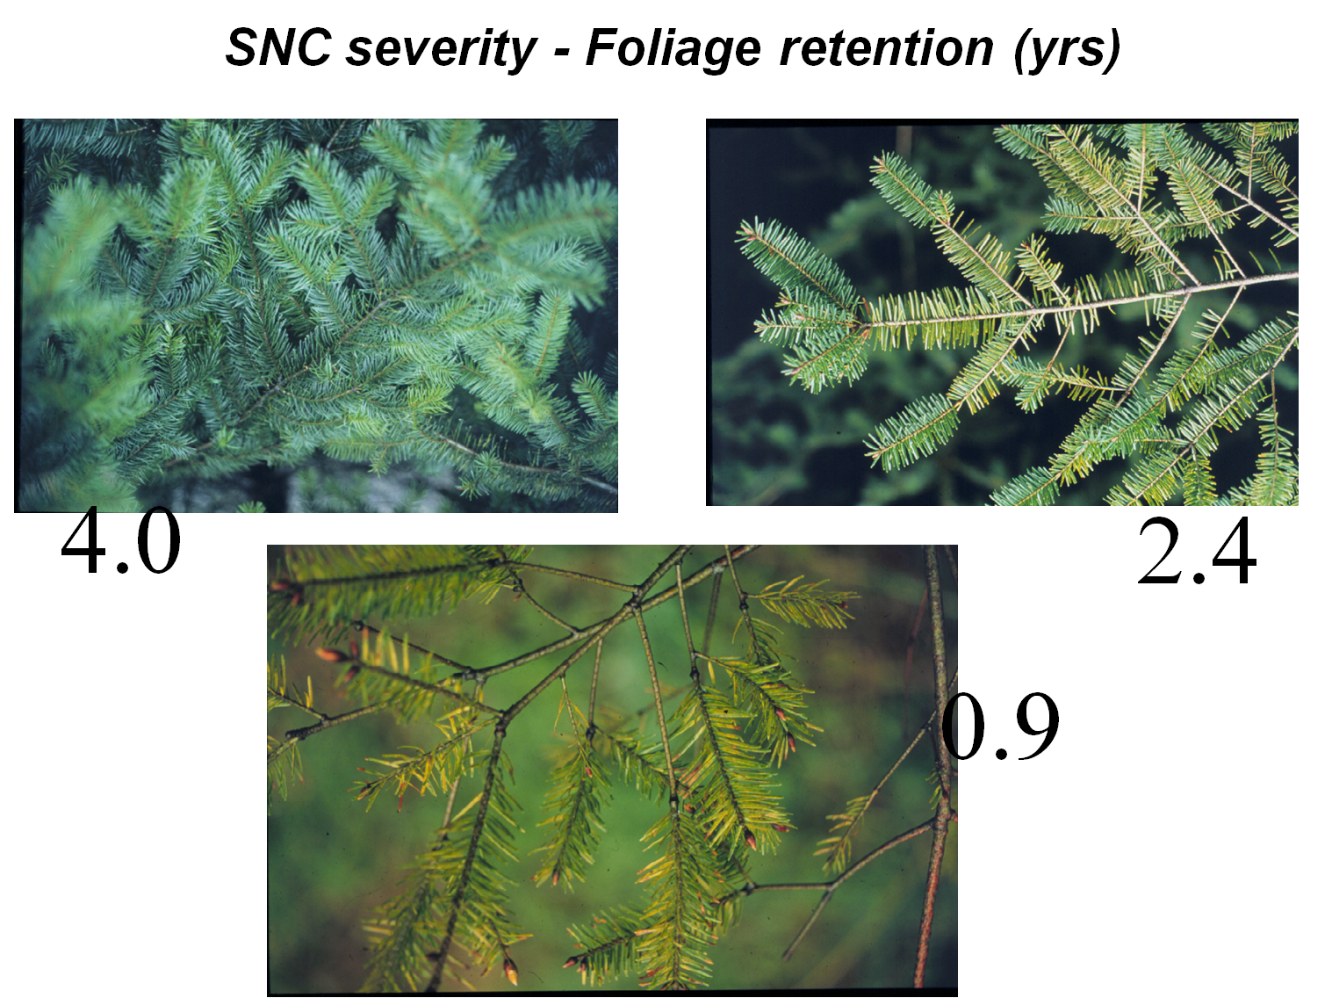
Notes:
These are three typical braches with different SNC severity. The upper left branch has foliage retention of 4 years, the upper right branch have foliage retention of 2.4 years, and the bottom branch have foliage retention about 0.9 year.

Slide 9
Western hemlock growth response to declining Douglas-fir in mixed-species stands across a gradient in Swiss Needle Cast intensity

Slide 10
Background
Growth of Douglas-fir has been negatively affected by Swiss needle cast (SNC)
In severe SNC, Douglas-fir plantations have failed, or Douglas-fir has become a smaller component within stands.
With the continued prevalence of SNC and the apparent compensatory growth response of western hemlock, landowners have shown increasing interest in western hemlock.

Slide 11
Objectives
to test the hypothesis that increasing SNC severity in mixed-species stands stimulates compensatory growth in western hemlock;
to quantify the compensatory growth, or diameter growth release, of western hemlock in mixed stands with varying SNC severity.

Slide 12
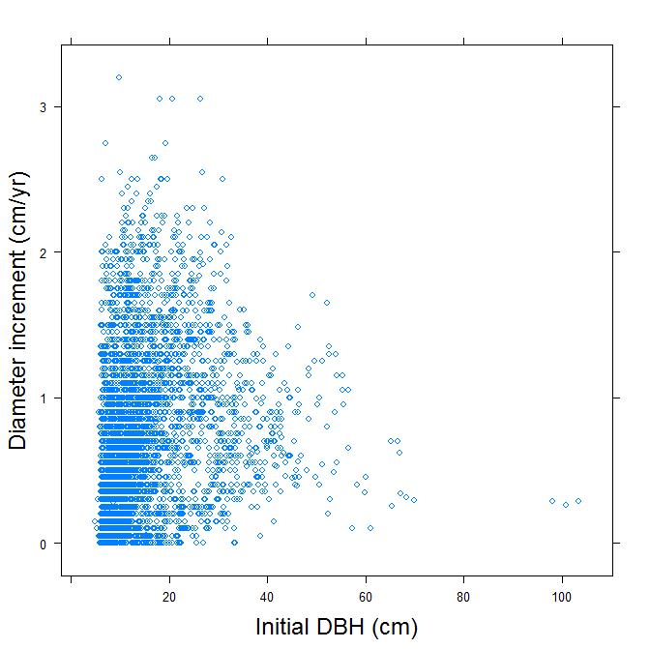
Relationship between PAI and DBH for individual western hemlock trees

Slide 13
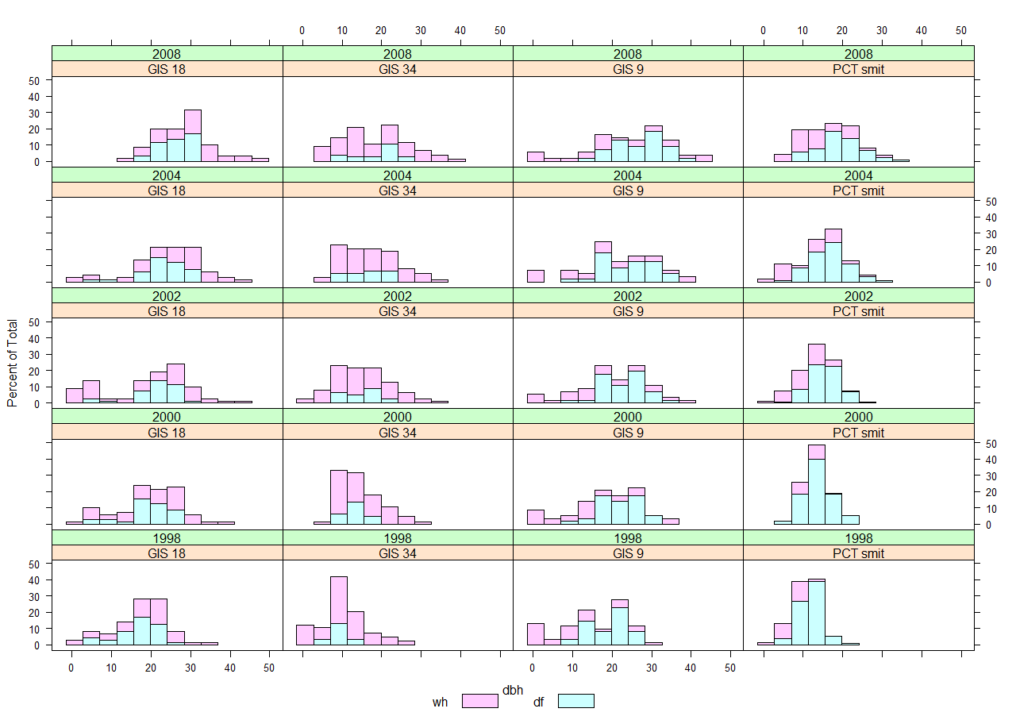
Diameter distribution for 4 plots
2008
2004
2002
2000
1998
2.42
2.13
2.35
1.95
WH
DF

Slide 14
Methods
Develop diameter increment model for western hemlock based on:
  Initial tree size
  Stand density
  Stand age/size
  Site quality
  SNC severity, including initial foliage retention (FR) and annual change in foliage retention (∆FR)

Slide 15
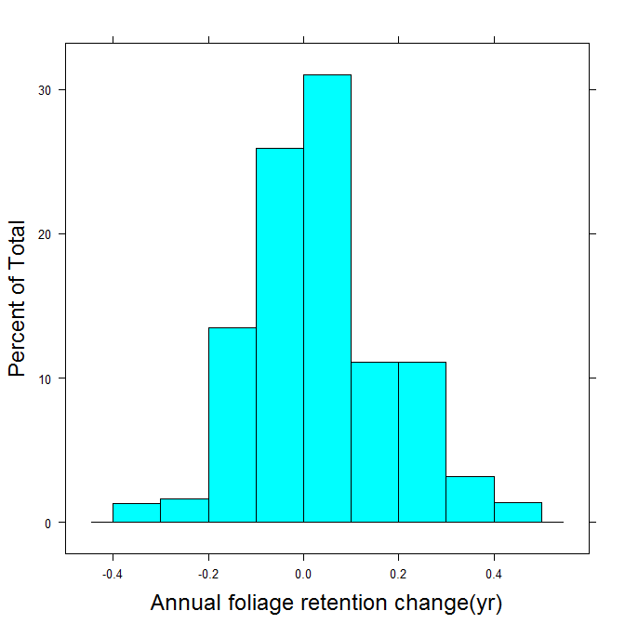
Frequency of individual western hemlock trees by plot-level Douglas-fir ∆FR class

Slide 16
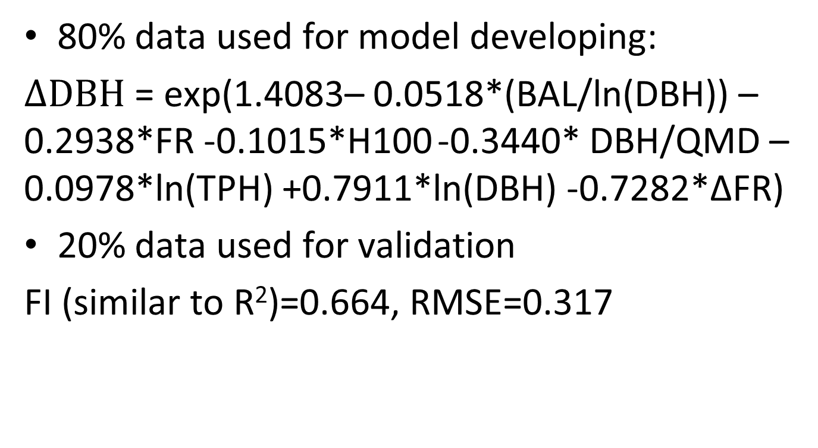
Results
80% data used for model developing:
$∆DBH$ = exp(1.4083– 0.0518*(BAL/ln(DBH)) – 0.2938*FR -0.1015*H100 -0.3440* DBH/QMD – 0.0978*ln(TPH) +0.7911*ln(DBH) -0.7282*ΔFR)
20% data used for validation
FI (similar to R²)=0.664, RMSE=0.317

Slide 17
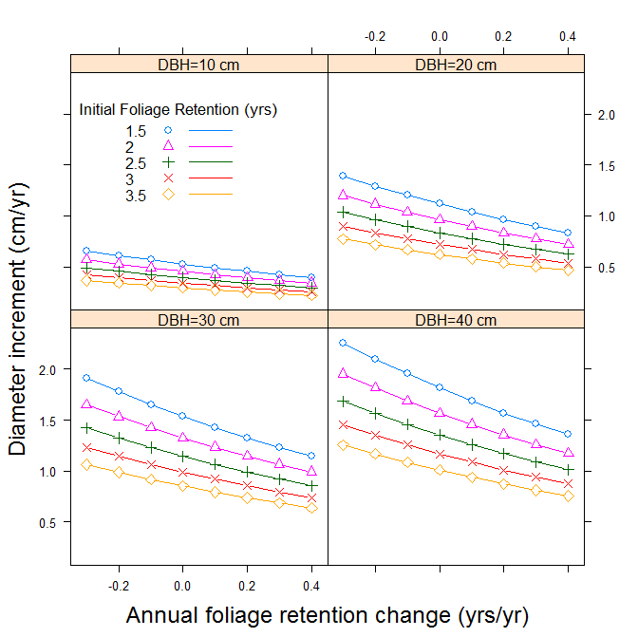
Predicted PAI of western hemlock at different levels of FR and ∆FR

Slide 18
Conclusion
Diameter increment of western hemlock increased under the lower initial Douglas-fir foliage retention associated with SNC.
The decline in Douglas-fir foliage retention over the growth period further stimulated the diameter increment of western hemlock trees.
Assuming no change in foliage retention over the growth period, western hemlock trees associated with severely impacted Douglas-fir grew 80% more in diameter relative to those associated with healthy Douglas-fir.

Slide 19
The effect of within-stand variation in Swiss needle cast intensity on Douglas-fir stand dynamics

Slide 20
Background
In previous studies growth losses have been predicted on the basis of only plot-level foliage retention.
In this analysis, the effects of tree-level variation on individual-tree growth impact and stand dynamics were analyzed.

Slide 21
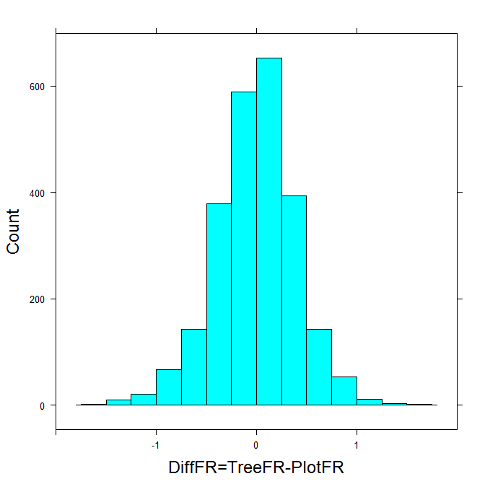
Histogram of deviation of tree-level FR from plot-average FR in GIS study
Worse than average
Better than average
Number of trees
-1
0
1
(years)

Slide 22
Methods
Models describing diameter increment of Douglas-fir were developed based on three different foliage retention ratings:
  plot-level foliage retention;
  tree-level foliage retention;
  a combination of plot-level foliage retention and the deviation of tree-level from plot-level foliage retention.

Slide 23
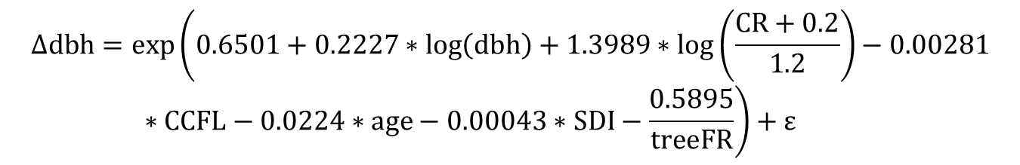
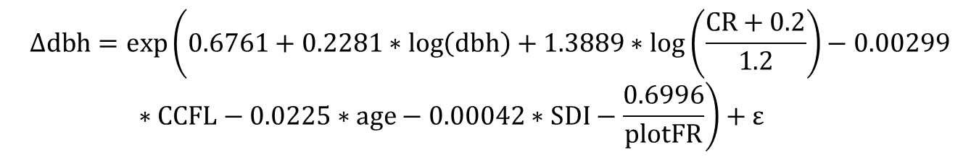
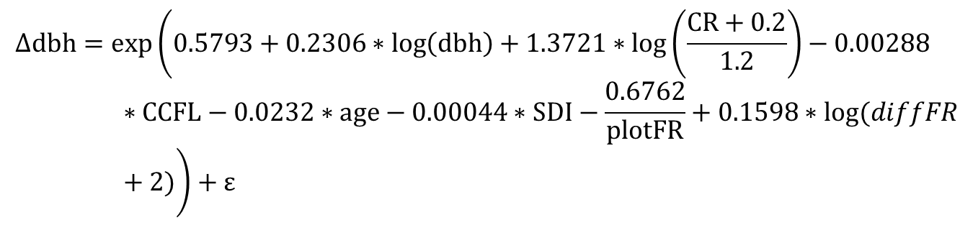
Results
$$∆dbh=exp\left(0.6761+0.2281∗\log\left(dbh\right)+1.3889∗log\left(\frac{CR+0.2}{1.2}\right)−0.00299∗CCFL−0.0225∗age−0.00042∗SDI−\frac{0.6996}{plotFR}\right)+ε$$
$$∆dbh=exp\left(0.6501+0.2227∗\log\left(dbh\right)+1.3989∗log\left(\frac{CR+0.2}{1.2}\right)−0.00281∗CCFL−0.0224∗age−0.00043∗SDI−\frac{0.5895}{treeFR}\right)+ε$$
$$∆dbh=exp\left(0.5793+0.2306∗\log\left(dbh\right)+1.3721∗log\left(\frac{CR+0.2}{1.2}\right)−0.00288∗CCFL−0.0232∗age−0.00044∗SDI−\frac{0.6762}{plotFR}+0.1598∗log⁡(diffFR+2)\right)+ε$$

Slide 24
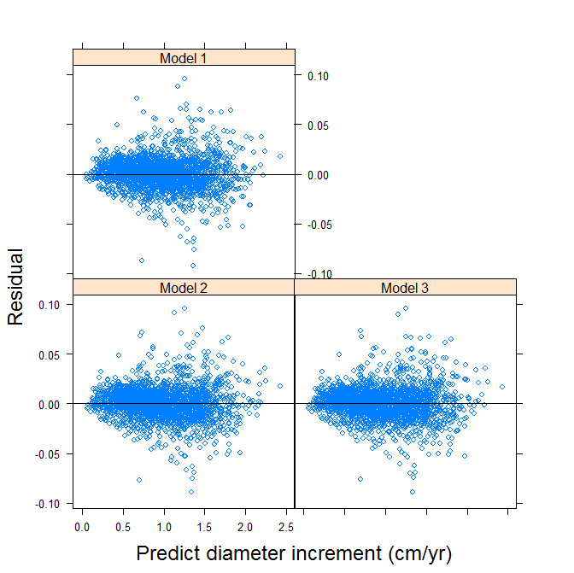
Compare residual plots of the three models

Slide 25
Compare goodness of fit of the three models
 | TreeFR model | PlotFR model | TreeFR+PlotFR model
Mean difference | 0.000522 | 0.000570 | 0.000554
mean squared difference | 0.000233 | 0.000233 | 0.000252
mean absolute difference | 0.010824 | 0.010849 | 0.010828
R² | 0.565519 | 0.564809 | 0.567824

Slide 26
Inferred diameter growth multipliers using treeFR, plotFR, or both.

Slide 27
Conclusion
Within-stand variation in individual-tree foliage retention has influenced individual-tree growth rates and stand dynamics.
The most severely impacted plots would have an average of 40% diameter growth loss for dominant and co-dominant trees.
For given plot-level foliage retention, trees with different tree-level foliage retention may differ in growth by about 20%.

Slide 28
Thank you for your attention!

