Slide 1
H. Bryan Lu and Fred C. Martin
Washington State Department of Natural Resources
Olympia, Washington
Mathematical Transformation of Stand Density Index

Slide 2
Objective
The purposes of this study are:
to reveal the implied mathematics used by Stage (1968) to partition Reineke’s stand density index (SDI).
to compare the values of SDI obtained from various formulations.

Slide 3
Overview
SDI of Reineke (1933)
Homogeneous functions and Euler’s theorem
Alternative forms of SDI
  Stage (1968)
  Long and Daniel (1990)
  Ducey and Larson (2003)
  SDI(TPA, BA)
Examples
Conclusions

Slide 4
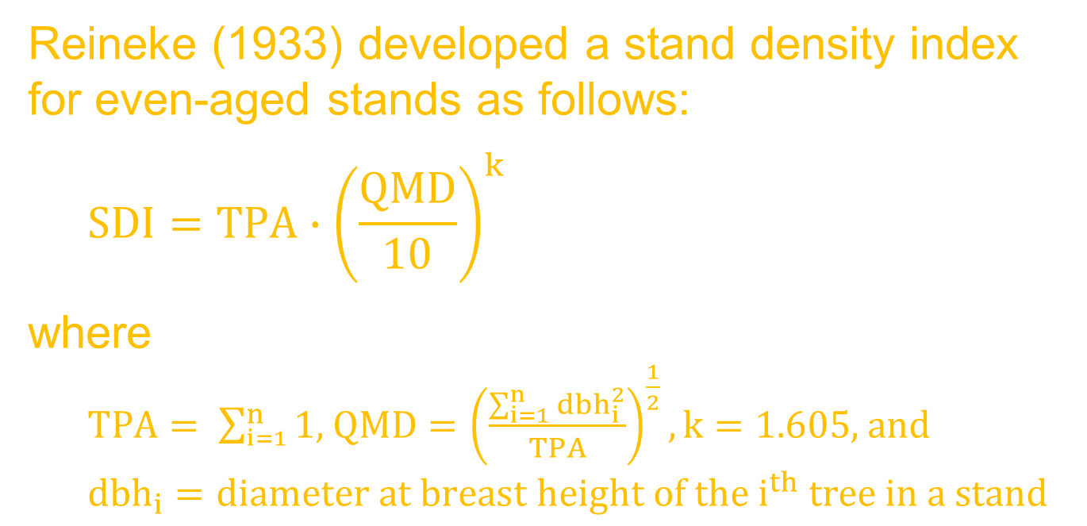
Reineke’s SDI
Reineke (1933) developed a stand density index for even-aged stands as follows:
  $$SDI=TPA∙{\left(\frac{QMD}{10}\right)}^{k}$$
where
  $TPA= \sum_{i=1}^{n}{1}$, $QMD={\left(\frac{\sum_{i=1}^{n}{{dbh}_{i}^{2}}}{TPA}\right)}^{\frac{1}{2}}, k=1.605$, and
  $${dbh}_{i}=diameter at breast height of the i^{th} tree in a stand$$

Slide 5
Question
Reineke’s SDI could not tell the contribution of various groups of trees in the stand to the total SDI for the stand.
Is there a way to make it happen? Yes, it could be done by transforming Reineke’s SDI to a linearly homogeneous function. Based on the Euler’s theorem, it could be partitioned.

Slide 6
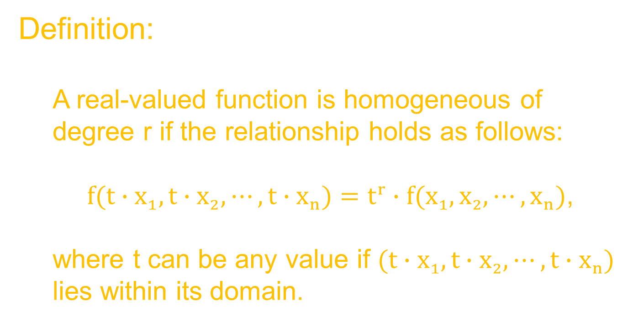
Homogeneous functions
Definition:
  A real-valued function is homogeneous of degree r if the relationship holds as follows:
    $f(t∙x_{1},t∙x_{2},⋯,t∙x_{n})=t^{r}∙f(x_{1},x_{2},⋯,x_{n})$,
  where t can be any value if $(t∙x_{1},t∙x_{2},⋯,t∙x_{n})$ lies within its domain.

Slide 7
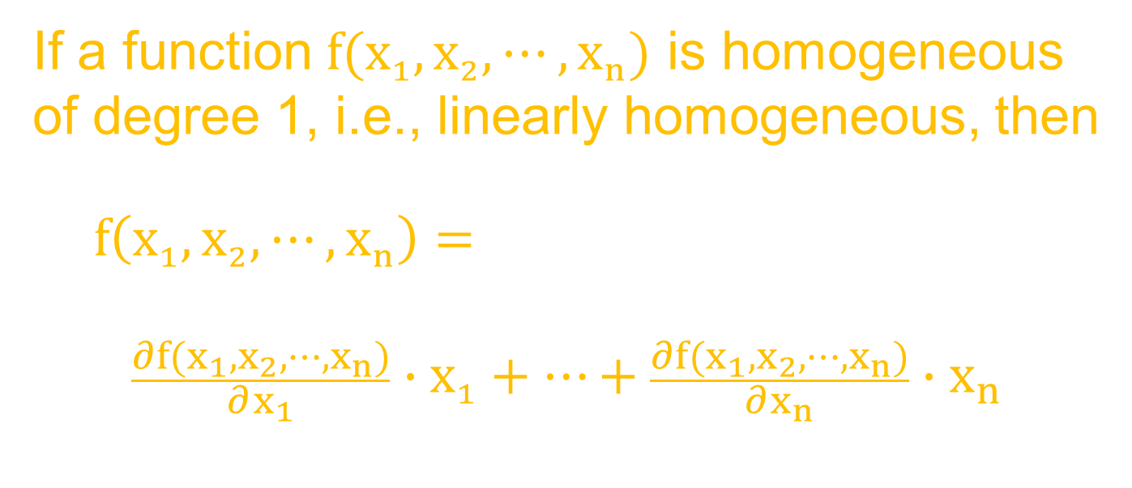
Euler’s Theorem
If a function $f(x_{1},x_{2},⋯,x_{n})$ is homogeneous of degree 1, i.e., linearly homogeneous, then
  $$f\left(x_{1},x_{2},⋯,x_{n}\right)=$$
$$\frac{∂f(x_{1},x_{2},⋯,x_{n})}{∂x_{1}}∙x_{1}+⋯+\frac{∂f(x_{1},x_{2},⋯,x_{n})}{∂x_{n}}∙x_{n}$$

Slide 8
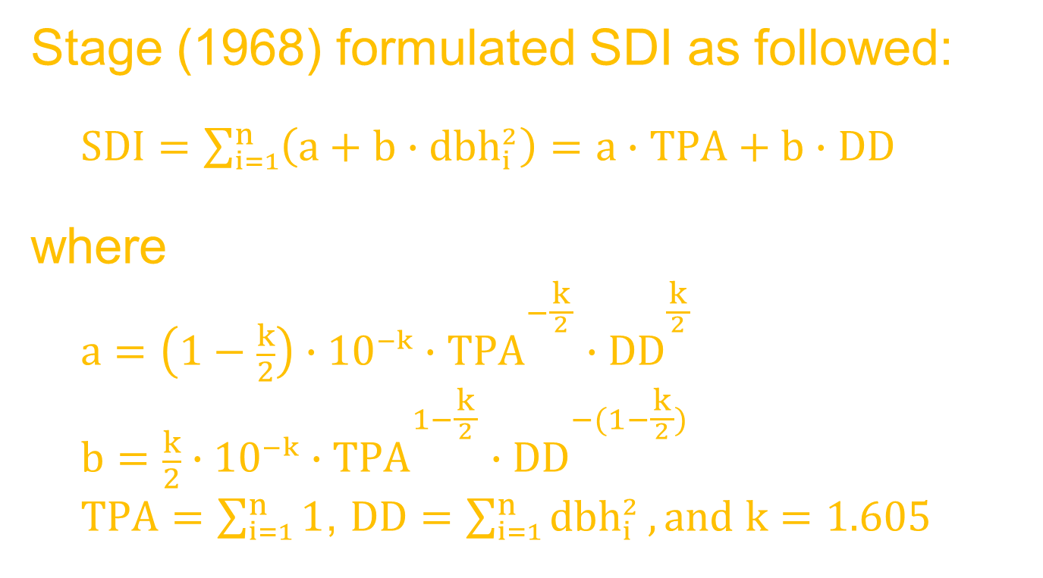
Stage’s SDI
Stage (1968) formulated SDI as followed:
  $SDI=\sum_{i=1}^{n}{\left(a+b∙{dbh}_{i}^{2}\right)}=a∙TPA+b∙DD$
where
  $$a={\left(1−\frac{k}{2}\right)∙10}^{−k}∙{TPA}^{−\frac{k}{{2 \atop }}}∙{DD}^{\frac{k}{{2 \atop }}}$$
  $$b={\frac{k}{2}∙10}^{−k}∙{TPA}^{1−\frac{k}{{2 \atop }}}∙{DD}^{−(1−\frac{k}{{2 \atop }})}$$
  $TPA=\sum_{i=1}^{n}{1}$, $DD=\sum_{i=1}^{n}{{dbh}_{i}^{2}},and k=1.605$

Slide 9
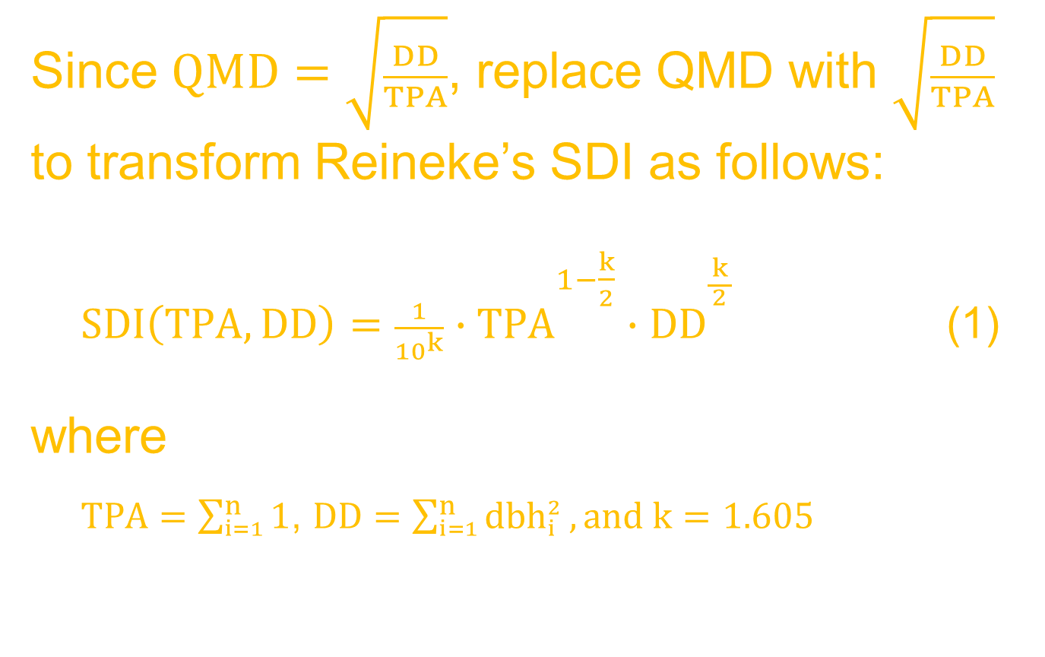
Stage’s SDI
Since $QMD=\sqrt{\frac{DD}{TPA}}$, replace QMD with $\sqrt{\frac{DD}{TPA}}$ to transform Reineke’s SDI as follows:
  $SDI\left(TPA, DD\right)=\frac{1}{{10}^{k}}∙{TPA}^{{1−\frac{k}{2} \atop }}∙{DD}^{\frac{k}{{2 \atop }}}$ (1)
where
  $TPA=\sum_{i=1}^{n}{1}$, $DD=\sum_{i=1}^{n}{{dbh}_{i}^{2}},and k=1.605$

Slide 10
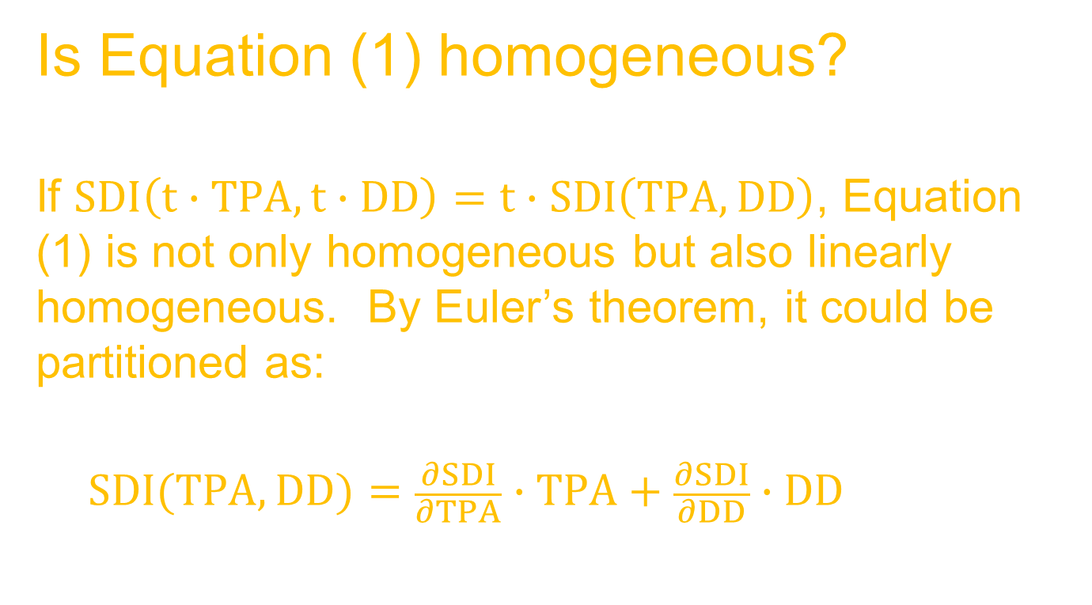
Stage’s SDI
Is Equation (1) homogeneous?
If $SDI\left(t∙TPA,t∙DD\right)=t∙SDI\left(TPA, DD\right)$, Equation (1) is not only homogeneous but also linearly homogeneous. By Euler’s theorem, it could be partitioned as:
  $$SDI(TPA, DD)=\frac{∂SDI}{∂TPA}∙TPA+\frac{∂SDI}{∂DD}∙DD$$

Slide 11
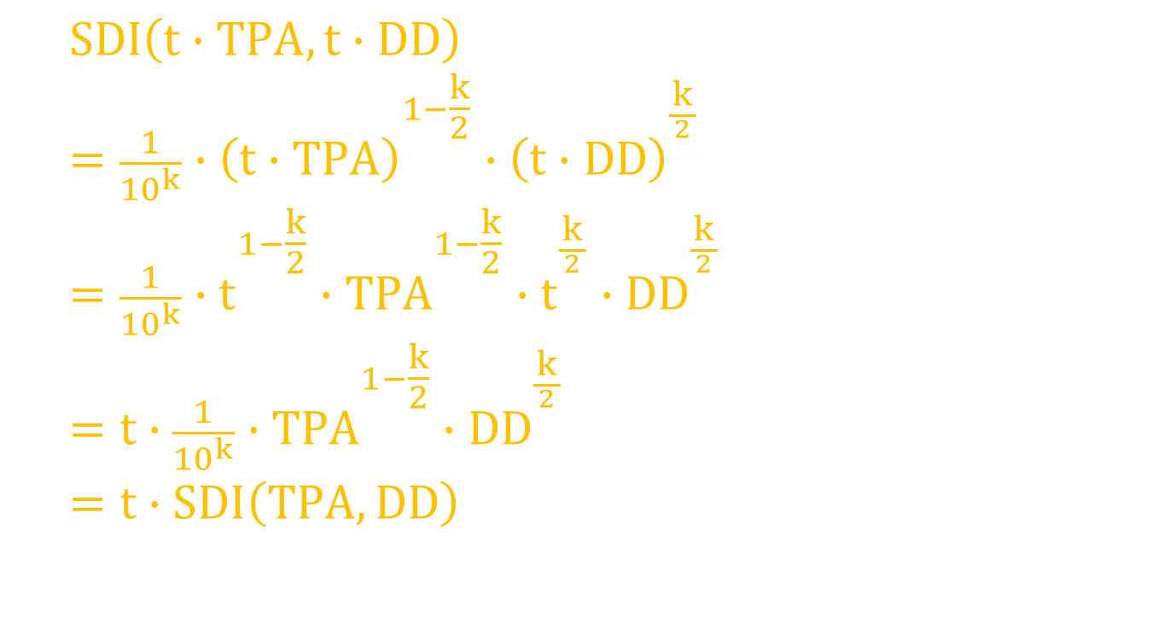
Stage’s SDI
  $$SDI\left(t∙TPA,t∙DD\right)$$
  $$=\frac{1}{{10}^{k}}∙{\left(t∙TPA\right)}^{{1−\frac{k}{2} \atop }}∙{\left(t∙DD\right)}^{\frac{k}{{2 \atop }}}$$
  $$=\frac{1}{{10}^{k}}∙t^{{1−\frac{k}{2} \atop }}∙{TPA}^{{1−\frac{k}{2} \atop }}∙t^{\frac{k}{{2 \atop }}}{∙DD}^{\frac{k}{{2 \atop }}}$$
  $$=t∙\frac{1}{{10}^{k}}∙{TPA}^{{1−\frac{k}{2} \atop }}{∙DD}^{\frac{k}{{2 \atop }}}$$
  $$=t∙SDI\left(TPA, DD\right)$$

Slide 12
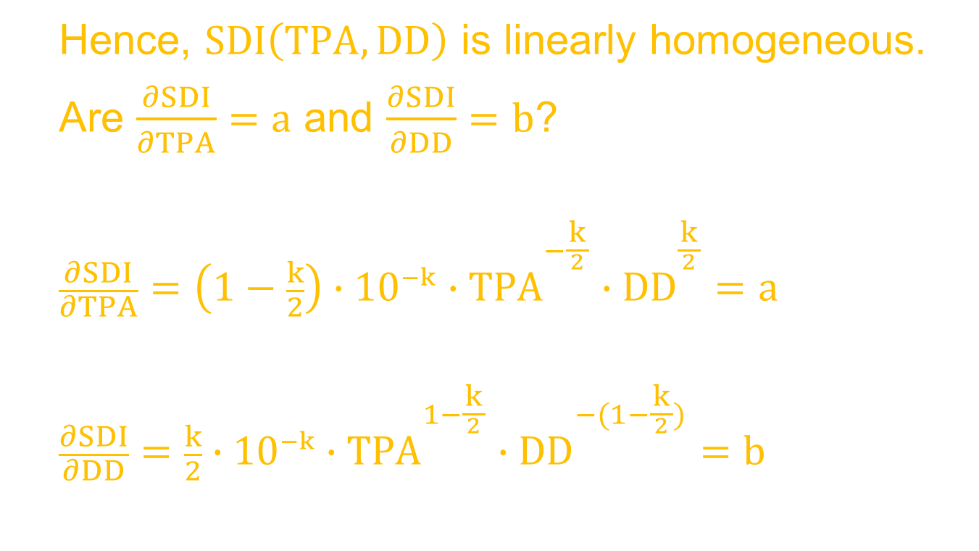
Stage’s SDI
  Hence, $SDI\left(TPA, DD\right)$ is linearly homogeneous.
  Are $\frac{∂SDI}{∂TPA}=a$ and $\frac{∂SDI}{∂DD}=b$?
  $$\frac{∂SDI}{∂TPA}={\left(1−\frac{k}{2}\right)∙10}^{−k}∙{TPA}^{−\frac{k}{{2 \atop }}}∙{DD}^{\frac{k}{{2 \atop }}}=a$$
  $$\frac{∂SDI}{∂DD}={\frac{k}{2}∙10}^{−k}∙{TPA}^{1−\frac{k}{{2 \atop }}}∙{DD}^{−(1−\frac{k}{{2 \atop }})}=b$$

Slide 13
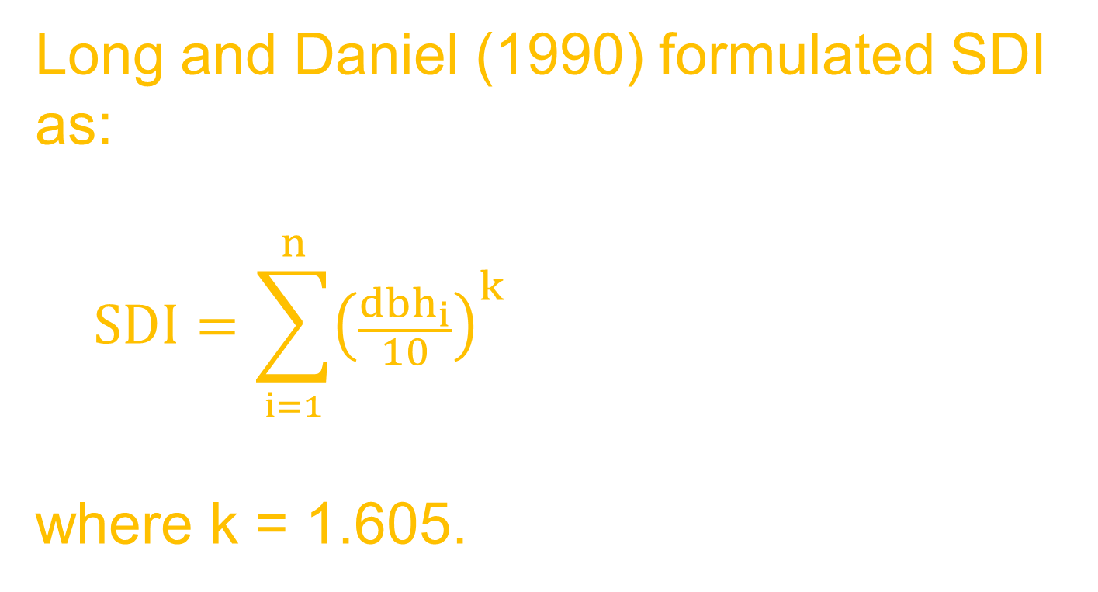
Long and Daniel’s SDI
Long and Daniel (1990) formulated SDI as:
  $$SDI=\sum_{i=1}^{n}{{\left(\frac{{dbh}_{i}}{10}\right)}^{k}}$$
where k = 1.605.

Slide 14
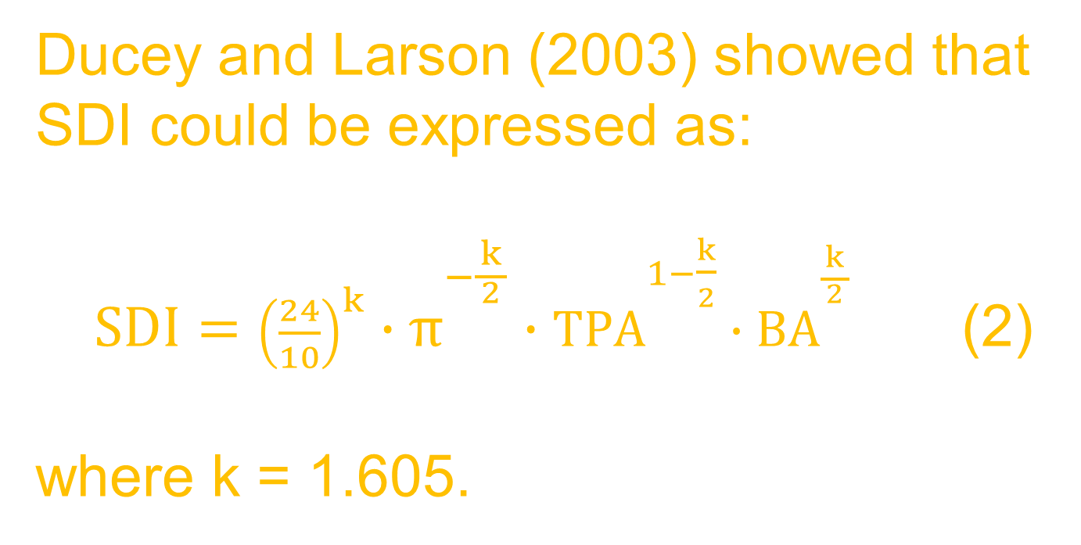
Ducey and Larson’s SDI
Ducey and Larson (2003) showed that SDI could be expressed as:
  $SDI={\left(\frac{24}{10}\right)}^{k}∙π^{−\frac{k}{{2 \atop }}}∙{TPA}^{{1−\frac{k}{2} \atop }}∙{BA}^{\frac{k}{{2 \atop }}}$ (2)
where k = 1.605.

Slide 15
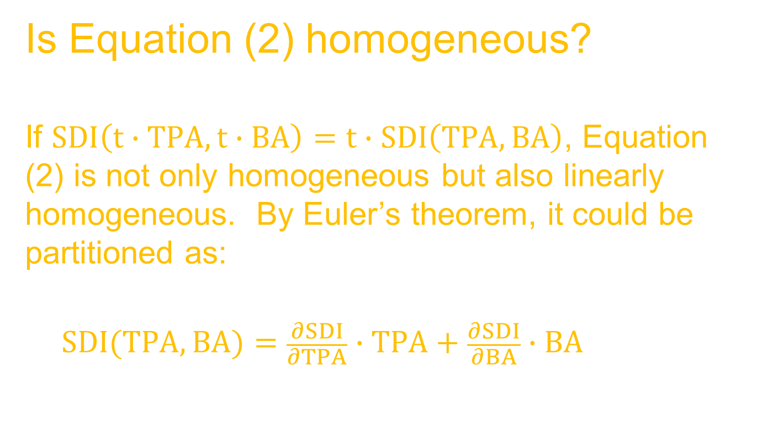
SDI(TPA, BA)
Is Equation (2) homogeneous?
If $SDI\left(t∙TPA,t∙BA\right)=t∙SDI\left(TPA, BA\right)$, Equation (2) is not only homogeneous but also linearly homogeneous. By Euler’s theorem, it could be partitioned as:
  $$SDI(TPA, BA)=\frac{∂SDI}{∂TPA}∙TPA+\frac{∂SDI}{∂BA}∙BA$$

Slide 16

SDI(TPA, BA)
  $$SDI\left(t∙TPA,t∙BA\right)$$
  $$=\frac{1}{{10}^{k}}∙{\left(t∙TPA\right)}^{{1−\frac{k}{2} \atop }}∙{\left(t∙BA\right)}^{\frac{k}{{2 \atop }}}$$
  $$=\frac{1}{{10}^{k}}∙t^{{1−\frac{k}{2} \atop }}∙{TPA}^{{1−\frac{k}{2} \atop }}∙t^{\frac{k}{{2 \atop }}}{∙BA}^{\frac{k}{{2 \atop }}}$$
  $$=t∙\frac{1}{{10}^{k}}∙{TPA}^{{1−\frac{k}{2} \atop }}{∙BA}^{\frac{k}{{2 \atop }}}$$
  $$=t∙SDI\left(TPA, BA\right)$$

Slide 17
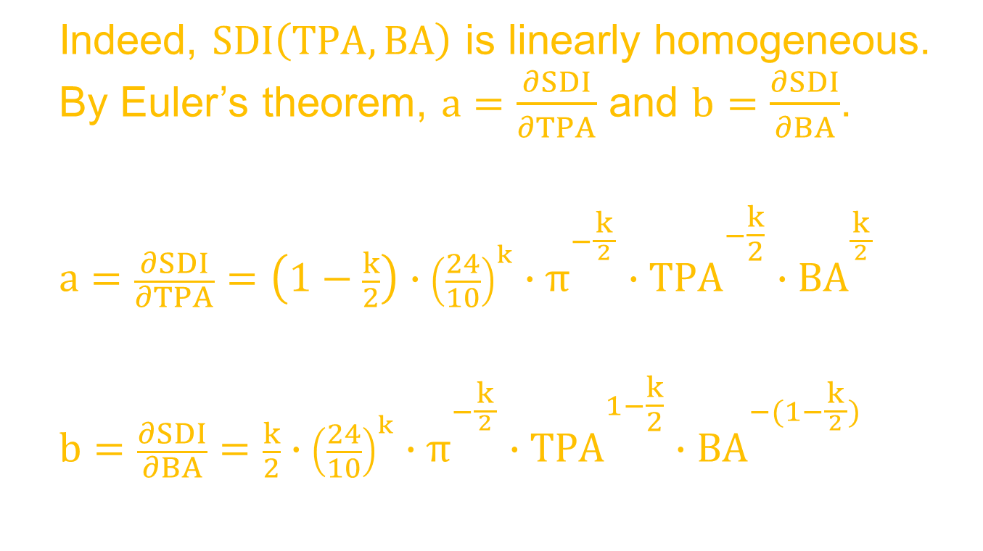
SDI(TPA, BA)
  Indeed, $SDI\left(TPA, BA\right)$ is linearly homogeneous. By Euler’s theorem, $a=\frac{∂SDI}{∂TPA}$ and $b=\frac{∂SDI}{∂BA}$.
  $$a=\frac{∂SDI}{∂TPA}=\left(1−\frac{k}{2}\right)∙{\left(\frac{24}{10}\right)}^{k}∙π^{−\frac{k}{{2 \atop }}}∙{TPA}^{{−\frac{k}{2} \atop }}∙{BA}^{\frac{k}{{2 \atop }}}$$
  $$b=\frac{∂SDI}{∂BA}=\frac{k}{2}∙{\left(\frac{24}{10}\right)}^{k}∙π^{−\frac{k}{{2 \atop }}}∙{TPA}^{{1−\frac{k}{2} \atop }}∙{BA}^{−(1−\frac{k}{{2 \atop }})}$$

Slide 18
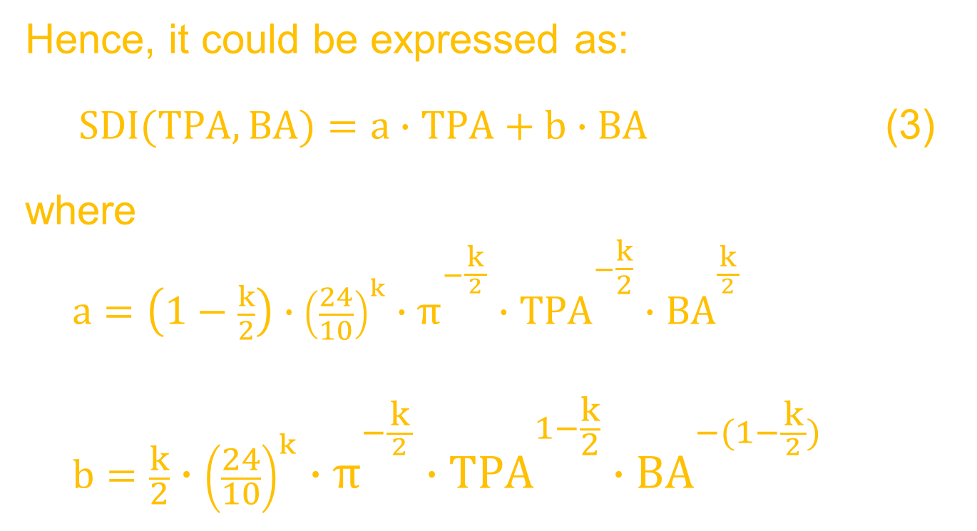
SDI(TPA, BA)
Hence, it could be expressed as:
  $SDI(TPA, BA)=a∙TPA+b∙BA$ (3)
where
  $$a=\left(1−\frac{k}{2}\right)∙{\left(\frac{24}{10}\right)}^{k}∙π^{−\frac{k}{{2 \atop }}}∙{TPA}^{{−\frac{k}{2} \atop }}∙{BA}^{\frac{k}{{2 \atop }}}$$
  $$b=\frac{k}{2}∙{\left(\frac{24}{10}\right)}^{k}∙π^{−\frac{k}{{2 \atop }}}∙{TPA}^{{1−\frac{k}{2} \atop }}∙{BA}^{−(1−\frac{k}{{2 \atop }})}$$

Slide 19
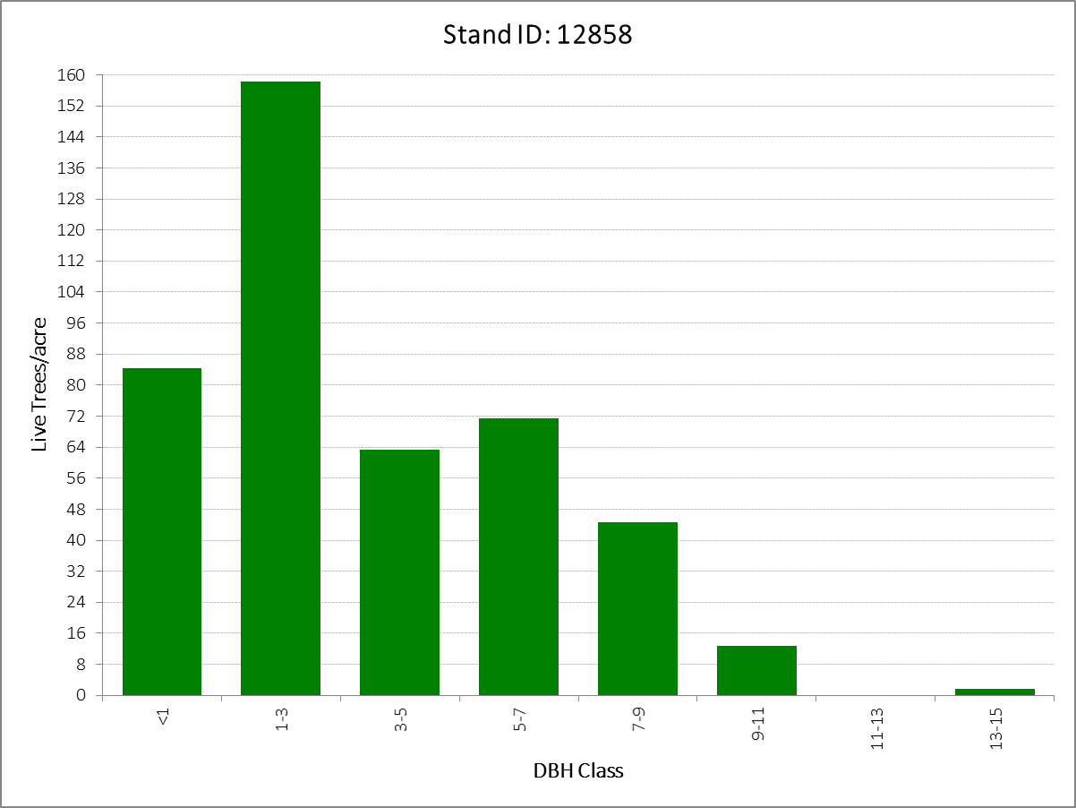
Example 1

Slide 20
Example 1

Slide 21
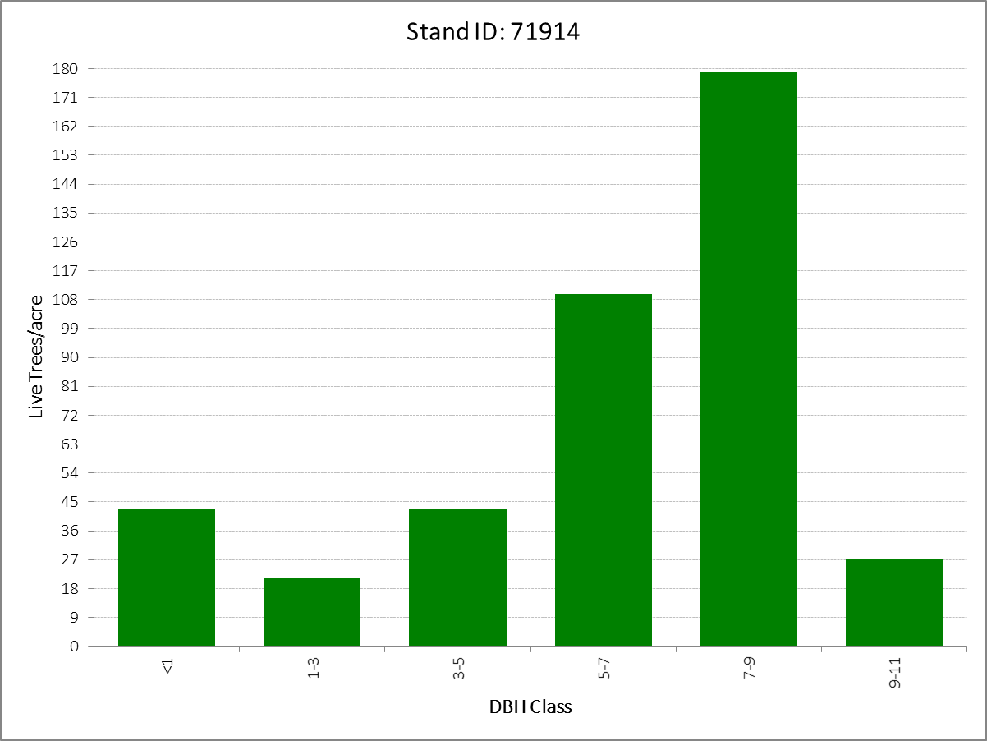
Example 2

Slide 22
Example 2

Slide 23
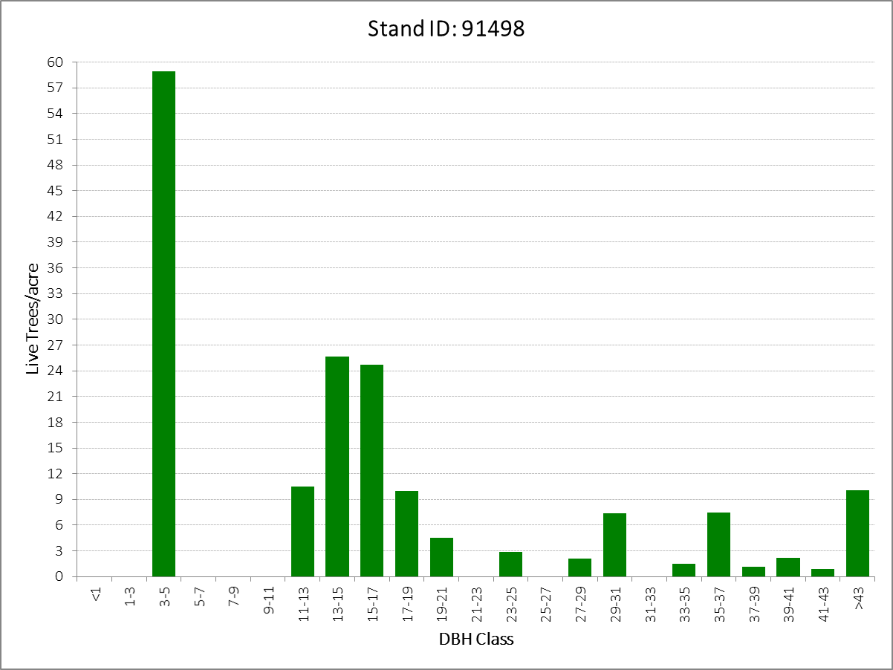
Example 3

Slide 24
Example 3

Slide 25
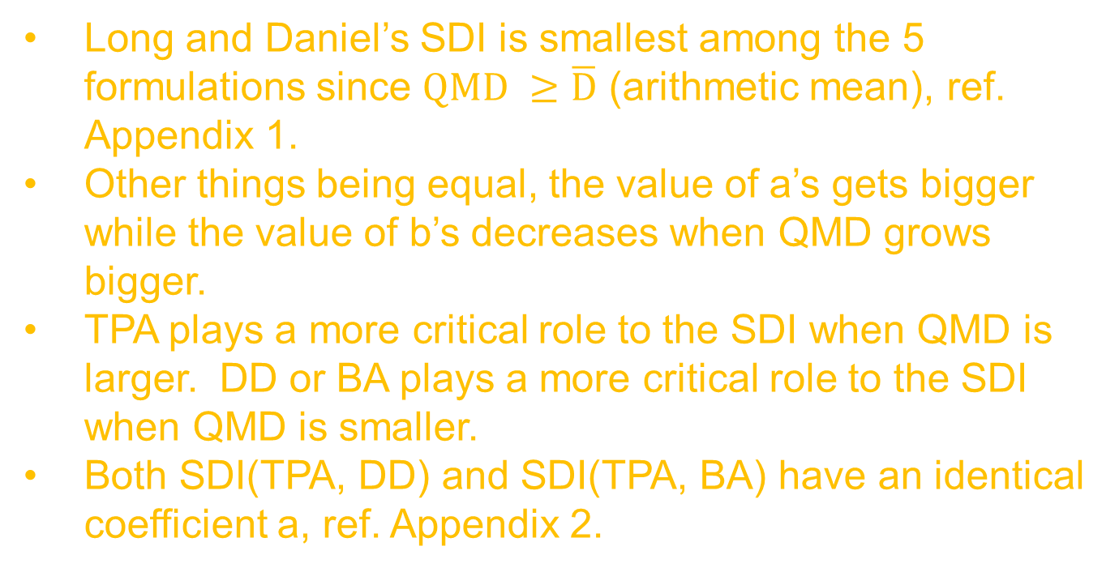
Conclusions
Long and Daniel’s SDI is smallest among the 5 formulations since $QMD ≥\overline{D}$ (arithmetic mean), ref. Appendix 1.
Other things being equal, the value of a’s gets bigger while the value of b’s decreases when QMD grows bigger.
TPA plays a more critical role to the SDI when QMD is larger. DD or BA plays a more critical role to the SDI when QMD is smaller.
Both SDI(TPA, DD) and SDI(TPA, BA) have an identical coefficient a, ref. Appendix 2.
Notes:
ca

Slide 26
Conclusions
SDI(TPA, DD) = SDI(TPA1, DD1) + SDI(TPA2, DD2), given TPA = TPA1 + TPA2 and DD = DD1 + DD2.
SDI(TPA, BA) = SDI(TPA1, BA1) + SDI(TPA2, BA2), given TPA = TPA1 + TPA2 and BA = BA1 + BA2.
Since the relative density index (RD) developed by Curtis (1980) is similar to SDI, it could be partitioned by transforming to the form of RD(TPA, DD) or RD(TPA, BA).

Slide 27
References
Clutter, J.L., J.C. Fortson, L.V. Pienaar, G.H. Brister, and R.L. Bailey. 1983. Timber Management: A Quantitative Approach. John Wiley & Sons, Inc., New York. 333p.
Curtis, R.O. 1982. A simple index of stand density for Douglas-fir. For. Sci. 28(1):92-94.
Ducey, M.J. and B.C. Larson. 2003. Is there a correct stand density index? An alternate interpretation. West. J. Appl. For. 18(3):179-184.
Long, J.N. and T.W. Daniel. 1990. Assessment of growing stock in uneven-aged stands. West. J. Appl. For. 5(3):93-96.

Slide 28
References
Reineke, L.H. 1933. Perfecting a stand-density index for even-aged forests. J. Agric. Res. 46(7):627-638.
Stage, A.R. 1968. A tree-by-tree measure of site utilization for grand fir related to stand density index. USDA For. Serv. Res. Note INT-77, 7p. Intermountain Forest & Range Experiment Station, Ogden, UT.

Slide 29
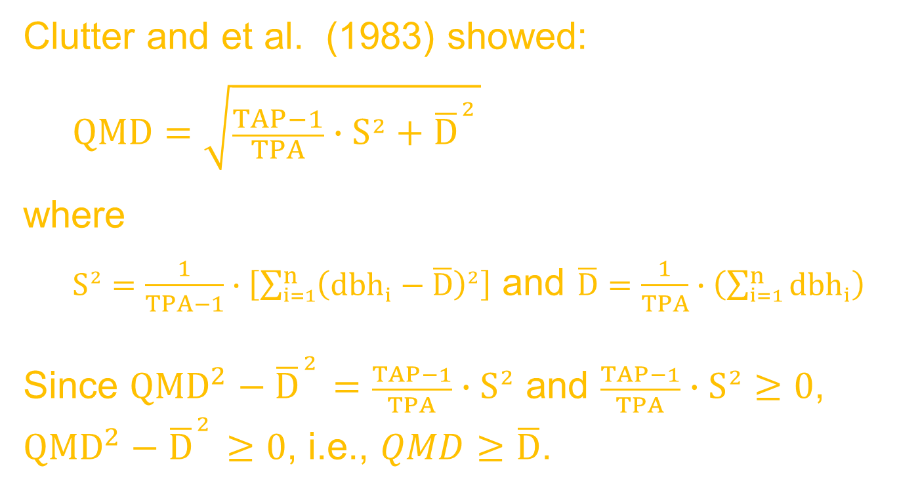
Appendix 1
Clutter and et al. (1983) showed:
  $$QMD=\sqrt{\frac{TAP−1}{TPA}∙S^{2}+{\overline{D}}^{{2 \atop }}}$$
where
  $S^{2}=\frac{1}{TPA−1}∙\left[\sum_{i=1}^{n}{{\left({dbh}_{i}−\overline{D}\right)}^{2}}\right]$ and $\overline{D}=\frac{1}{TPA}∙\left(\sum_{i=1}^{n}{{dbh}_{i}}\right)$
Since ${QMD}^{2}−{\overline{D}}^{{2 \atop }}=\frac{TAP−1}{TPA}∙S^{2}$ and $\frac{TAP−1}{TPA}∙S^{2}≥0$, ${QMD}^{2}−{\overline{D}}^{{2 \atop }}≥0$, i.e., $QMD≥\overline{D}$.

Slide 30
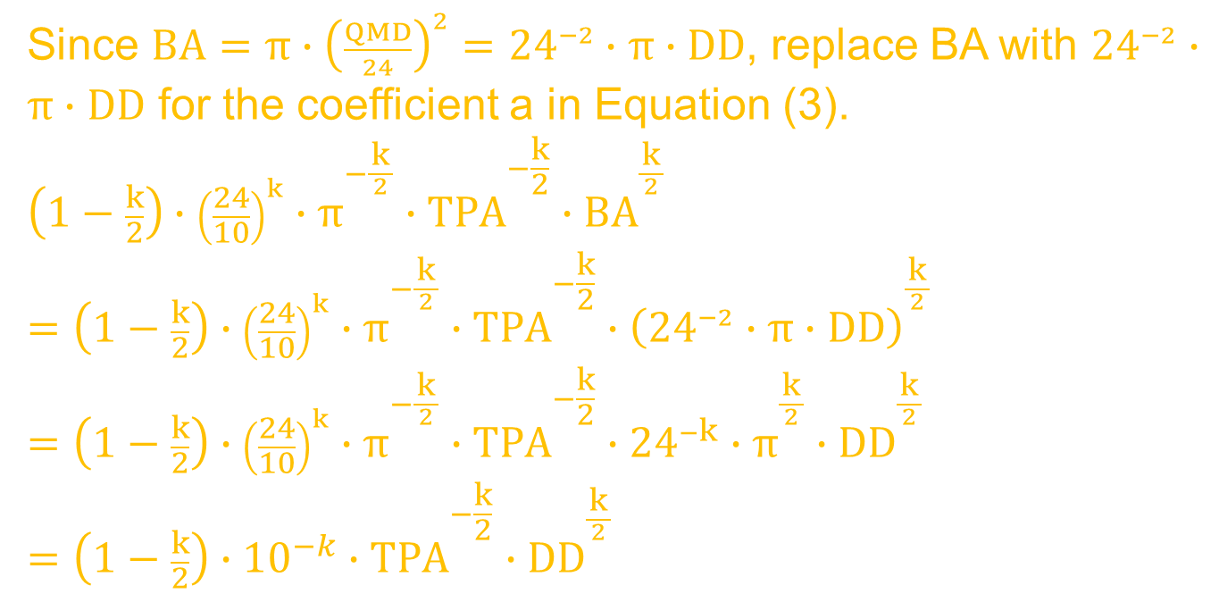
Appendix 2
Since $BA=π∙{\left(\frac{QMD}{24}\right)}^{2}={24}^{−2}∙π∙DD$, replace BA with ${24}^{−2}∙π∙DD$ for the coefficient a in Equation (3).
$$\left(1−\frac{k}{2}\right)∙{\left(\frac{24}{10}\right)}^{k}∙π^{−\frac{k}{{2 \atop }}}∙{TPA}^{{−\frac{k}{2} \atop }}∙{BA}^{\frac{k}{{2 \atop }}}$$
$$=\left(1−\frac{k}{2}\right)∙{\left(\frac{24}{10}\right)}^{k}∙π^{−\frac{k}{{2 \atop }}}∙{TPA}^{{−\frac{k}{2} \atop }}∙{\left({24}^{−2}∙π∙DD\right)}^{\frac{k}{{2 \atop }}}$$
$$=\left(1−\frac{k}{2}\right)∙{\left(\frac{24}{10}\right)}^{k}∙π^{−\frac{k}{{2 \atop }}}∙{TPA}^{{−\frac{k}{2} \atop }}∙{24}^{−k}∙π^{\frac{k}{{2 \atop }}}∙{DD}^{\frac{k}{{2 \atop }}}$$
$$=\left(1−\frac{k}{2}\right)∙{10}^{−k}∙{TPA}^{{−\frac{k}{2} \atop }}∙{DD}^{\frac{k}{{2 \atop }}}$$

