Slide 1
Measurement Systems Analysis (MSA): a seedling example
David Marshall
Growth Model Users Group
2/27/2015

Slide 2
Measurement Systems
The process of taking measurements which could include:
  Parts being measured (trees)
  Instruments or equipment (Caliper, D-tape)
  Procedures (definition of DBH)
  Hardware and software (data recorders or paper)
  Conditions (weather)
  People
All of these can cause variability and errors in a measurement

Slide 3
Measurement Systems
Requirements for a “good” Measurement System
  stability over time (no drift)
  the variability is small compared to the specified limits (tolerance)
  the variability is small compared to the process variability
  Resolution of an instrument is small relative to either the specified tolerance or the process variation
    A rule of thumb is that it should be 1/10 of smaller of the tolerance or variation (manufacturing)

Slide 4
Uncertainty Analysis
Uncertainty analysis investigates the uncertainties in a measurement.
Simple Error Model
  X = x + Δx
    X = true value
    x = measured value
    Δx = uncertainty
If we assume Δx is normally distributed (doesn’t have to be) the uncertainty for a single measurement would be
± t_{α/2,n}*SD

Slide 5
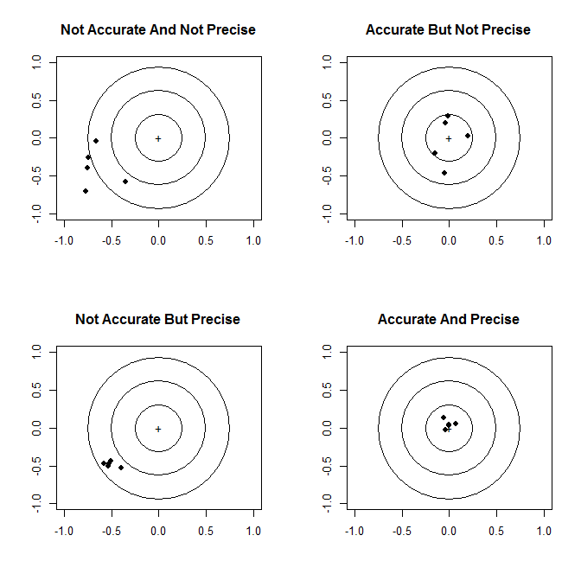
Definitions
Accuracy
  the agreement between a measured value (or mean) and the true value
  bias = true value - measured
Precision
  how repeatable (variable) are the measurements
  consistency among independent measurements)
  does not imply anything about accuracy!
Stability
  same measurement over time (e.g. drift, periodic calibration)

Slide 6
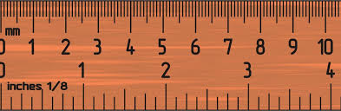
Definitions
Precision / Resolution / Discrimination
  Minimum increment (digits) which a measurement can be made
Tolerance
  Performance requirement (usually precision)
  Unwanted but acceptable deviation from a desired dimension
    how much variation (range) from ideal measurements you can accept
    limit of allowable error or departure from the true value
  Usually specified as ± some value
    ±0.5(largest – smallest difference)
  Example: 25 mm ± 1 mm
    Tolerance is ± 1 mm (specification limit)
    Total Tolerance (TT) = 2 mm
    Which means things can vary as much as 24 to 26 mm
Rule of thumb – 20 measurement increments within the tolerance limits (TT=1 then minimum resolution = 0.05)
The precision of measurements
cannot be estimated only on the
basis of the instrument’s resolution.
Resolution must be adequate to meet tolerance requirements.

Slide 7
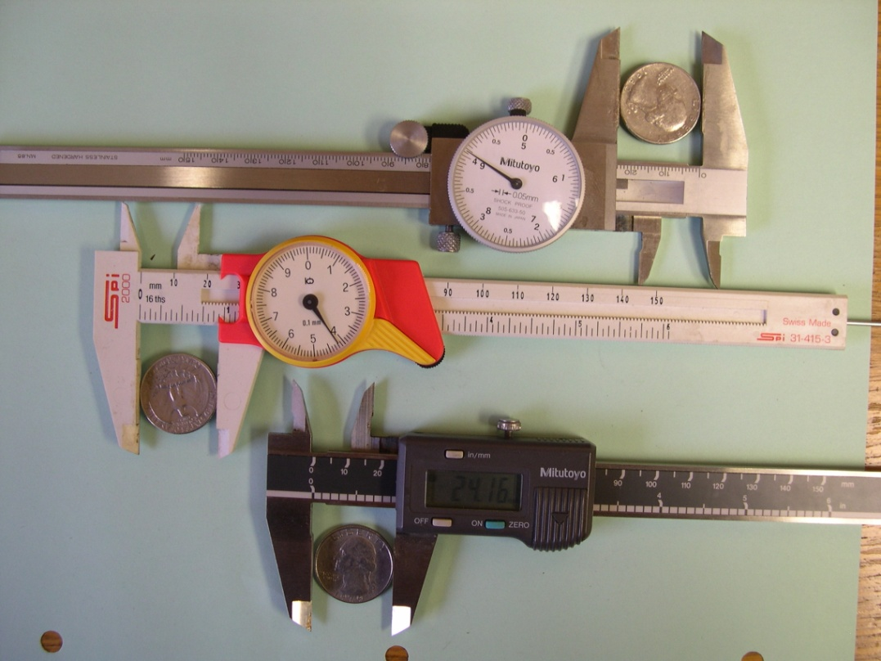
Instrument Precision (Resolution)
“Precision” of an instrument is the
smallest unit which it can measure
(the smallest fraction or division
on the scale).
0
1
2
3
4
5
6
0
1
2
3
4
5
6
0
1
2
3
4
5
6
A rule of thumb is that the uncertainty of a single measurement is half of
the quantity between markings (maybe). And what if it is digital? Do we trust
all the digits?).

Slide 8
Measurement Systems Analysis
The purpose of MSA is to qualify a measurement system for use by quantifying its accuracy, precision and stability.
  Evaluates the entire process of obtaining measurements
  Collection equipment, operators, procedures, conditions, etc.
In order to insure the integrity of data for its intended use and understand (improve) measurement systems
  meet required tolerances
  appropriate tolerances (cost)
  reduce errors

Slide 9
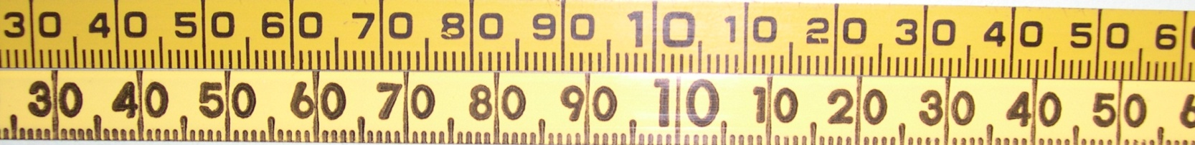
Measurement Errors
Measurement Errors
Systematic Errors
Random Errors
operator variation
instrument variation
environmental variation
Variation with time
Systematic Error – constant value instrument is off from true value (calibration)
Random Error – caused by differences in operators, equipment, over time
and changes in environmental conditions

Slide 10
Quantifying Accuracy and Precision
Accuracy
Precision
Linear
  accuracy or bias through the range of measurements (i.e. same accuracy for different sizes parts)
Bias
  the difference between the observed average measurement and the true value
Stability (or drift)
  Total variation in measurements when obtained with same equipment on same part over time
Gage (or Gauge) linearity and bias (accuracy) Study
Repeatability
  How well the instrument is repeatedly able to measure the same characteristic under the same condition
Reproducibility
  The variation due to different operators using the same instrument at different times and different conditions
Gage (or Gauge) R&R Study

Slide 11
Quantifying Accuracy and Precision
Accuracy
Precision
Linear
  accuracy or bias through the range of measurements (i.e. same accuracy for different sizes parts)
Bias
  the difference between the observed average measurement and the true value
Stability (or drift)
  Total variation in measurements when obtained with same equipment on same part over time
Gage (or Gauge) linearity and bias (accuracy) Study
Repeatability
  How well the instrument is repeatedly able to measure the same characteristic under the same condition
Reproducibility
  The variation due to different operators using the same instrument at different times and different conditions
Gage (or Gauge) R&R Study

Slide 12
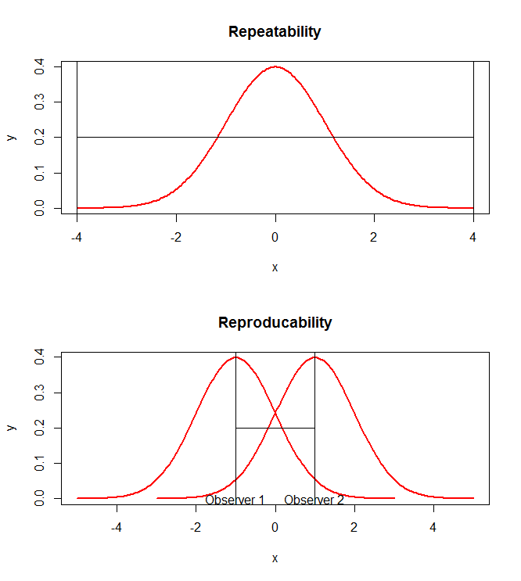
Quantifying Precision – Gage R&R
Repeatability
  How well the instrument is repeatedly able to measure the same characteristic under the same condition
Reproducibility
  The variation due to different operators using the same instrument at different times and different conditions

Slide 13
Quantifying Precision – Gage R&R
Gage Repeatability and Reproducibility (Gage R&R) studies provide information
about the precision (stability or consistency) of measurements from instruments
and one or more operators. This is done by partitioning the variation of a
measurement system into variation due to the nature of the equipment (repeatability)
and the variation due to the operators (reproducibility).
Part-to-Part
Operator
Total
Variation
Reproducibility
Measurement
System
Operator
X Part
Repeatability

Slide 14
Gage R&R Studies
Is the variability of a measurement system small compared with the process variability?
Is the variability of a measurement system small compared with the specified limits?
How much variability in a measurement system is caused by differences between operators?
Is a measurement system capable of discriminating between parts?
Developed by the automotive industry in the 1960s
“Average and Range Method”
  Considered approximate
“ANOVA Method”
  more efficient for estimating variances
  allows for computing confidence intervals
  Generally Random Effects
  Crossed design is when multiple operators (b) measure the same parts (a)
    Y_{ijk} = u + a_{i} + b_{j} + (ab)_{ij} + e_{ijk}
  Nested design is when an operator (b) measures single part (a) (e.g. destructive sample)
    Y_{ijk} = u + b_{j} + a_{i(j)} + e_{ijk}

Slide 15
ANOVA Table
Crossed Gage R&R Study
Source | DF | Mean Square | F-test | Expected MS (Random)
Parts | a-1 | MSp | MSp/MSE | σ²_{e} + nσ²_{pa} + anσ²_{p}
Appraisers | b-1 | MSa | MSa/MSE | σ²_{e} + nσ²_{pa} + bnσ²_{p}
PxA Interaction | (a-1)(b-1) | MSpa | MSpa/MSE | σ²_{e} + nσ²_{pa}
Error |  | MSe |  | σ²_{e}
Total | abn-1
Components of Variation
Part-to-Part
(σ²_{p})
Total
Variation
(σ²_{p} +σ²_{e} +σ²_{a}+ σ²_{pa})
Operator (σ²_{a})
Reproducibility
(σ²_{a}+ σ²_{pa})
Measurement
System
(σ²_{e} +σ²_{a}+ σ²_{pa})
Operator
X Part (σ²_{pa})
Repeatability (σ²_{e})

Slide 16
Gage R&R Study Design
Design Considerations
  Could not find sample size calculation methods but the general recommendations for a Gage R&R study are (AIAG standards):
  Operators/Appraisers
    3
  Parts
    10 parts (or 5 to 25)
    spanning the range of tolerance
  Trials (replication)
    2 (or 3)

Slide 17
Seedling Gage R&R Study
5 operators
5 trees (parts)
3 trials (measurements)
  morning, noon and afternoon
  Independently (turned in sheet after each measurement
  Caliper at 15 cm from ground line to nearest 0.1 mm
  Height from ground line to nearest 0.1 cm
  All used same equipment
Appraiser | Date | Trial 1 | Trial 2 | Trial 3
A | 6/05 | 0745 | 1310 | 1705
B | 6/06 | 0715 | 1107 | 1510
C | 6/06 | 0850 | 1150 | 1530
D | 6/07 | 8080 | 1315 | 1630
E | 6/13 | 0715 | 1115 | 1415
5 Assessors
3 Measurements
5 Parts (trees)
75 Total (measurements)
Since this is an example, I ignore time/days
for this analysis (growth?).

Slide 18
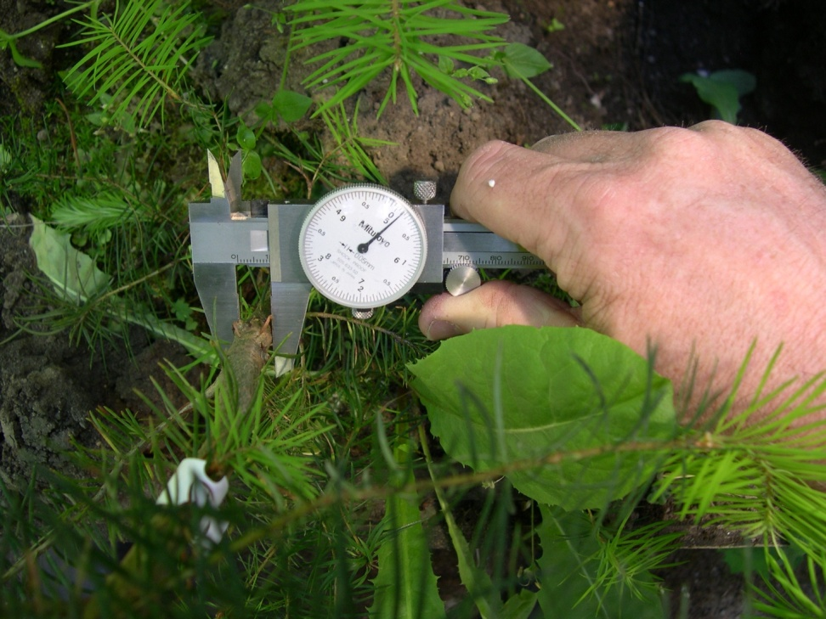
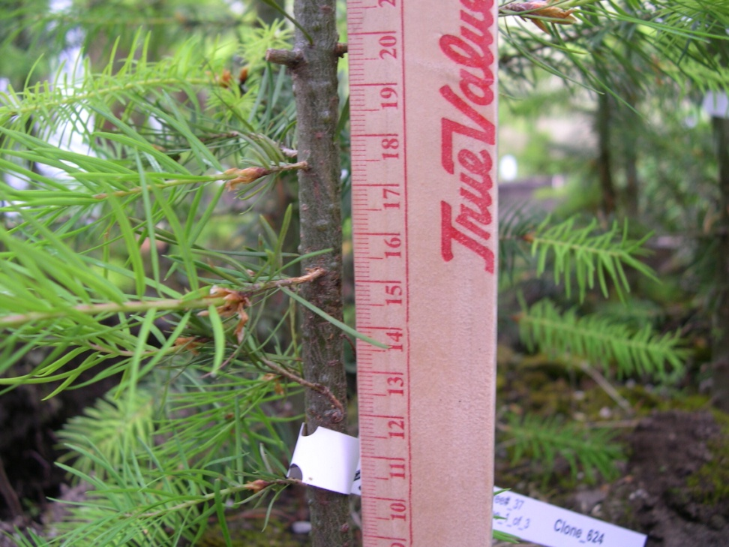
Seedling Measurements
(everyone used the same equipment)

Slide 19
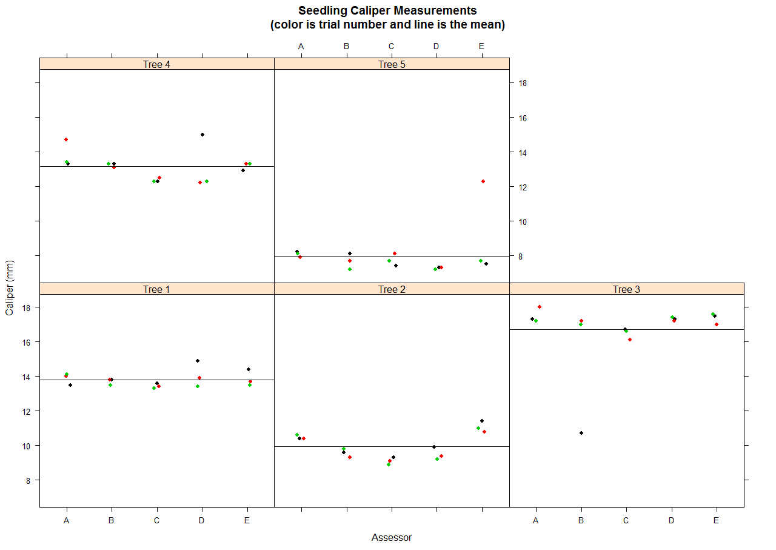
Seedling Caliper Measurements
2 “Blunders” (arbitrarily
defined ±3 standard deviations
from the mean for that tree)
for a 2.7% error rate.

Slide 20
Seedling Caliper Measurements (mm)
Assessor | Mean | SD | Min. | Max.
A | 12.74 | 3.36 | 7.9 | 18.0
B | 11.83 | 3.18 | 7.2 | 17.2
C | 11.82 | 3.23 | 7.4 | 16.7
D | 12.26 | 3.71 | 7.2 | 17.4
E | 12.93 | 3.05 | 7.5 | 17.6
Source | DF | MS | P-value
Part | 4 | 3.90 | 0.0101
Operator | 4 | 175.10 | <0.0001
OxP | 16 | 0.98 | 0.5403
Error | 50 | 1.05
5 Assessors
3 Measurements
5 Parts (trees)
75 Total
Assume (for example):
Tolerance = ± 0.1 mm
and alpha = 0.05

Slide 21
Yes R can do this analysis!
library(qualityTools)
# create an object with the study design and data
design = gageRRDesign(Operators=5, Parts=5, Measurements=3, randomize=FALSE)
temp <- dataD[order(dataD$trial, dataD$part, dataD$operator), ]
response(design) <- temp$data
# do the analysis and output the results
gdo <- gageRR(design, method="crossed", sigma=6, alpha=0.05, tolerance=0.10)
summary(gdo)
plot(gdo)
Also libraries SixSigma and qcc

Slide 22
Seedling Caliper
VarComp VarComp Stdev StudyVar StudyVar P/T Ratio
Contrib Contrib
totalRR 1.226 0.0956 1.107 6.64 0.309 66.4
repeatability 1.035 0.0807 1.017 6.10 0.284 61.0
reproducibility 0.191 0.0149 0.437 2.62 0.122 26.2
Operator 0.191 0.0149 0.437 2.62 0.122 26.2
Operator:Part 0.000 0.0000 0.000 0.00 0.000 0.0
Part to Part 11.605 0.9044 3.407 20.44 0.951 204.4
totalVar 12.831 1.0000 3.582 21.49 1.000 214.9
tolerance is ± 0.1 mm
VarComp -- amount of variation that each source of measurement error and part-to-part differences contribute to the total variation
VarComp Contrib -- VarComp as a proportion of total variation
Stdev -- square root of the VarComp (same units as part and tolerance)
StudyVar -- 6*StdDev
  Typically process variation is defined as 6*StdDev and for a normal population that means approx. 99.73% of the data fall with in 6 SDs (±3 SDs from the mean), for 99% the data fall within 5.15 SDs (±2.575 SDs from the mean)
StudyVar Contrib -- square root of StudyVar (best metric if interested in reducing part-to-part variation)
P/T Ratio -- Precision/Tolerance Ratio (best metric if parts are evaluated relative to a specification)

Slide 23
Precision/Tolerance Ratio
Measurement system precision is defined by the Precision/Tolerance (P/T) Ratio
  P/T Ratio = 6*σ_{R&R}/(upper-lower spec limit)
Best metric if parts are evaluated relative to a specification
Rule of Thumb
P/T Ratio | Requirement
P/T < 10% | Accept
10% < P/T < 30% | Marginal
P/T > 30% | Fail

Slide 24
Seedling Caliper
VarComp VarComp Stdev StudyVar StudyVar P/T Ratio
Contrib Contrib
totalRR 1.226 0.0956 1.107 6.64 0.309 66.4*
repeatability 1.035 0.0807 1.017 6.10 0.284 61.0
reproducibility 0.191 0.0149 0.437 2.62 0.122 26.2
Operator 0.191 0.0149 0.437 2.62 0.122 26.2
Operator:Part 0.000 0.0000 0.000 0.00 0.000 0.0
Part to Part 11.605 0.9044 3.407 20.44 0.951 204.4
totalVar 12.831 1.0000 3.582 21.49 1.000 214.9
* If set tolerance to ± 1.0 mm and P/T ratio = 6.64
Part-to-Part
(90.4%)
Operator
(1.5%)
Total
Variation
Reproducibility
(1.5%)
Measurement
System
(9.6%)
Operator
X Part
(0.0%)
Repeatability
(8.1%)

Slide 25
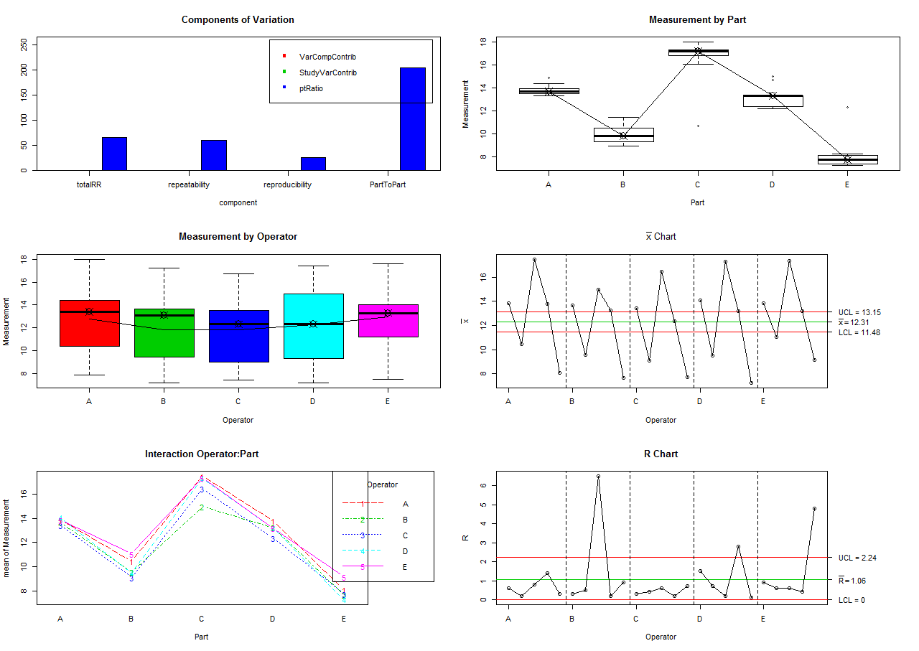
Seedling Caliper Measurements tolerance = 0.1 mm and alpha = 0.05

Slide 26
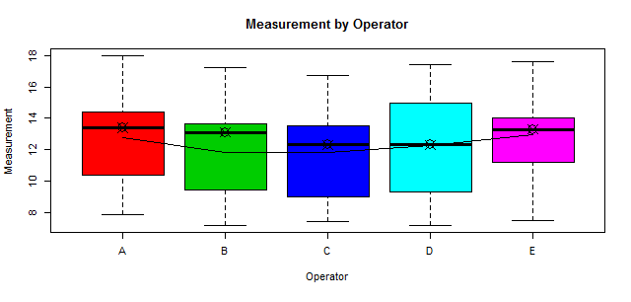
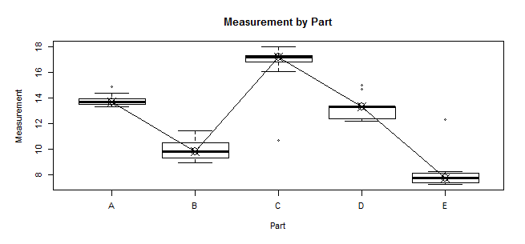
Seedling Caliper Measurements
Measurement by operator
  Should be parallel to x axis (or operators are measuring the parts differently on average)
  The spread should be about the same (operators are measuring parts consistently, similar variation, on average)
Measurement by part (tree)
  The spread should be about the same (operators are measuring parts consistently)
  Which on did they have the most trouble with?

Slide 27
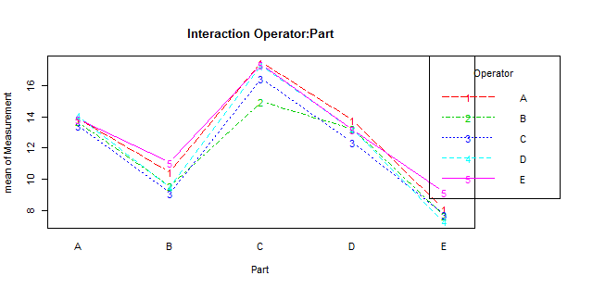
Seedling Caliper Measurements
Interaction Plot
Pattern | Indicates
Line virtually identical | Operators are measuring the parts similarly
One line consistently higher or lower | One operator is measuring parts consistently different
Lines not parallel (cross) | An operators ability to measure the part depends on the part being measured (operator X part interaction)

Slide 28
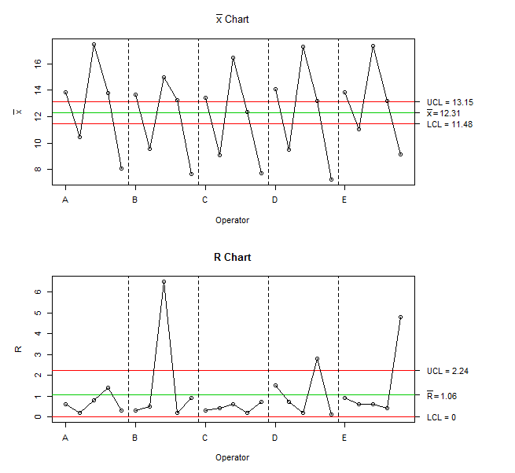
Seedling Caliper Measurements
tolerance = 0.1 mm
and alpha = 0.05
Xbar chart (part-to-part variation)
  If many of the points are above or below the control limits it indicates the part-to-part variation is larger than the instrument variation (lack of control)
R-chart (operator consistency)
  If any points fall above the UCL the operator is not consistently measuring the parts.
  UCL takes into account the number of times operator measured the part (want small range)

Slide 29
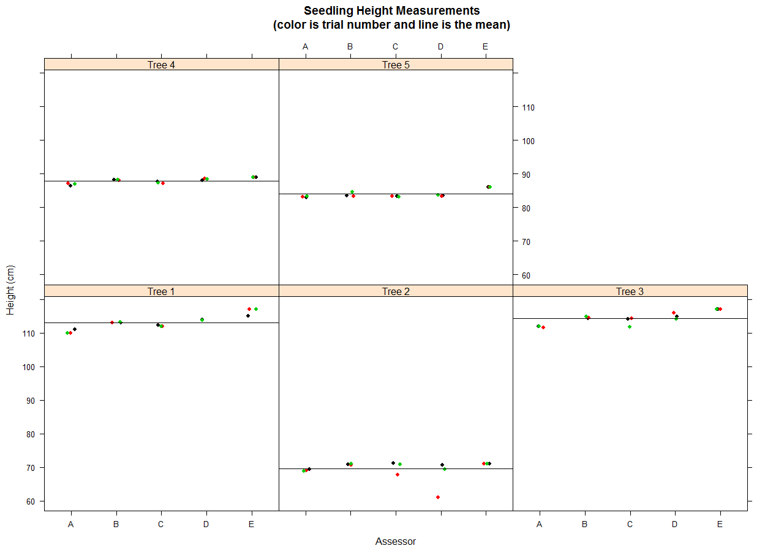
Seeding Height Measurements
1 “Blunder” (arbitrarily
defined ±3 standard deviations
from the mean for that tree)
for a 1.3% error rate.
Possible growth?

Slide 30
Seedling Height Measurements (cm)
Assessor | Mean | SD | Min. | Max.
A | 92.28 | 17.06 | 68.9 | 112.0
B | 94.14 | 17.71 | 70.6 | 114.9
C | 93.23 | 17.55 | 67.7 | 114.3
D | 93.57 | 19.20 | 61.0 | 116.0
E | 95.87 | 18.68 | 71.0 | 117.0
Source | DF | MS | P-value
Part | 4 | 27 | <0.0001
Operator | 4 | 5674 | <0.0001
OxP | 16 | 3 | 0.015
Error | 50 | 1
Possible growth?
5 Assessors
3 Measurements
5 Parts (trees)
75 Total
Assume (for example):
Tolerance = ± 0.1 cm
and alpha = 0.05

Slide 31
Seedling Height Measurement
VarComp VarComp Stdev StudyVar StudyVar P/T Ratio
Contrib Contrib
totalRR 3.639 0.00953 1.908 11.45 0.0976 114.5*
repeatability 1.477 0.00387 1.215 7.29 0.0622 72.9
reproducibility 2.161 0.00566 1.470 8.82 0.0752 88.2
Operator 1.546 0.00405 1.244 7.46 0.0636 74.6
Operator:Part 0.615 0.00161 0.784 4.71 0.0401 47.1
Part to Part 378.058 0.99047 19.444 116.66 0.9952 1166.6
totalVar 381.697 1.00000 19.537 117.22 1.0000 1172.2
* Set tolerance to ± 1.0 cm and P/T ratio = 11.45
Part-to-Part
(99.0%)
Operator
(0.4%)
Total
Variation
Reproducibility
(0.6%)
Measurement
System
(1.0%)
Operator
X Part
(0.2%)
Repeatability
(0.4%)

Slide 32
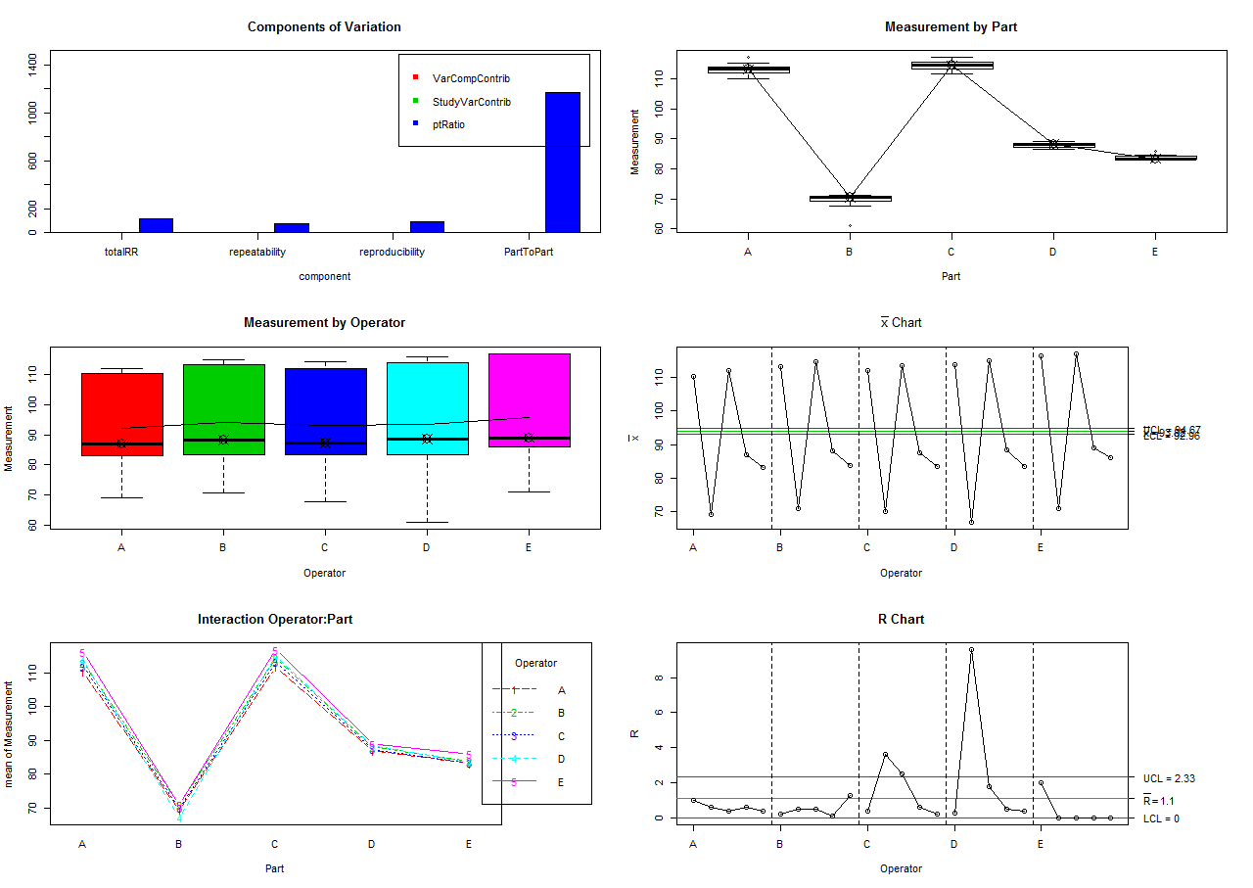
Seedling Height Measurements tolerance = 0.1 cm and alpha = 0.05

Slide 33
So what?
Accuracy, Precision and Cost

Slide 34
Tolerance
Tolerance limit – the upper and lower values (range) in which we can expect a specified percentage of the population (all measurements) will lie (with a specified level of confidence)
  Different from confidence or prediction intervals.
Mean ± K*sd
  sd = standard deviation (= measurement system SD)
  K = value based on the assumed distribution (e.g. normal), confidence, percent of population and number of replications

Slide 35
Detour
For a normal distribution (and a 2 sided tolerance limit):
N = number replications (43)
p = proportion (0.90) and σ=(1-p)/2
ϒ = probability (99%)
z²_{(1-p)/2} = 1.654 and χ²_{ϒ,n-1} = 23.650
K = 2.217
(n-1)(1+(1/n))z²_{(1-p)/2}
K= (------------------------------- ) ^{0.5}
(χ²_{ϒ,n-1})

Slide 36
Approximate Tolerance
Tolerance (99%) = 3.00*S_{R&R}
  where SR&R = (S_{Repeatability}²+S_{Reproducibility}²)^{0.5}
Expect 99% (6 SDs or ±3 SDs of normal) of the measurements are within ± the measured value (6 sigma rule)
Approximate Caliper Tolerance
  T = 3.00*(1.017² + 0.437²) ^{0.5} = ± 3.32 mm (99%)
  T = 2.57*(1.017² + 0.437²) ^{0.5} = ± 2.84 mm (95%)
Approximate Height Tolerance
  T = 3.00*(1.215² + 1.470²) ^{0.5} = ± 5.72 cm (99%)
  T = 2.57*(1.215² + 1.470²) ^{0.5} = ± 4.90 cm (95%)

Slide 37
Conclusions and Observations
The precision of measurements cannot be estimated only on the basis of the instrument’s resolution.
  Clearly the tolerances set for the example are not attainable for caliper or height!
  Reproducibility (surprisingly?) better than repeatability for caliper measurements
  Reproducibility and repeatability were similar for height
Clear procedures
  Where is ground?
    A couple trees had 1 cm HT difference depending on if you were on right or left
  How to handle whorls?
    2 trees (B and D) had whorls at 15 cm and they had the largest variation
  Where is the top?
    Base or top of bud, terminal leader or highest green?
    Tree C had a branch above the terminal and it was a bit hard to tell what was the terminal (depending on the definition)
Calipers
  Touch – Operator A had a much lighter touch with caliper than Operator C (strangled the trees?). The difference between a light and very tight touch could be 0.5 mm on these trees!
  Cleaning the caliper jaw (pitch, etc.) made a 1.0 mm difference!
  Single Caliper and stem out-of-roundness (0.2-0.4 mm)
Equipment complaints
  Caliper scale was a bit hard to read and had to be “zeroed” a lot
  Height stick too short for the taller trees and was 0.915 m and not 1.0 m which could be a problem for the bigger trees if you assumed it was a meter stick (everyone got this!)

Slide 38
Very Simple Error Propagation Example
If we assume seedlings are cones (common practice in the literature) :
  V = (H/3)*π*R²
    V = volume
    H = height
    R = radius (caliper/2)
and we assume some random (independent) error in height and caliper
  µ_{v} + ∆v= f(µ_{h} + ∆h, µ_{r} + ∆r)
and expanding the Taylor series (and truncating) and cancel the true values
  µ_{v} + ∆v = f(µ_{h})+(∂f/∂h)∆h + f(µ_{r})+ (∂f/∂r)∆r + …
  ∆v = (∂f/∂h)_{r} ∆h + (∂f/∂r)_{h}∆r
so the variance of V related to H and C (assuming independence) and random errors
  σ ² = (∂f/∂h)² σ_{h}² +( ∂f/∂r)² σ_{r}² + 2(∂f/∂h) ( ∂f/∂r) σ_{hr}²

Slide 39
Very Simple Error Propagation Example
Given (about the average tree)
  caliper 1.2 cm (SD=0.1107 cm)
  height of 94.0 cm (SD=1.908 cm)
Seedling volume (assuming a cone)
  V = (H/3)*π*R² = (70/3)*π*(1.0/2)² = 35.4 cm³
The estimated standard deviation of volume (assuming independence)
  σ = [(∂f/∂h)² σ_{h}² + (∂f/∂r)² σ_{r}² ]^{0.5} =
  σ = [(πr²/3)² σ_{h}² + (2Hπr/3)² σ_{r}²]^{0.5} =
    σ_{h} = 1.9808 and σ_{r} = 0.0554
  σ = [0.558 + 42.83] ^{0.5} = 6.6 cm³
  Which gives 35.4 ± 6.6 cm³
What is the main source of “error” in this example (if my units and math are correct)?

Slide 40
