Slide 1
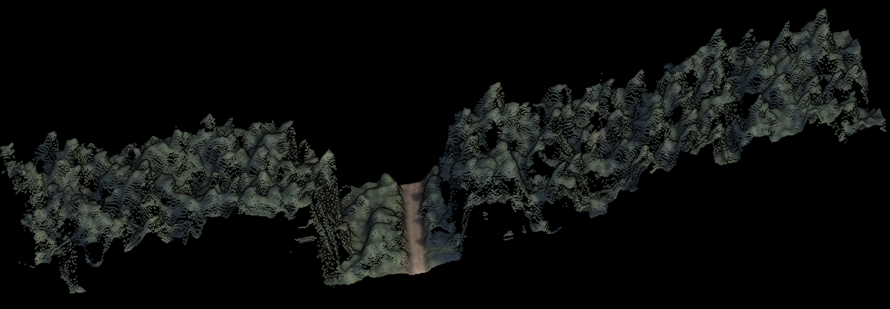
A Picture’s Worth a 1000² Points: Phodar as an Alternative to LiDAR
Peter Gould and Jacob Strunk
Washington State Department of Natural Resources

Slide 2
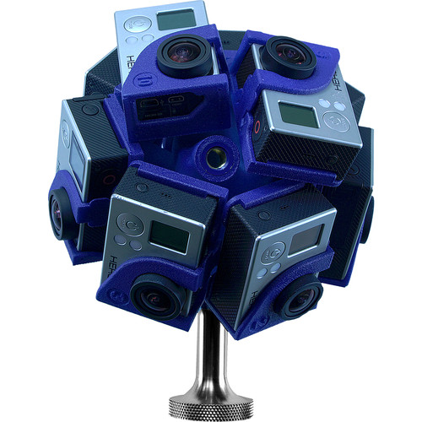
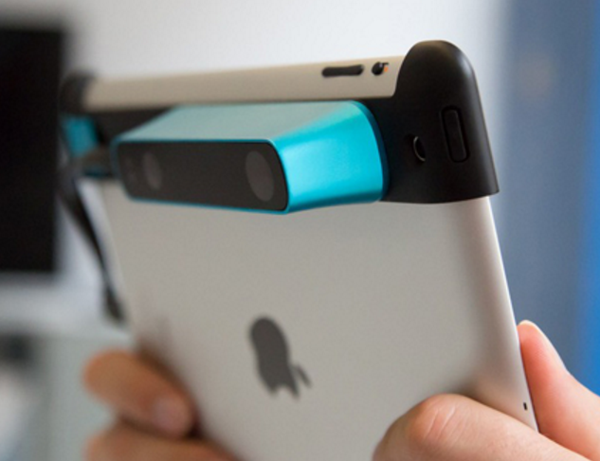
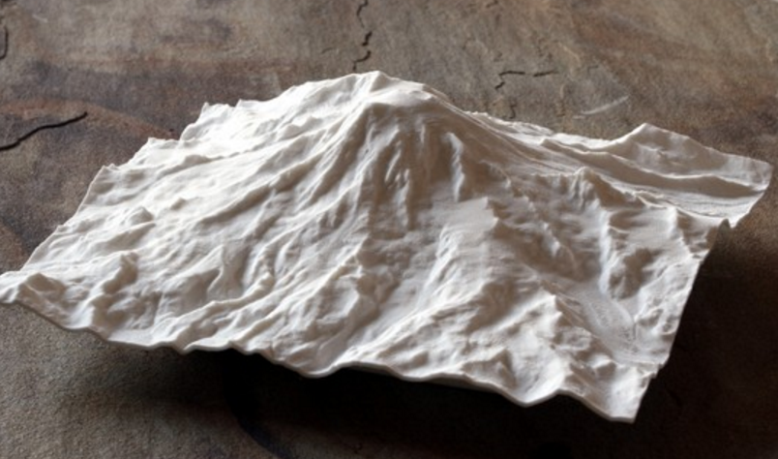
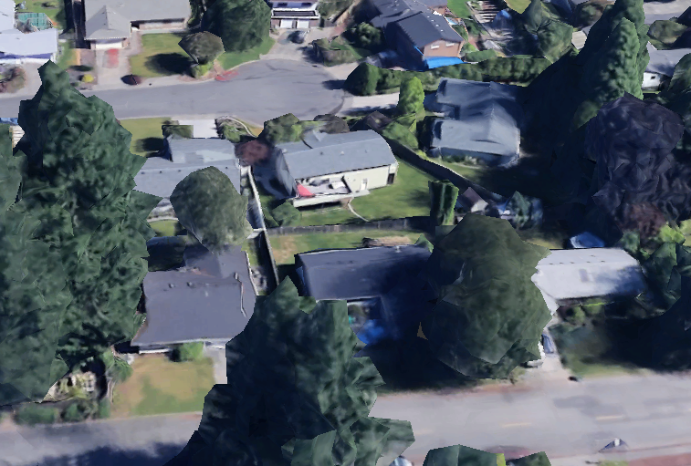
3D is the new 2D

Slide 3

Phodar
(digitial surface models)
Computer mimics the human eye (parallax -> distance)
Need 2 or more image pairs
Lots of software packages (cheap to very expensive)
Higher resolution, more pairs should produce a better result
Can produce LAS files (same as lidar)

Slide 4
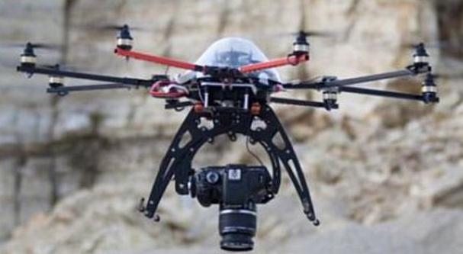
Phodar in Forest Inventory
“Drop-in” replacement for lidar
20% of cost of 8 ppm lidar
Doesn’t require expensive sensor
Doesn’t see the ground (typically need a previous lidar flight)

Slide 5
Two Experiences with Phodar
RS-FRIS Version 1.0
  DNR is transitioning to a RS inventory
  Needs are high and immediate
  Only about 25% of westside lands had current lidar, but another 50% or so had old lidar
  Already owned statewide stereo from 2013 NAIP (3 ft pixel).

Slide 6
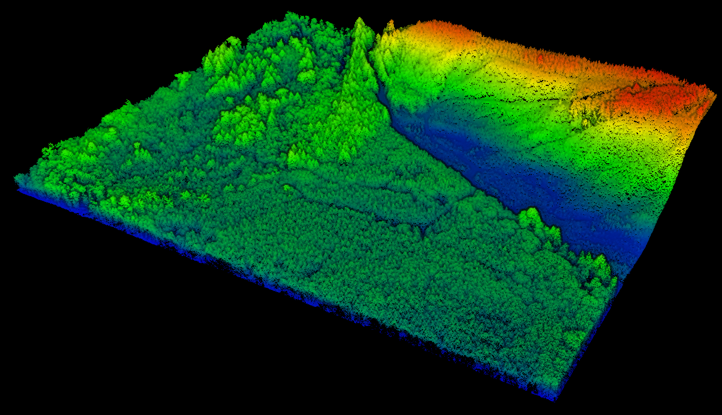
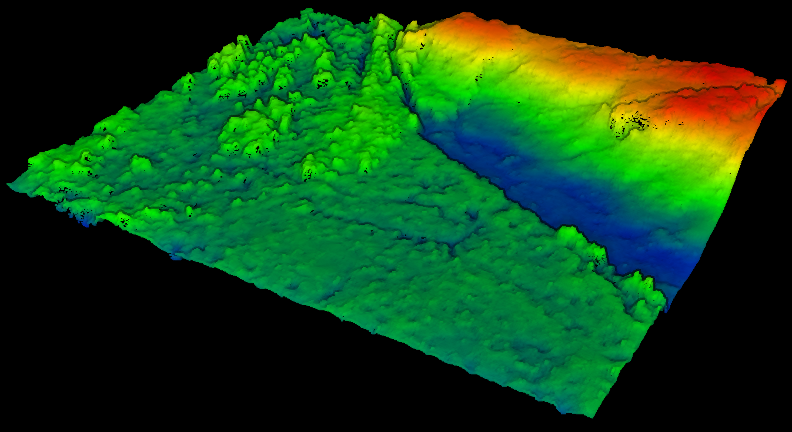
NAIP
PHODAR

Slide 7
1. RS-FRIS Version 1.0
Fit single models across the westside (several 100 plots)
Used climate variables in some cases to try to capture variation in allometric relationships.

Slide 8
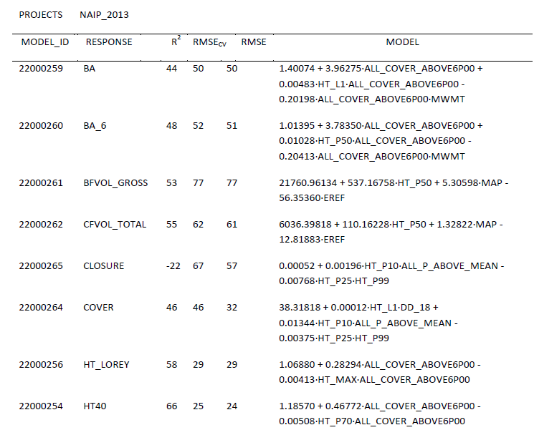
Modeling Results

Slide 9
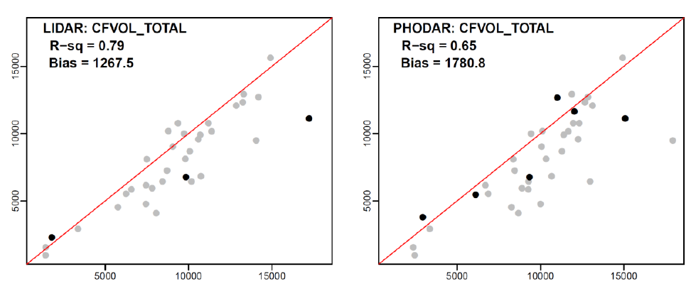
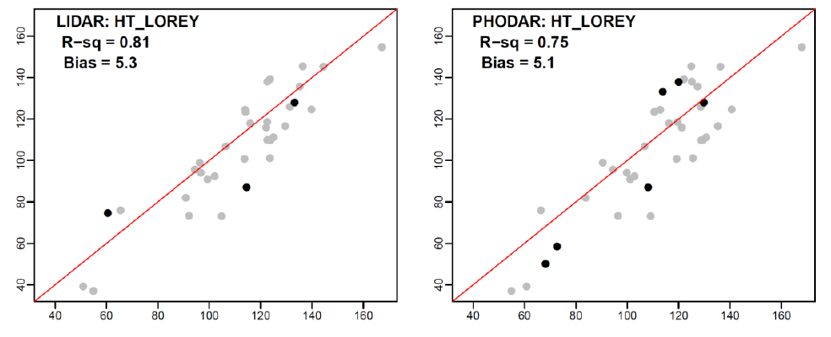
Validation Results (3.6 acres)

Slide 10
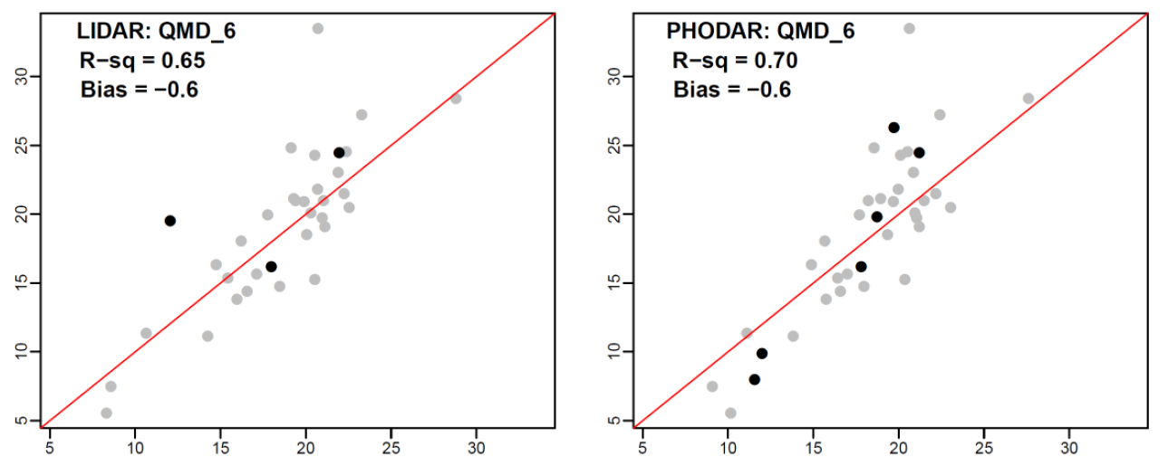
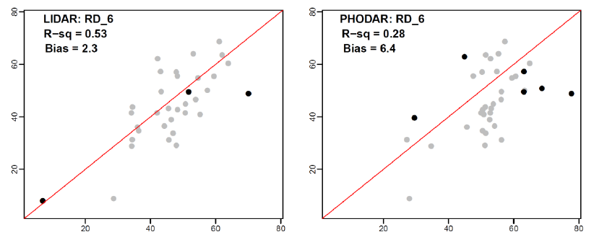
Validation Results (3.6 acres)

Slide 11
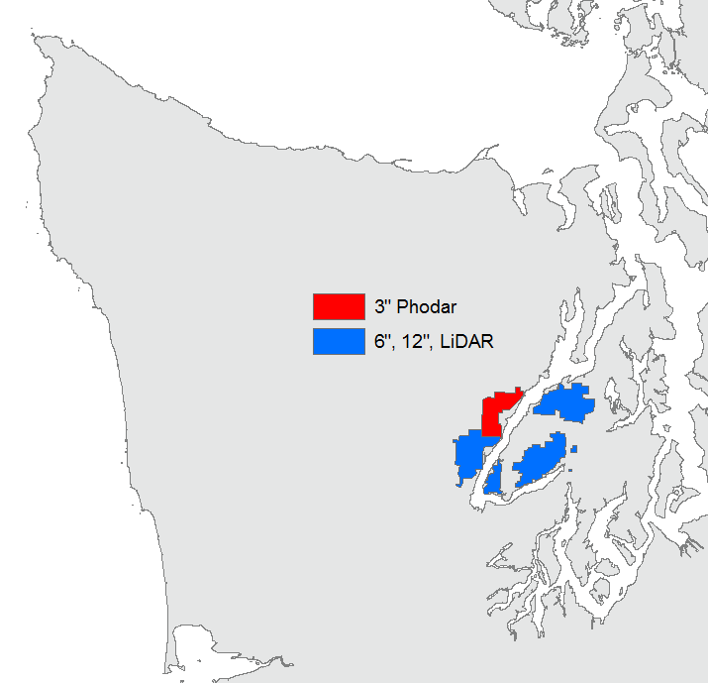
Hood Canal Project
Can we get more from phodar?
What resolution of imagery?
Acquisitions
  Lidar
  3” phodar
  6” phodar
  12” phodar
58 sample plots (randomized grid)

Slide 12
Hood Canal Project
Is Phodar ready?
What resolution of imagery?
What are the tradeoffs with lidar?
Acquisitions
  Lidar
  3” phodar
  6” phodar
  12” phodar
58 sample plots (randomized grid)

Slide 13
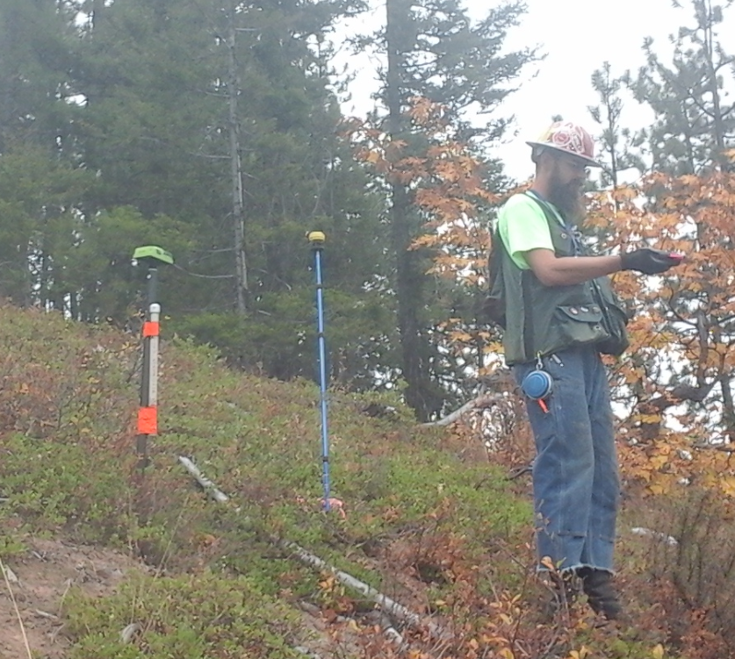
Field Data Acquisition
Live and dead trees
  1/10th Acre for trees >= 5.5” DBH
  1/40th acre for trees down to 2”
  1/250th acre for trees down to 1’ ht
Canopy cover and closure
  Moosehorn
  Spherical densiometer
Down wood transects
  2 x 50 ft
Javad Triumph 2 GPS
Android tablets
  Zip file with SQLite DB, GPS data, photos

Slide 14
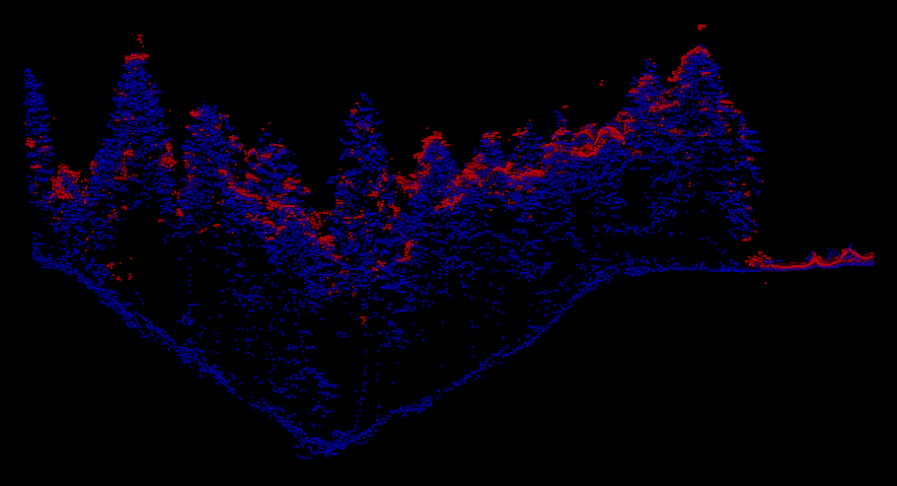
Hood Canal Project

Slide 15
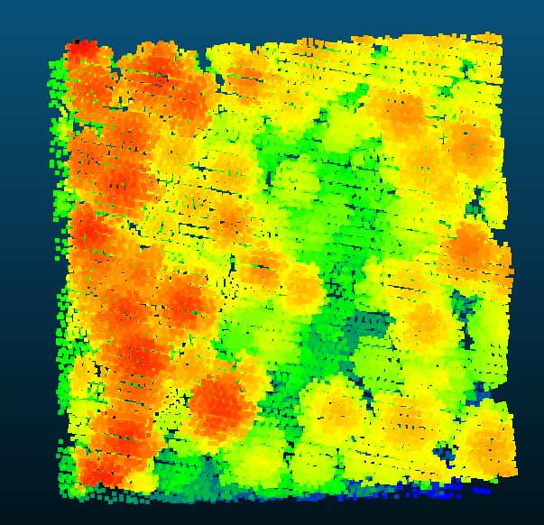
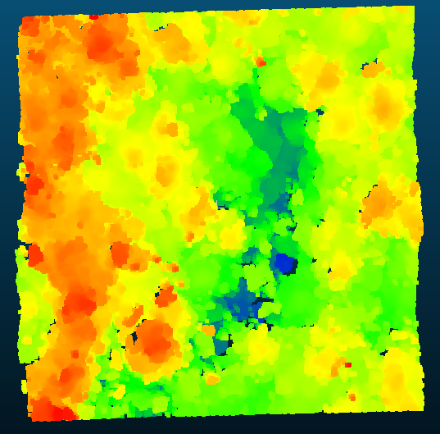
Hood Canal Project
Looking down

Slide 16
Gridmetrics Comparisons

Slide 17
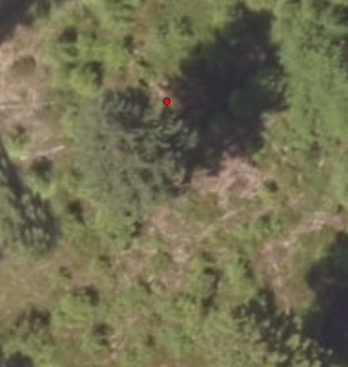
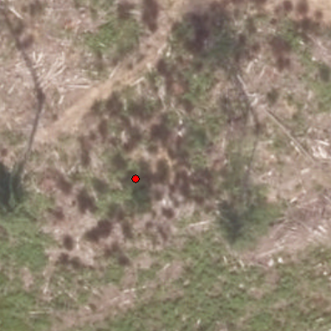
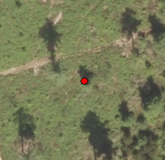
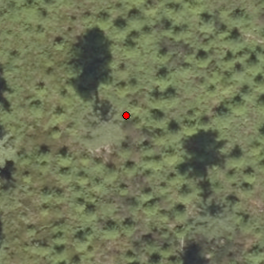
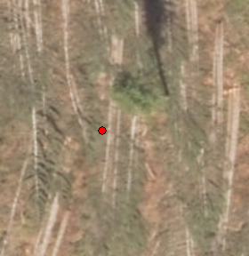
Outlier Plots

Slide 18
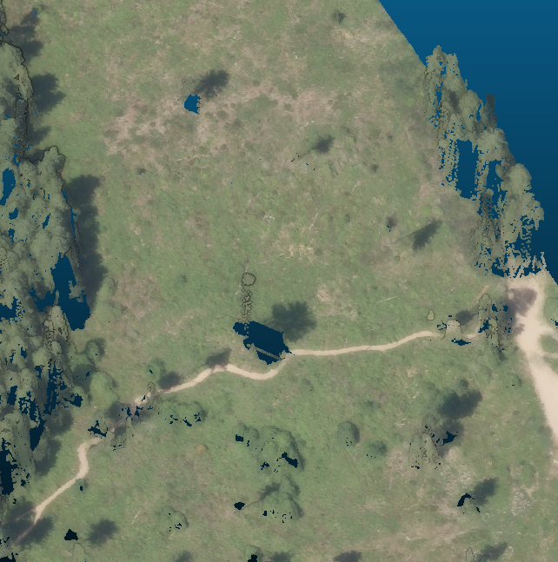
Outlier Plots

Slide 19
Gridmetrics Comparisons

Slide 20
Gridmetrics Comparisons

Slide 21
Modeling Results
(best subsets, 3 variables, no interactions)
Adjusted R²
Maximum Height
RS Data | All Data (N=58) | Minus Outliers (N=53)
12” Phodar | 83.3 | 93.3
6” Phodar | 74.3 | 93.8
Lidar | 95.8 | 95.6
Lorey’s Height
RS Data | All Data (N=58) | Minus Outliers (N=53)
12” Phodar | 80.1 | 93.8
6” Phodar | 75.9 | 95.2
Lidar | 96.1 | 96.0

Slide 22
Modeling Results
(best subsets, 3 variables, no interactions)
Adjusted R²
CF Volume
RS Data | All Data (N=58) | Minus Outliers (N=53)
12” Phodar | 78.2 | 75.3
6” Phodar | 63.9 | 78.4
Lidar | 77.5 | 79.4
BF Volume
RS Data | All Data (N=58) | Minus Outliers (N=53)
12” Phodar | 80.4 | 78.9
6” Phodar | 67.7 | 81.9
Lidar | 77.8 | 81.0

Slide 23
Modeling Results
(best subsets, 3 variables, no interactions)
Adjusted R²
Basal Area
RS Data | All Data (N=58) | Minus Outliers (N=53)
12” Phodar | 65.3 | 63.1
6” Phodar | 58.5 | 66.2
Lidar | 72.9 | 72.6
Curtis’s RD (summation method)
RS Data | All Data (N=58) | Minus Outliers (N=53)
12” Phodar | 48.3 | 41.6
6” Phodar | 53.8 | 53.7
Lidar | 71.5 | 67.6

Slide 24
Modeling Results
(best subsets, 3 variables, no interactions)
Adjusted R²
Canopy Cover
RS Data | All Data (N=58) | Minus Outliers (N=53)
12” Phodar | 90.0 | 88.9
6” Phodar | 82.6 | 90.3
Lidar | 95.0 | 94.1
Canopy Closure
RS Data | All Data (N=58) | Minus Outliers (N=53)
12” Phodar | 93.7 | 91.8
6” Phodar | 82.5 | 92.1
Lidar | 95.0 | 93.5

Slide 25
Conclusions
Phodar is in the running
Not a clear improvement at 6” vs 12”
Room for improvement
  Acquisition spec (more overlap)
  Processing software makes a difference
  Can test processing strategies

