Slide 1


+
=PyFVS
Pythonic Wrappers and Class Modules for Open-FVS
Tod Haren
Forest Resource Analyst
Oregon Dept. of Forestry
GMUG, World Forestry Center, 1/27/2017

Slide 2
PyFVS - Motivation
Systems integration - Inventory databases, harvest model, reporting
Shelling out to cmd.exe is slow
Direct access to data for efficient I/O
Leverage the Python data stack, http://pydata.org, and related packages
  Numpy; Pandas; PyTables; Numexpr; Cython
R is great, but I prefer Python (maybe you do too)
Personal curiosity and education

Slide 3
PyFVS - Implementation
Open-FVS API that has been developed for R, etc.
Additional API routines
  FVS Step subroutines (library functions similar to start/stop)
  Data API - Capture trees, snags, etc. at runtime to simplify output collection
FVS Class - Mid level abstraction for interactive and scripting
CLI - variant unification - Example application

Slide 4
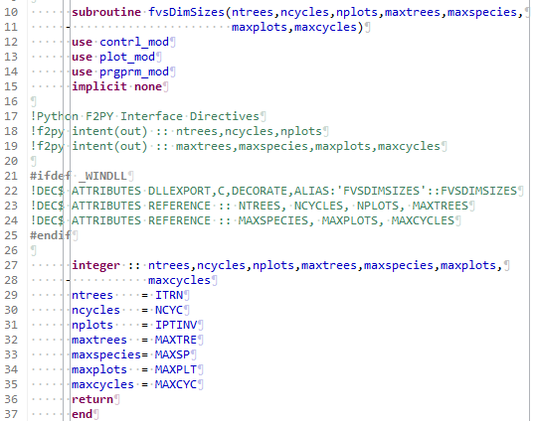
F2PY Export Tags

Slide 5
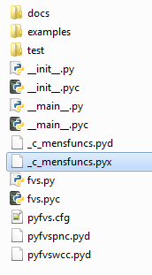
PyFVS - Python as Glue
Compiled extensions - pyfvs<variant>
_c_mensfuncs.pyx - Cython (C+Python) = fast loops

Slide 6
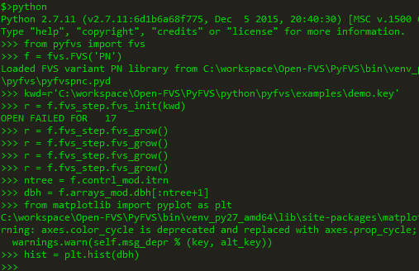
PyFVS - Interactive Example (low level api)

Slide 7
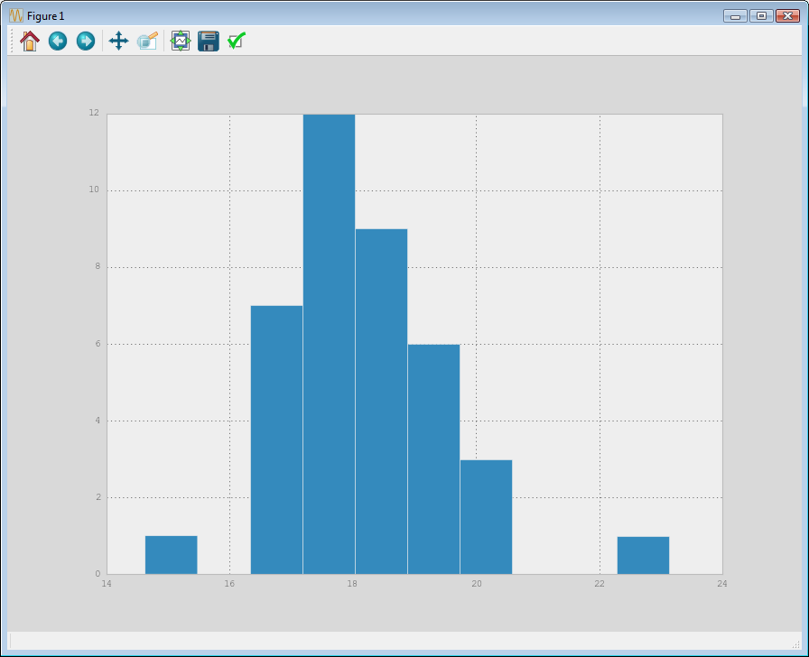
PyFVS - Interactive Example (low level api)

Slide 8
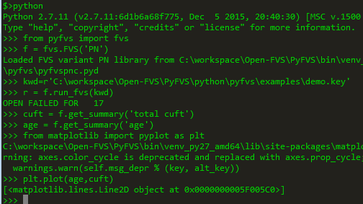
PyFVS - Interactive (high level api)

Slide 9
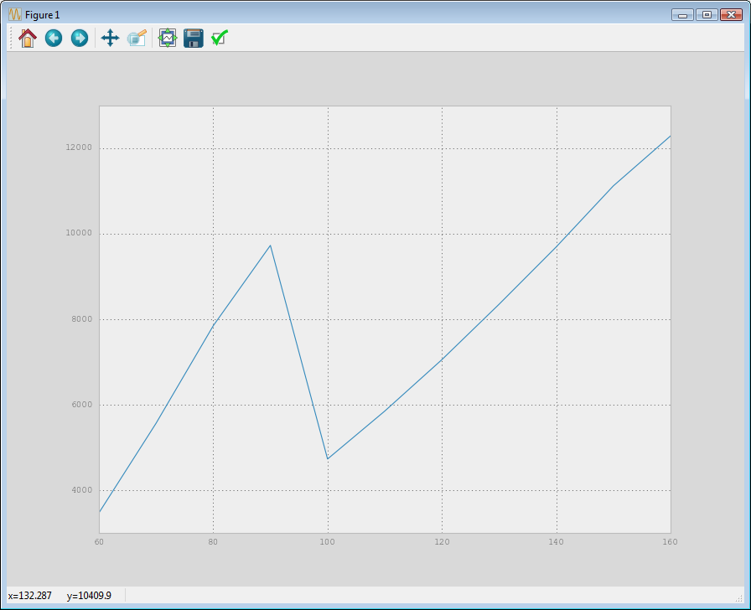
PyFVS - Interactive (high level api)

Slide 10
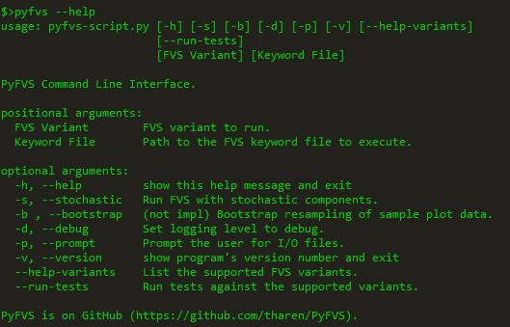
PyFVS - Common Command Line Interface
Executable created by setuptools during packaging
Easy to add functionality, plotting, bootstrap plots, etc.

Slide 11
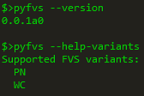
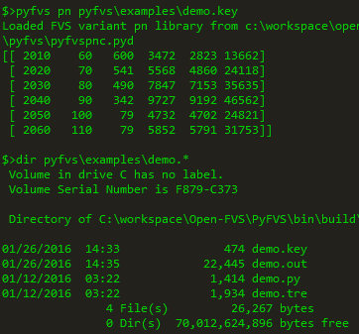
PyFVS - CLI

Slide 12
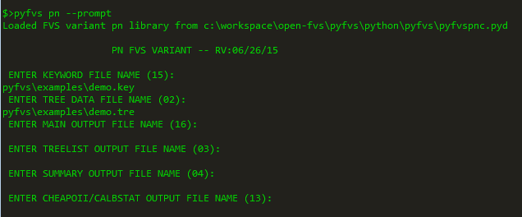
PyFVS - CLI - Legacy FVS Prompts

Slide 13
PyFVS - Unit Testing
Automated testing to catch regression bugs, and other bugs
Only basic tests so far
Plan to run same tests (similar anyway) as Open-FVS
Facilitates continuous integration - distributed development
Encourages best practices

Slide 14
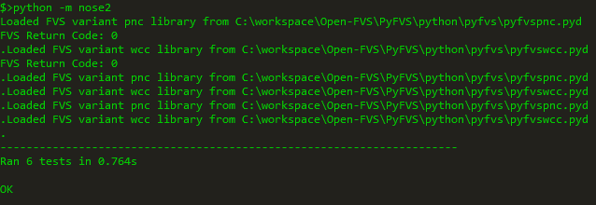
PyFVS - Unit Testing API Wrapper
Nose2 automatically discovers tests and executes them

Slide 15
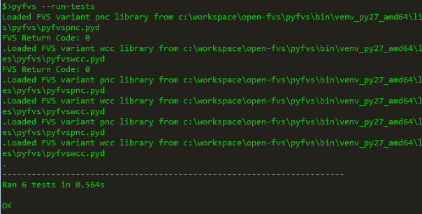
PyFVS - Unit Testing (CLI)

Slide 16
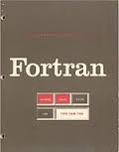



PyFVS
F90+ Port of F77 include files
  Because it’s difficult to learn 40 Fortran semantics
  Modules are just better
  This is not your father’s FORTRAN
    Object oriented when needed
    Better integration with C - ISO_C_Binding
Development Environment
  CMake
  Python
  MinGW

Slide 17
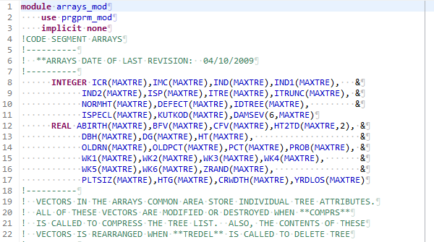
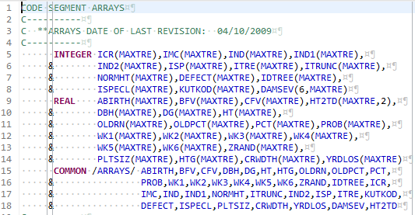
F90 Modules v. F77 Includes

Slide 18

PyFVS - Repository
Fork of Open-FVS branch
  Open-FVS PyFVS branch includes the basic F2PY wrappers
  May eventually integrate back upstream
GitHub
  trunk and PyFVS branches mirror SourceForge SVN
  master and dev branches include API and other modifications
  https://github.com/tharen/PyFVS
    Fork, branch, pull

Slide 19


PyFVS - Cloud Automation
Continuous Integration
    Automatic build, test, deploy on pushed commits
    Sandboxed build and test environment
  Travis-CI.org - Ubuntu Linux
  AppVeyor.com - Windows Server
Free for open source projects

