Slide 1
FVS PN/WC - Organon Mortality
Where does truth lie?

Slide 2
DF Bare Ground Simulations
Questions:
Organon mortality has been integrated with PN & WC variants. OK, what now?
Maximum SDI and BAA is critical. What is the correct approach?
  Should simulations achieve the theoretical limit, 85%, 55%, etc.?

Slide 3
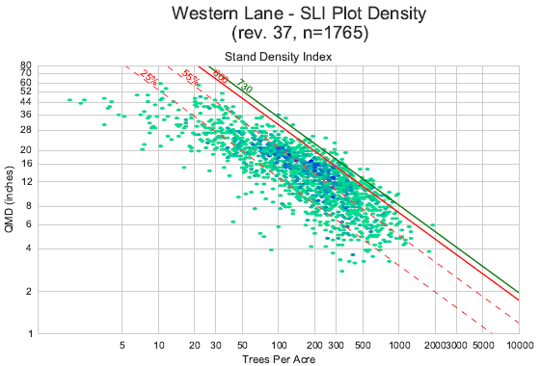
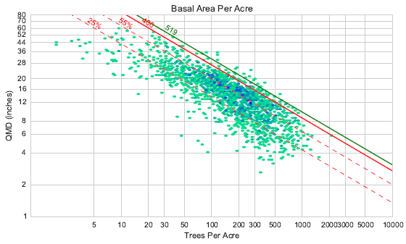
Stand Level Inventory (Variable Radius Plots)

Slide 4
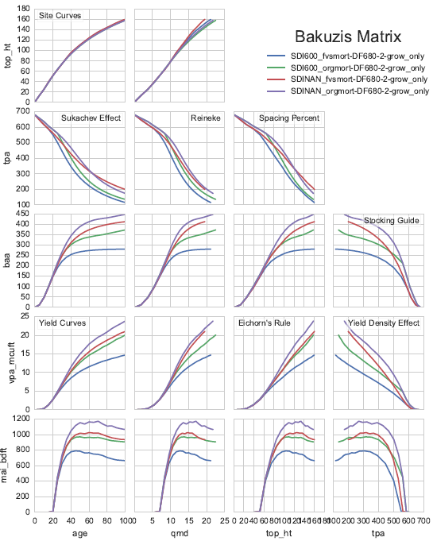
100 years
680 TPA
Site 120
SDI Max 600
Default SDI Max

Slide 5
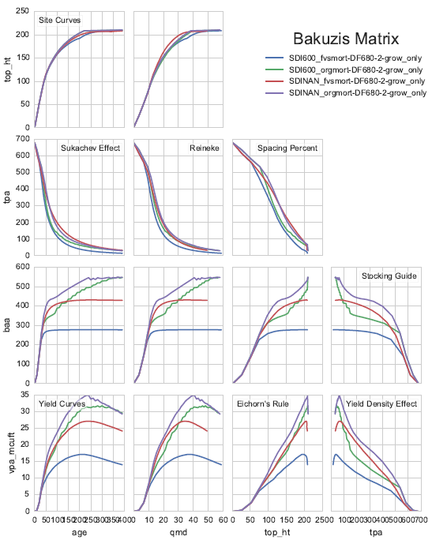
400 Years
680 TPA
Site 120
SDI Max 600
Default SDI Max

