Slide 1
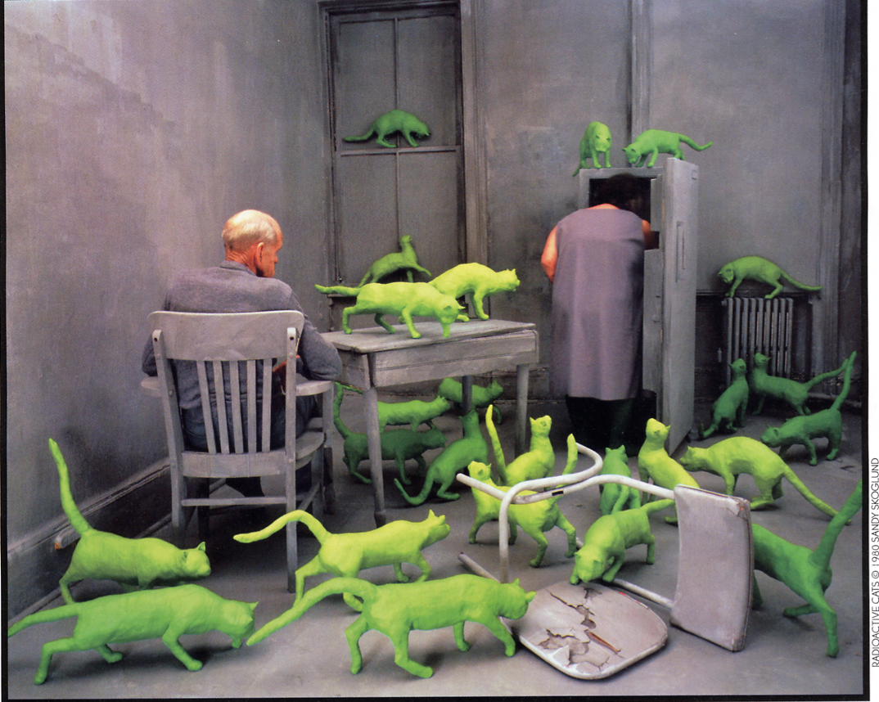
Let’s rumble!
What Maguire really teaches in FOR 322 Forest Models
(and YOU would teach WHAT?!!)

Slide 2
FOR
322
FOR 322 – Forest Models
What you see in the OSU course catalog:
FOR 322 FOREST MODELS (3)
Introduction to static and dynamic forest models: defining what they are, how they might be used, and, in general terms, how they are developed.
What you see in the course syllabus:

Slide 3
FOR
322
FOR 322 – Forest Models
Student Learning Outcomes:
The Student Learning Outcomes of this course include an ability to:
Fit simple regression models to data.
Apply static models for estimating tree volume/taper, stand density relationships, and productivity.
Apply dynamic models for predicting growth, yield, and structure of forest stands under alternative silvicultural scenarios.
Forecast change in stand attributes over time and in response to silvicultural treatments and site productivity.
Validate forest models to assess their utility and limitations.
Be conversant in applications of models in forest land management.

Slide 4
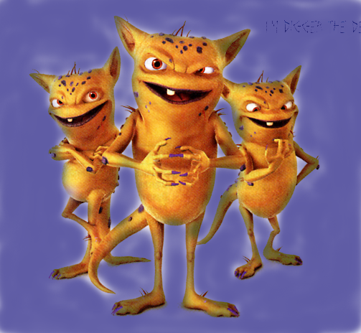
FOR
322
FOR 322 – Forest Models
Pre-requisites
  MTH 241 (Calculus)
  ST 201/202, 351/352 (Statistical Methods)
  FOR 321 (Forest Mensuration)

Slide 5
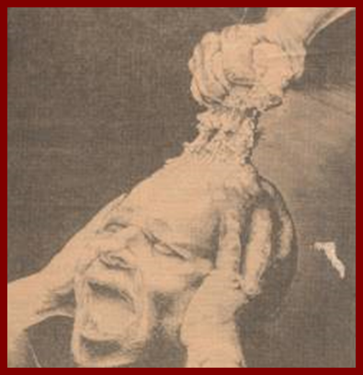
Math Preparedness Quiz
FOR
322

Slide 6
Math Preparedness Quiz
FOR
322
1) Express the following as integers (whole numbers):
1^{0.25} =
(2⁴)^{0.5} =
0.25⁻¹ =
ln(1) =
e⁰ =
e^{ln(6)} =
log₁₀(10) =
16
10
10
8
15
13
12
Correct out of 31 students

Slide 7
Math Preparedness Quiz
FOR
322
2) Take the following equation, multiply the slope by 2, and graph it on the axes below (label the axes).
Y = 4 – 1.5 X
Correct:
11/31

Slide 8
Math Preparedness Quiz
FOR
322
3) Find the numeric answer for Y in the following equations:
  a) Y = (1 + X)³
for X = 0.10
  b) Y = a + b(X⁻¹) + c(1 - X) + X²/d; a=1, b=6, c=2, d=9
for X=3
c) y = a + b(X₁²X₂); a=3, b=0.5
for X₁ = 2 and X₂ = 5
26/31
13/31
26/31

Slide 9
Math Preparedness Quiz
FOR
322
4) Calculate the following statistics for the random variables in the table.
i | X_{i}
1 | 7
2 | 5
3 | 1
4 | 7
5 | 6
a) The mean of X_{i} =
b) The median of X_{i} =
c) Circle the following number that comes closest to the variance of X_{i}:
1) 0.00
2) 160.0
3) 32.00
4) 24.80
5) 6.20
29/31
20/31
20/31

Slide 10
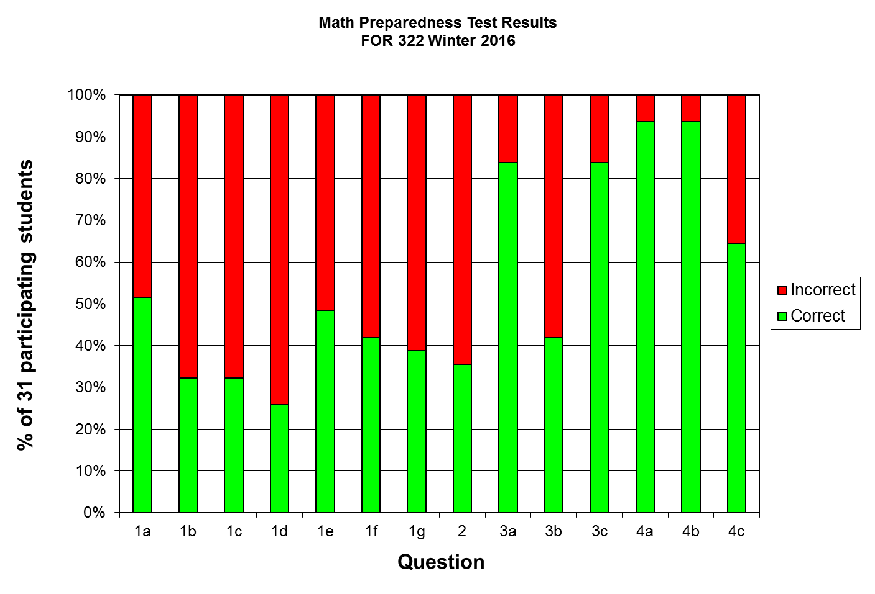
Math Preparedness Quiz
FOR
322
Stem and Leaf diagram
2 | 002
1 | 011122446677777888899999
0 | 3889

Slide 11
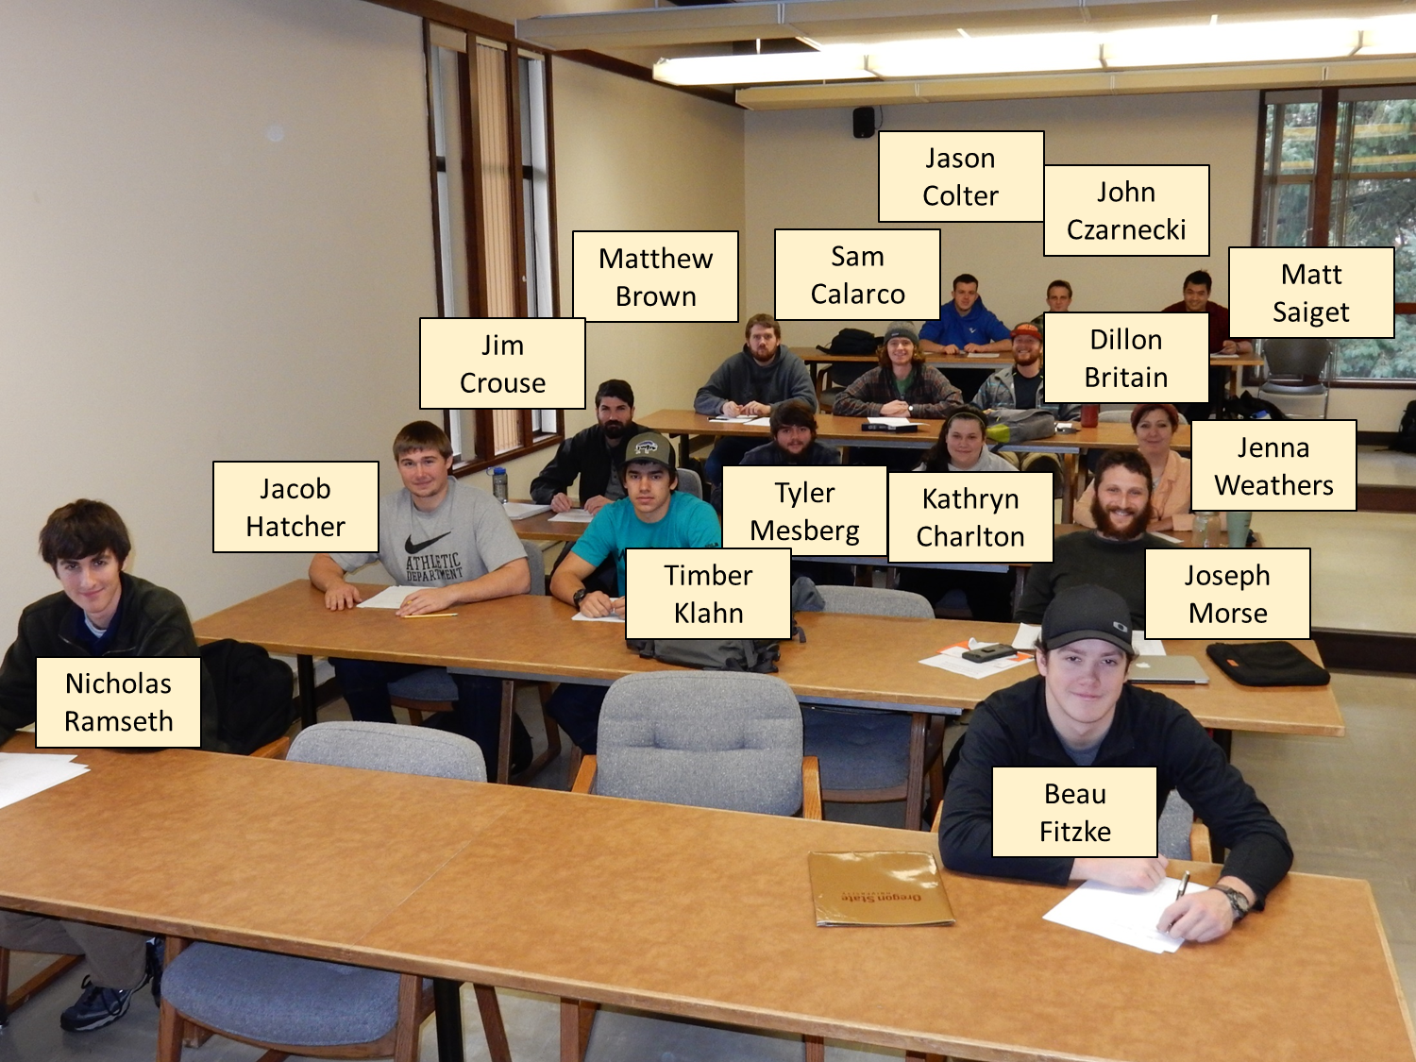
FOR
322
FOR 322 – Forest Models

Slide 12
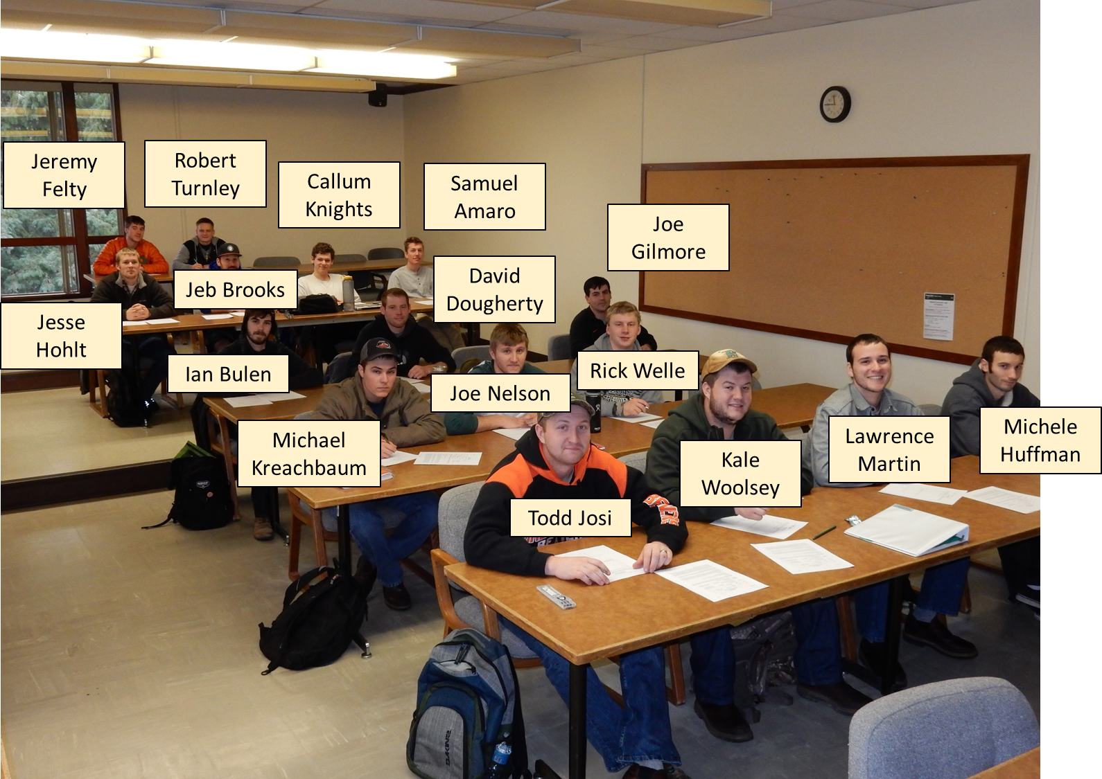
FOR
322
FOR 322 – Forest Models

Slide 13
FOR
322
FOR 322 – Forest Models
Schedule of topics
Jan. 5 #1 Course Structure, Rules, Mensuration Review
Jan. 7 #2 Introduction to Forest Models
Jan. 12 #3 Overview of model development and regression
Jan. 14 #4 Overview of model development and regression
Jan. 19 #5 Stem form, stem taper, volume equations
Jan. 21 #6 Stem form, stem taper, volume equations (Cont’d)
Jan. 26 #7 Stand density & stocking concepts
Jan. 28 #8 Stand density & stocking concepts (Cont’d)
Midterm #1

Slide 14
FOR
322
FOR 322 – Forest Models
Schedule of topics (cont’d)
Feb. 2 #9 Measures of site productivity
Feb. 4 #10 Drivers of site productivity
Feb. 9 #11 Principles of growth, yield, stand dynamics
Feb. 11 #12 Overview of growth & yield models
Feb. 16 #13 Fundamental growth equations
Feb. 18 #14 Fundamental growth equations (Cont’d)
Feb. 23 #15 Modeling response to competing vegetation
Feb. 25 #16 Modeling effects of genetic tree improvement
Midterm #2

Slide 15
FOR
322
FOR 322 – Forest Models
Schedule of topics (cont’d)
Mar. 1 #17 Modeling response to thinning and fertilization
Mar. 3 #18 Modeling wood quality
Mar. 8 #19 Model validation
Mar. 10 #20 Model validation (cont’d) and course review
Final Exam

Slide 16
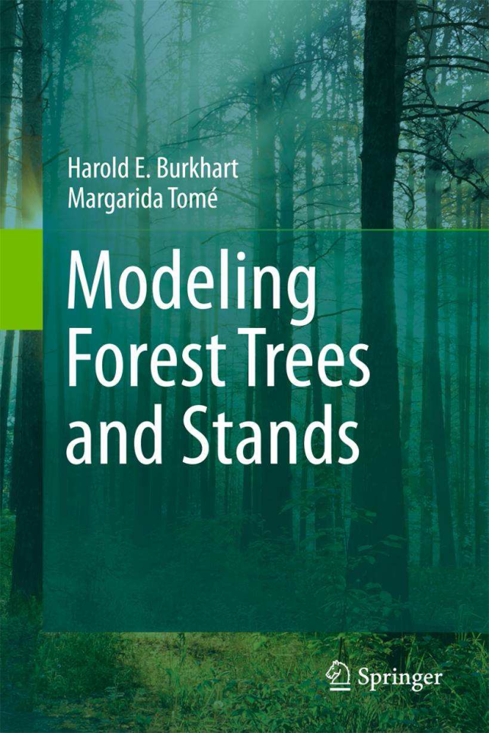
FOR
322
FOR 322 – Forest Models
Optional readings in
Burkhart and Tomé (2012)
Modeling Forest Trees and Stands)

Slide 17
FOR
322
FOR 322 – Forest Models
Simulation exercises in computer lab
Simulation topic | Model | User interface
Mixed species stand development | FVS | LMS
Alternative shelterwood systems | ORGANON | LMS
Initial spacing effects in Douglas-fir | ORGANON | LMS
Response to thinning and fertilization | ORGANON | Command line
Silvicultural effects on wood quality | ORGANON | Cipsr (R)
Fuel dynamics under alternative treatments | FVS | SUPPOSE
Responses to competing vegetation control | CIPSANON | XORG
Validation/comparison of long-term stand dynamics simulated by FVS and ORGANON | FVS & ORGANON | LMS

Slide 18
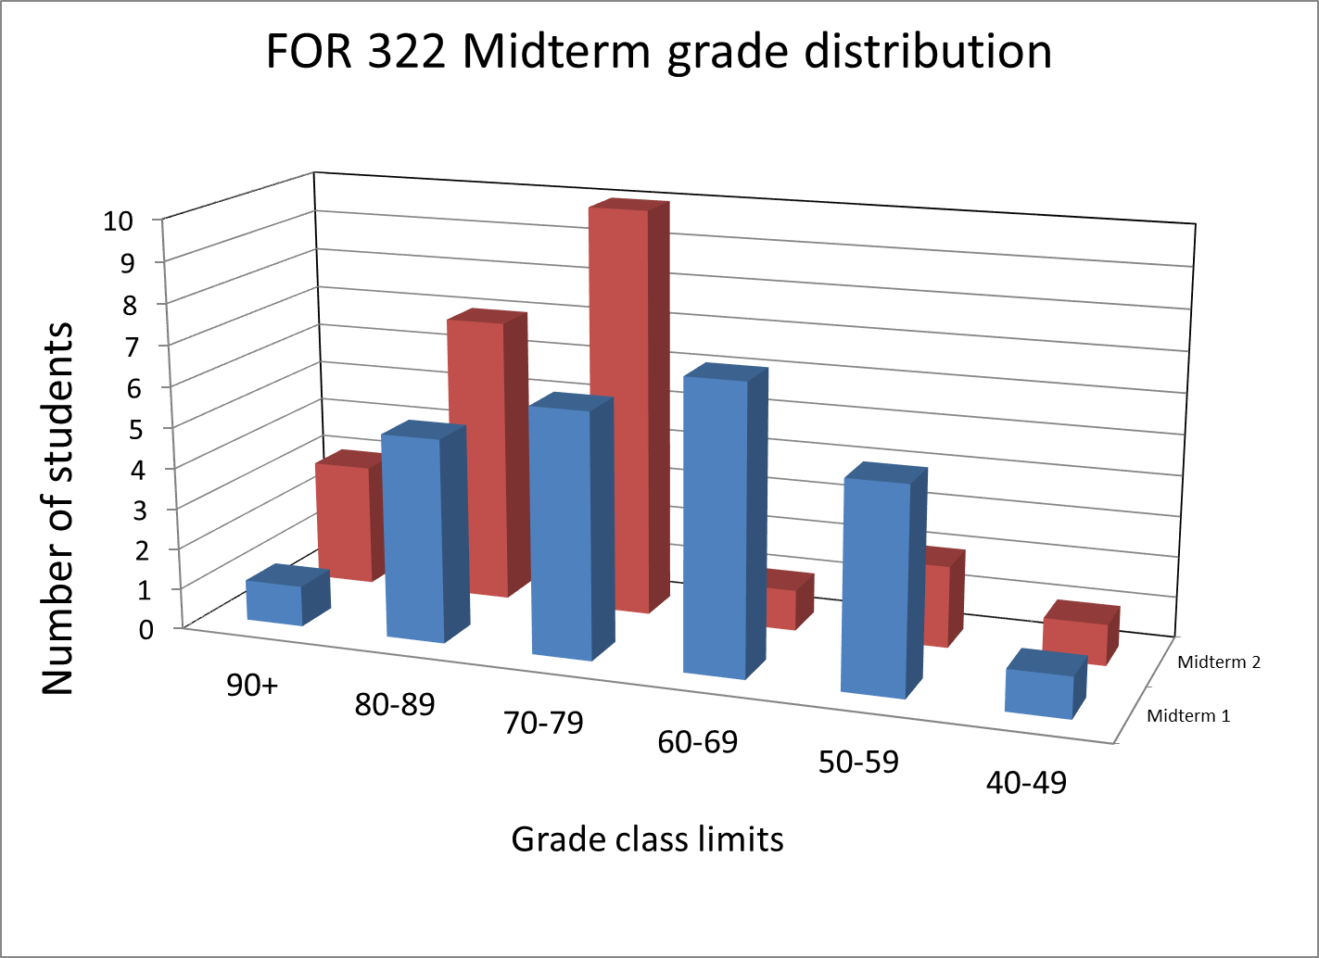
FOR
322
FOR 322 – Forest Models

Slide 19
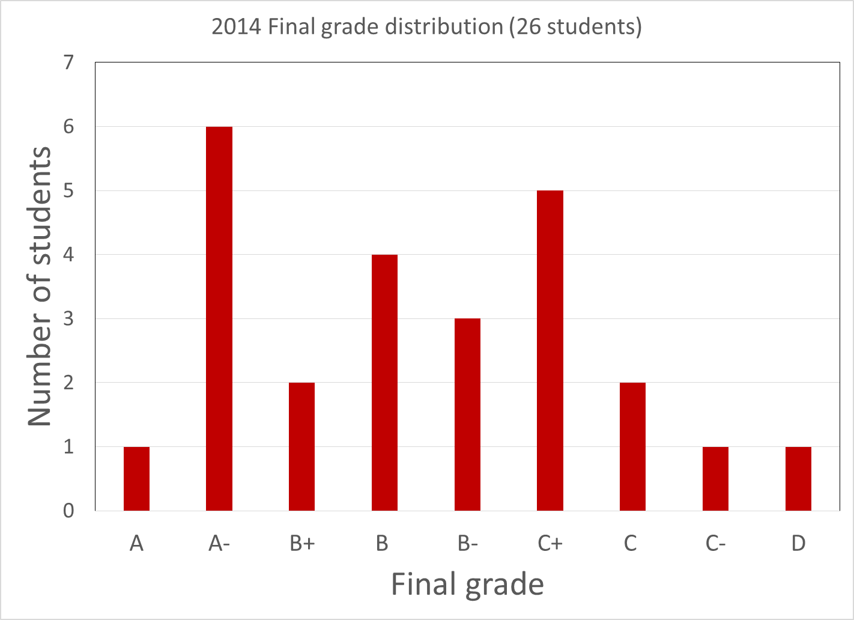
FOR
322
FOR 322 – Forest Models

Slide 20
Achilles heels
FOR
322
Expansion factor for 12-in tree on:
40-ft x 80-ft rectangular plot
37.2-ft radius circular plot
20 BAF plot

Slide 21
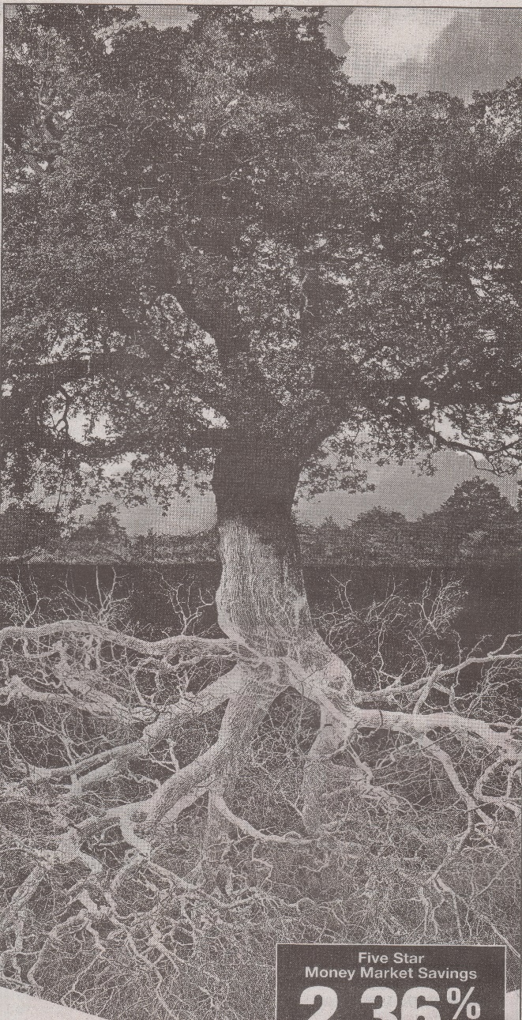

FOR
322
FOR 322 – Forest Models
Open for constructive suggestions
Thanks!

Slide 22
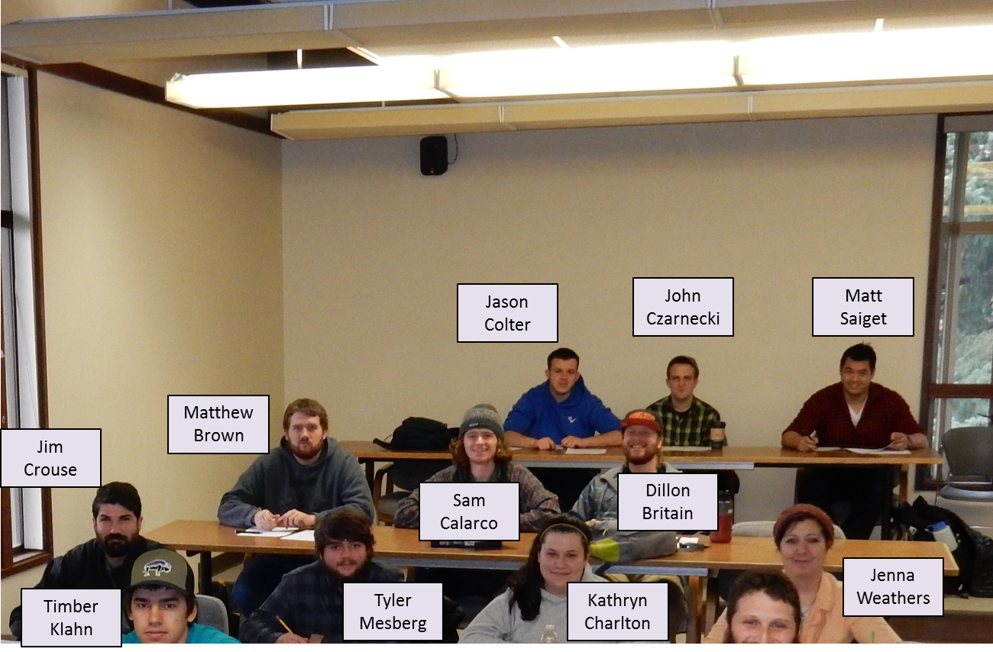
FOR
322
FOR 322 – Forest Models

Slide 23
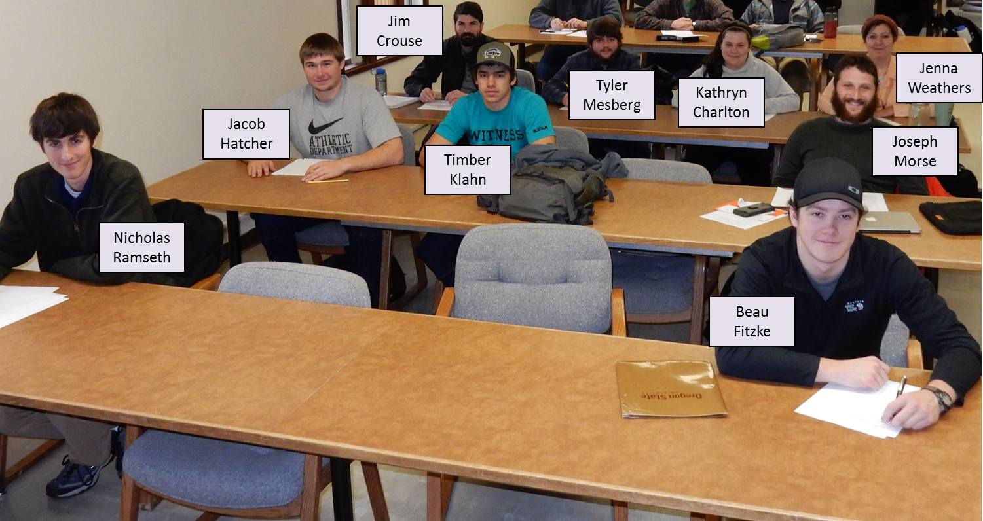
FOR
322
FOR 322 – Forest Models

Slide 24
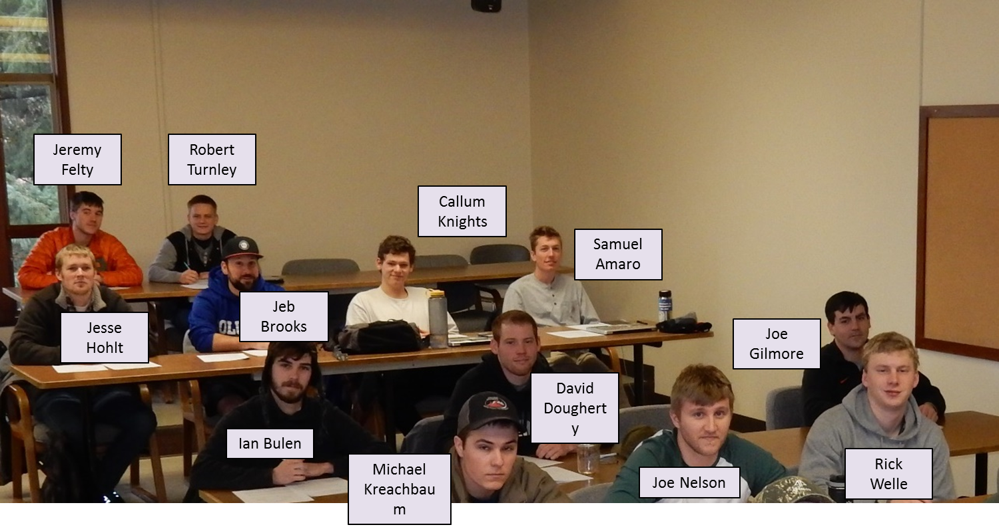
FOR
322
FOR 322 – Forest Models

Slide 25
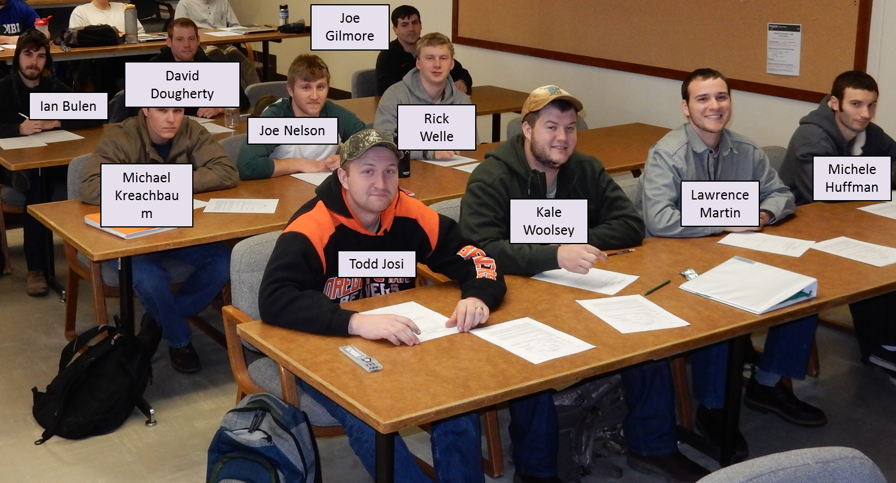
FOR
322
FOR 322 – Forest Models

